Slide 1
Automating interpretive edge transport modeling on DIII-D with UEDGE
by
Z. A. Xing
with
A.O. Nelson, O. Izacard, M. E. Austin, A. Jarvinen, A. Marinoni, M. Umansky, E. Kolemen
62nd Meeting of APS DPP
Nov 6th, 2020

Slide 2
Automating interpretive edge transport modeling on DIII-D with UEDGE
Motivation:
  Allowing more edge analysis to be done faster.
Workflow:
  Incorporating automatic tools such as profile analysis results from CAKE and grid generation utilities.
  Heuristic based adjustments to transport profiles, and gas input to match temperature and density targets.
Preliminary results:
  >100 interpretive timeslice produced to study edge and divertor dynamics during ELM cycle.
  Observations of divertor behavior matched by interpretive modeling constrained at the midplane.

Slide 3
UEDGE fluid simulation provides valuable insight of edge conditions
UEDGE provides 2D fluid transport simulations for edge and divertor analysis. The necessary process to produce a simulation to match observations can be laborious, limiting how it can be used for interpretive analysis.
autoUEDGE aims to simplify the process involved. This would allow:
  Interpretive edge analysis scans and database for better statistical comparison.
  Integrated analysis workflow for experiments.
  Shorten experimental turn around time from execution to analysis to new experiment.

Slide 4
Automating interpretive edge transport modeling on DIII-D with UEDGE
Motivation:
  Allowing more edge analysis to be done faster.
Workflow:
  Incorporating automatic tools such as profile analysis results from CAKE and grid generation utilities.
  Heuristic based adjustments to transport profiles, and gas input to match temperature and density targets.
First results:
  >100 interpretive timeslice produced to study edge and divertor dynamics during ELM cycle.
  Observations of divertor behavior matched by interpretive modeling constrained at the midplane.

Slide 5
autoUEDGE is part of larger workflow aimed to automate edge analysis
kinetic equilibria
CAKE
grid generation
Gingred
fluid simulation
autoUEDGE
edge profiles
CAKE or OMFITprofiles

Slide 6
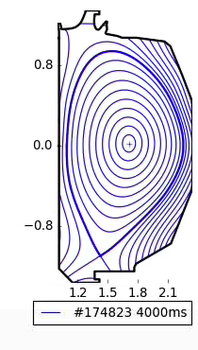
Automatic kinetic EFIT workflow robustly generates equilibria
The Consistent Automatic Kinetic Equilibria(CAKE) tool have been developed to produce kinetically constrained reconstructions with minimal human intervention.
CAKE uses profile analysis to calculate pressure and current constraints. Additionally, MSE measurements, fast ion modeling and bootstrap current calculations are also used.

Slide 7
CAKE/OMFITprofiles provides equilibria and profile
CAKE is an automatic kinetic equilibria maker that also fits basic profiles.
  The process is tuned to be consistent (in settings and assumptions), automatic and robust.
  ELM filtering, and TS alignment is automatically handled.
OMFITprofiles provides a less automatic but more sophisticated set of profile tools in exchange.

Slide 8
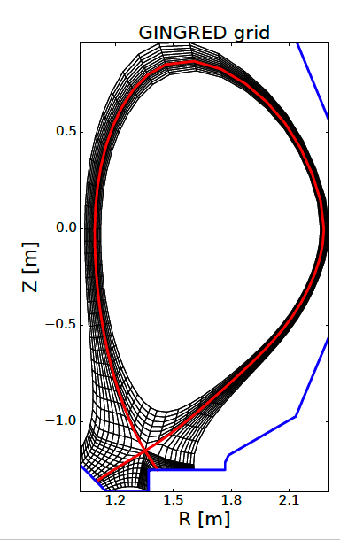
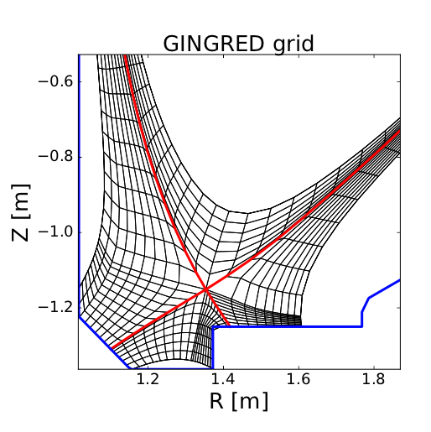
GINGRED makes the grids
The Gingred grid generator automatically conforms to divertor geometry robustly for open (non-SAS) geometries.
Options allows the varying of cell size as well as increasing the relative resolution of the separatrix region.

Slide 9
Automatizing interpretive UEDGE
‘Basic’ UEDGE functions as predictive model based on transport coefficients as inputs.
Propagating UEDGE state until steady state establishes quasi-equilibrium plasma profiles given input transport profile.
Interpretive UEDGE depends on iterating on this process by adjusting the transport profile until the resulting quasi-equilibrium profile

Slide 10
Transport profiles determined via iterative adjustments
autoUEDGE seeks to match a set of input profiles (n_{e}, T_{e}, T_{i} ), by adjusting χ_{e}, χ_{i}, and D iteratively.
The transport coefficients are adjusted using a gradient comparison method to achieve fits with observation.
The code additionally seeks to match a neutral density target set on the lcfs by adjusting gas rate from the outer wall.
T_{e}
n_{e}
T_{i}
n₀

Slide 11
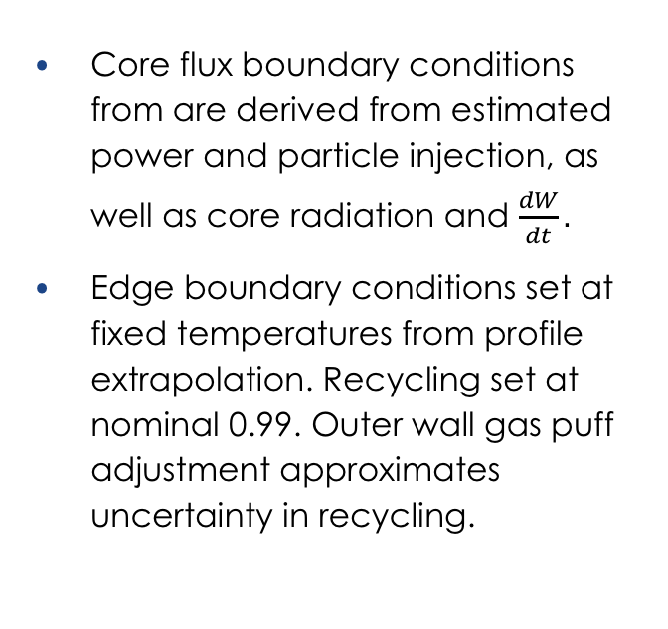
Interpretive UEDGE runs with automatic profile matching
Core flux boundary conditions from are derived from estimated power and particle injection, as well as core radiation and $\frac{dW}{dt}.$
Edge boundary conditions set at fixed temperatures from profile extrapolation. Recycling set at nominal 0.99. Outer wall gas puff adjustment approximates uncertainty in recycling.

Slide 12
Automating interpretive edge transport modeling on DIII-D with UEDGE
Motivation:
  Allowing more edge analysis to be done faster.
Workflow:
  Incorporating automatic tools such as profile analysis results from CAKE and grid generation utilities.
  Heuristic based adjustments to transport profiles, and gas input to match temperature and density targets.
First results:
  >100 interpretive timeslices produced to study edge and divertor dynamics during ELM cycle.
  Observations of divertor behavior matched by interpretive modeling constrained at the midplane.

Slide 13
Automatic matching of neutral levels is an important control for consistent simulations
AutoUEDGE uses gas rates to match neutral to density target.
Plasma profile matching by itself have little ability to constrain neutral levels.

Slide 14
Neutral sensitivity scan shows expected dependence
The diffusion coefficient result is very sensitive to neutral density as expected.
The thermal transport result is much less sensitive, as convective transport is relatively small, but still responds noticeably with changes in modeled neutral density.

Slide 15
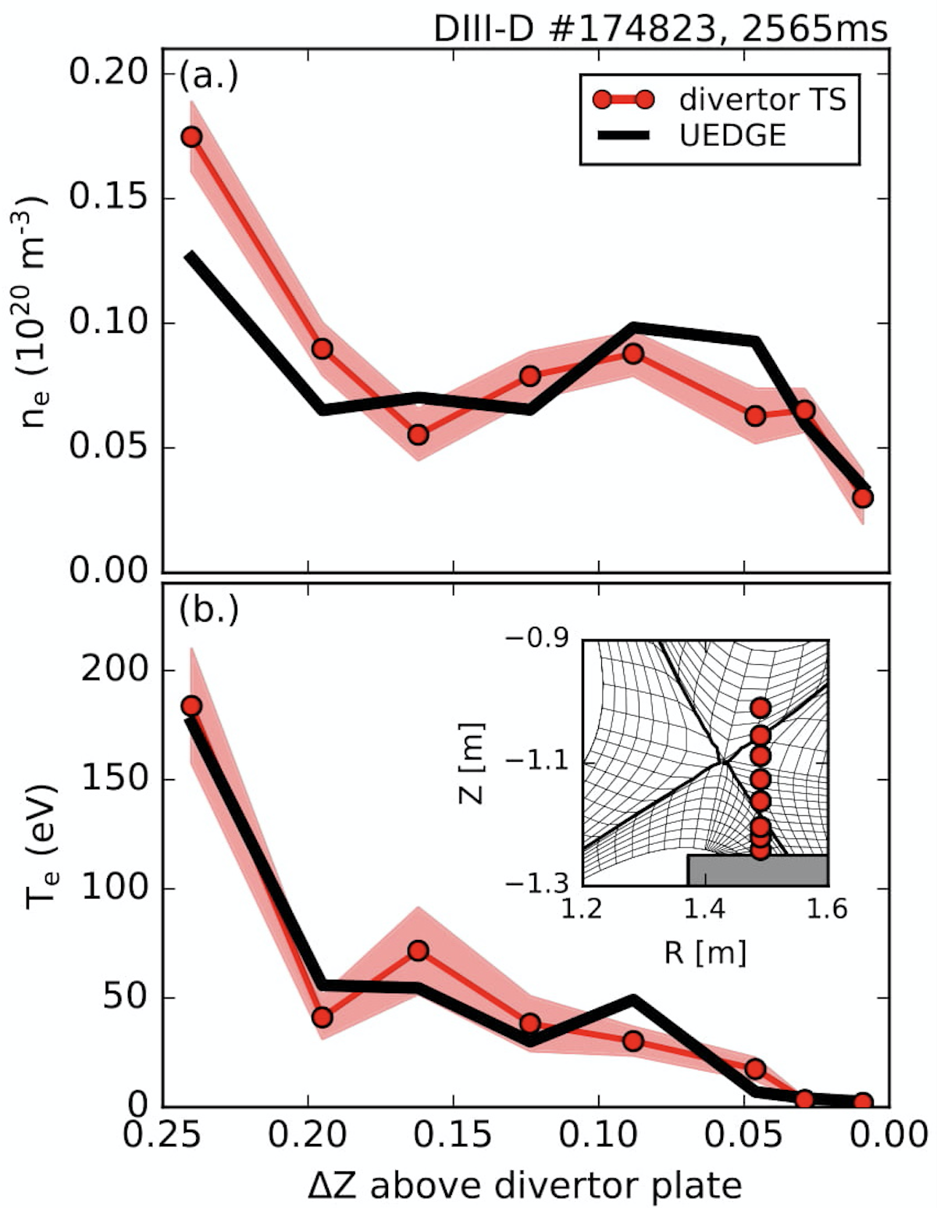
Interpretive simulations show good match with divertor TS measurements
Divertor TS measurement was not used in interpretive matching.
AutoUEDGE was able to produce simulations with well matched divertor temperature and density with upstream profiles.
Currently unclear if this holds for wider range of temperature and density configurations.
A. O. Nelson, in review

Slide 16
Divertor heat flux peak matches IRTV measurements
But the shape of the heat flux does not match as well, especially in the private flux (PF) region.
Possible cause includes inaccuracies in drifts and PF region transport coefficients. Additionally, a significant portion of PF heating is due to radiation.

Slide 17
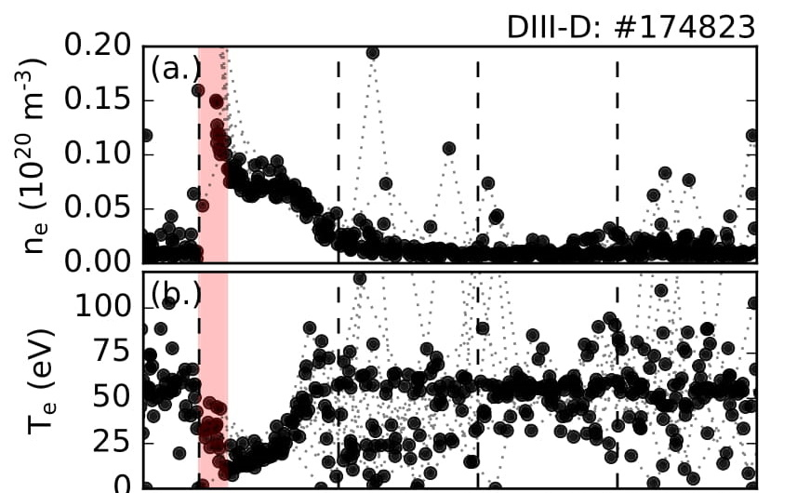
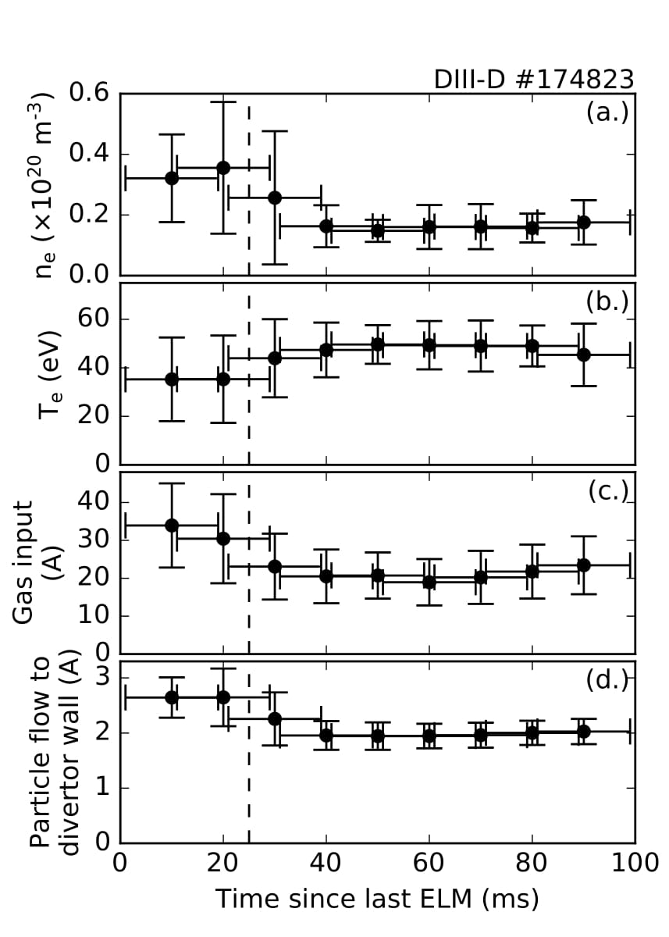
ELM phase scan reproduces divertor trends
An ELM phase scan was performed with
When applied to study of ELM cycle behavior, autoUEDGE reproduces qualitative divertor conditions
Divertor n_{e} rises (0.2 → 0.4 /m³)
Divertor T_{e} falls (50 → 30 eV)
Same time scale as experiment
A. O. Nelson, in review

Slide 18
Summary and future work
autoUEDGE workflow allows batch interpretive analysis for large number of time slices. It automatically arrives at transport coefficients compatible with input profile, power fluxes, and neutral density targets.
The result show promising ability to reflect divertor conditions from matching of upstream profiles.
Future work includes verification of robustness across scenarios, and especially of robustness of reproducing divertor conditions. At the same time, upgrading to a more detailed impurity carbon simulation.

