Slide 1
Data-driven models for Alfvén eigenmode classification based on ECE diagnostics at DIII-D
Azarakhsh (Aza) Jalalvand
Data scientist at Ghent University - Belgium
Visiting postdoc at Plasma Control Group - Princeton University
Co-authors: A. Kaptanoglu, A. Garcia, A. Nelson, J. Abbate, M. Austin, G. Verdoolaege, S. Brunton, W. Heidbrink, E. Kolemen
Collaboration: DIII-D Team
Presented at the
APS-DPP meeting
November 2021
Notes:
ELM detection with BES (Lakshya): CP11.00067, PP11.00160
Locating AE with ECE (Alan): CP11.00101, PP11.00154
AE spectrogram enhancement (Eric): JP11.00102
Autoencoder for BES compression (Prannav): JP11.00107
AE classification with CO2 (Alvin): PP11.00133
ELM detection with BES (Dave): PP11.00138
AE classification with RCN (Aza): TM10.00006
ML for plasma monitoring plasma – DOE project (Egemen): UM10.00003

Slide 2
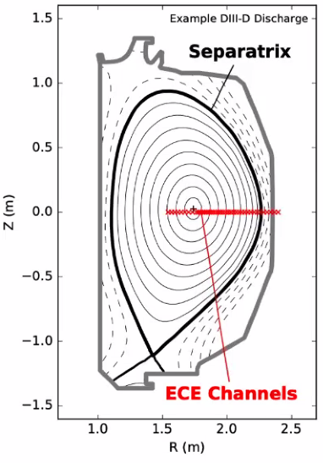
Alfvén eigenmode instabilities in DIII-D
Project:
Machine Learning for Real-time Fusion Plasma Behavior Prediction and Manipulation (DE-SC0021275)
Data
40 ECE diagnostics as inputs (ECEs provide spatial information)
Tasks
Detect/classify Alfvén eigenmode (AE)
Detect the location and shape of AE in plasma
Predict and control AE

Slide 3
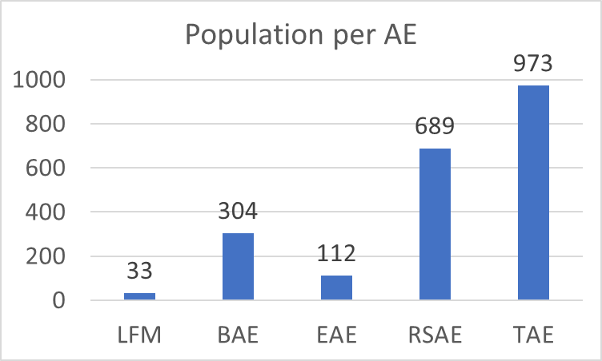
Alfvén eigenmode dataset
919 shots of 2 seconds
5 AE modes (BAAE/LFM, BAE, EAE, RSAE, TAE)
Challenges
Labels are not perfect
Duration of events is not available
Subject to the experts’ opinion (W.W. Heidbrink et al 2021 Nucl. Fusion 61 016029)
Imbalanced data
ECE is Noisy (Low SNR)
We did not do any preprocessing rather than mean-variance normalization on ECE signals

Slide 4
Alfvén eigenmode classification using ECE
Reservoir computing network (RCN)
Recurrent neural network with Random connections
Suitable for time-series data analysis
Only Last layer is trained using linear regression.
Input to RCN: 40 ECE signals
Output: Probability of AE modes at each time step

Slide 5
Alfvén eigenmode classification using ECE
True Positive Rate: %91
False Positive Rate: %7

Slide 6
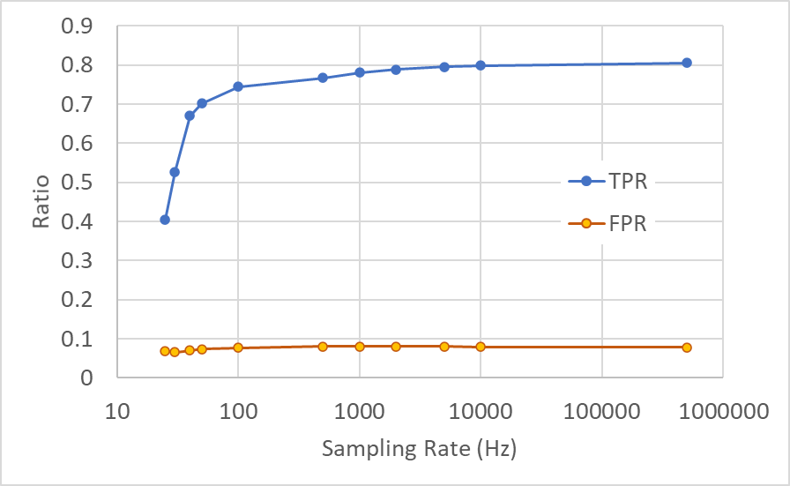
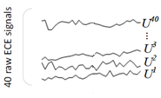
Subsampling the ECE signals
Subsampling the ECE signals has minor impact on the AE classification performance
Hypotheses:
Lower frequencies still contain enough information.
The model’s memory covers missing data
Other ideas?

Slide 7
Conclusion
Promising performance in detecting AE modes With minimum feature engineering on ECE data
Possible future work
Re-labeling the data using the current model’s output?
Enriching the input features by including more diagnostics
More advanced ML techniques
Locating AE modes using ML and image processing techniques
Related presentations at APS-DPP21
ML for monitoring plasma (overview of the DOE project): UM10.00003
ELM detection using BES diagnostics: CP11.00067, PP11.00160
Locating AE using ECE diagnostics: CP11.00101, PP11.00154
AE spectrogram enhancement using image processing: JP11.00102
Autoencoders for BES data compression: JP11.00107
AE classification using interferometry data: PP11.00133
ELM detection using BES diagnostics: PP11.00138

Slide 8
Thank you!

