Slide 1
Machine learning for tokamak control
J. Abbate¹,
R. Conlin^{1,2}, E. Fable³, G. Tardini³,
E. Kolemen^{1,2}
¹ Princeton Plasma Physics Laboratory
² Princeton University, Department of Mechanical and Aerospace Engineering
³ Max Planck Institute for Plasma Physics
APS-DPP: ML in Plasma
November 11, 2021
Notes:
add slide numbers

Slide 2
Desire for better tokamak control
Tokamaks primarily use simple control for individual scalars
line-averaged density <--> puffed neutral gas
betan <--> total beam power
rotation for given CER channel <--> beam torque
Want more holistic control
Set all profile shapes rather than average or point values
Want smarter control
Better model than assuming proportionality of signal to single actuator
Notes:
self-consistent
might be able to use fancy control tricks like the one used to get into super H-mode
MAYBE BIGGER FONT
Ricardo: want accurate and robust, but there aren’t enough actuators to do everything you want

Slide 3
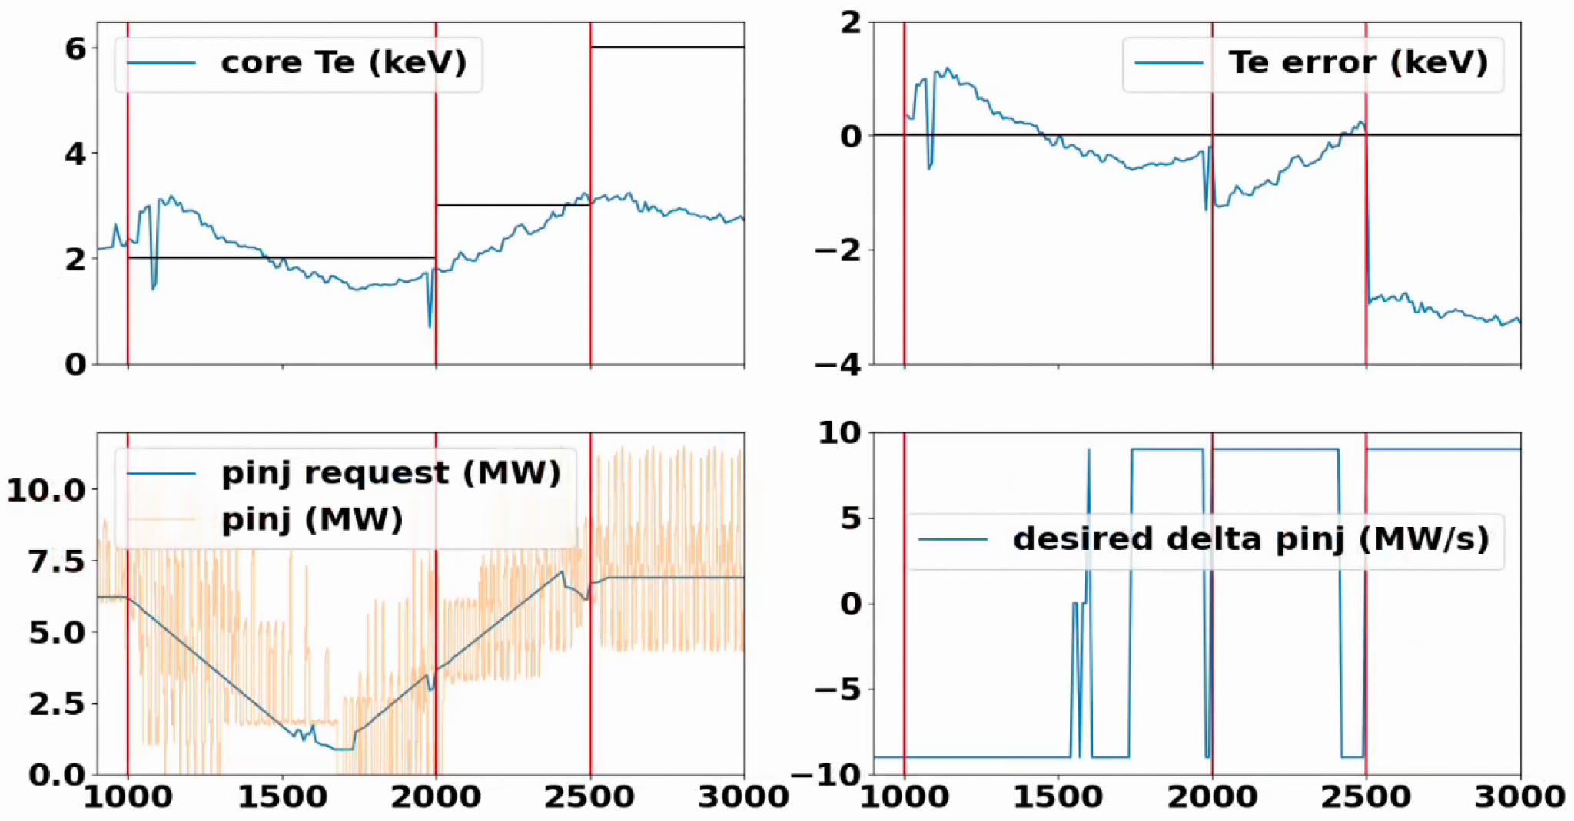
Initial test: reasonable core-Te tracking via pinj control
DIII-D shot 187076
Notes:
DIII-D experiment in June: under the hood is a neural network and a naive control algorithm that uses its predictions, but ultimately the task our machine learning controller seeks to accomplish is simple: as you can see on the top left plot, we’re trying to achieve the black line values for the core temperature. Specifically we try to ramp from 2keV to 3 keV to 6 keV
As you can see in the bottom left, the neutral beam injected power (pinj) is the primary control knob for the core Te temperature: the temperature basically follows the injected power with a 30ish-ms lag, which is approximately the beam slowing down time
On the right, you can see that we have pid-like control
“We have no idea what’s in this neural net, and it did reasonable control that looks like PI - so really good from that perspective” -- “Ian and stuff did this, compared to PID do similar, worse, better something in that range” → “REAL EXPERIMENT”
“put a neural net, did control, didn’t blow up”

Slide 4
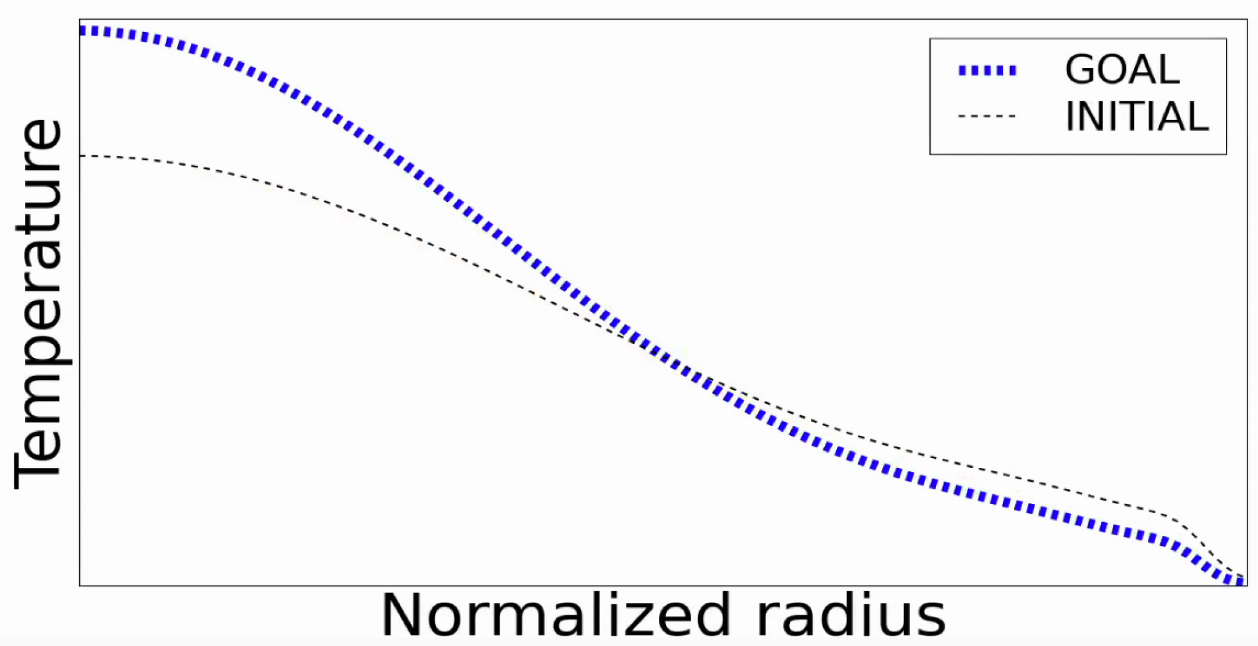
Naive Control Idea

Slide 5
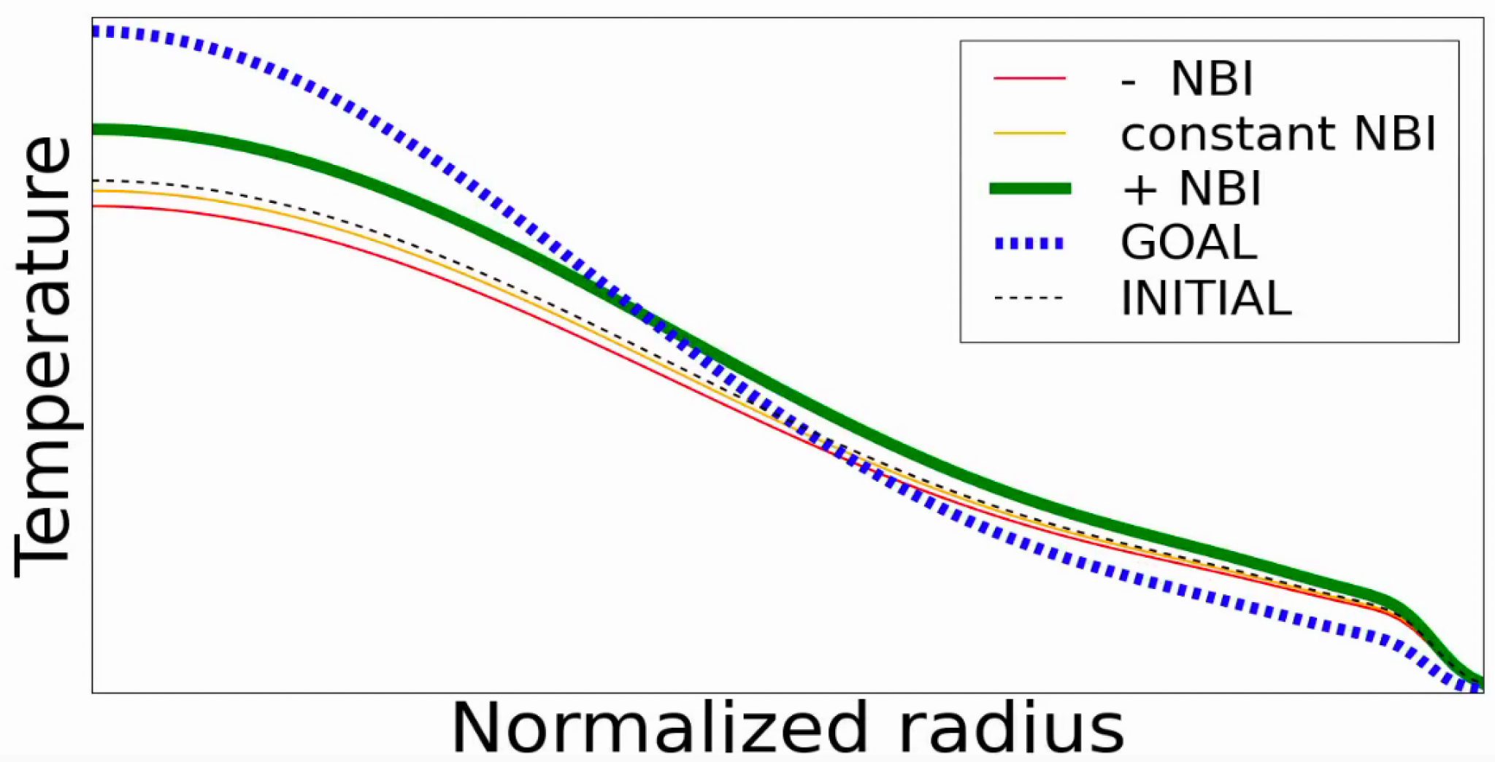
Naive Control Idea

Slide 6
Model under-the-hood: fully data-driven
Black Box
LSTM “memory” network
Actuators
Dense
CNN “convolution” network
Profiles @ t
Predicted Profiles @ t+Δt
Notes:
Profiles at the present timestep, along with shape parameters encoding the equilibrium boundary shape, were fed in at the present timestep. We are trying to predict profiles delta t into the future, which based on the DIII-D energy confinement time being between 50 and 200ms we chose to be 200ms - just enough time for there to be a significant change in profiles due to changing actuators
This black box can be anything, and indeed we tried a variety of techniques

Slide 7
Model under-the-hood: fully data-driven neural net
Abbate, Conlin 2021 Nucl. Fusion 61 046027
LSTM “recurrent” network
Actuators
Dense Neural Net
CNN “convolution” network
Profiles @ t
Predicted Profiles @ t+Δt
Notes:
we tried a variety of black box methods, including linear regression and processing profiles in a variety of ways, e.g. principal component analysis to reduce scalars
Ultimately we found neural nets worked best doing a 70/20/10 split of the data into train / validation

Slide 8
Model captures profile responses to NBI
Abbate, Conlin 2021 Nucl. Fusion 61 046027
DIII-D shot 175970
Notes:
everything below 0 is a decreasing rotation, everything above is an increasing rotation
we see in this particular shot

Slide 9
Model captures profile responses to NBI
Abbate, Conlin 2021 Nucl. Fusion 61 046027
DIII-D shot 175970
Decrease in Power →
Decrease in Temp
Notes:
everything below 0 is a decreasing rotation, everything above is an increasing rotation
we see in this particular shot

Slide 10
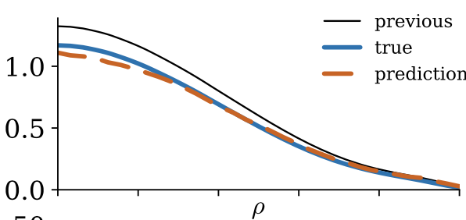
Model captures profile responses to NBI
Abbate, Conlin 2021 Nucl. Fusion 61 046027
DIII-D shot 175970
Notes:
everything below 0 is a decreasing rotation, everything above is an increasing rotation
we see in this particular shot

Slide 11
(Reminder): reasonable core-Te tracking via pinj control
DIII-D shot 187076
Notes:
to loop back to what we started with, at every cycle as the control system runs, we predict what would happen to the temperature profile if we kept constant, decreased, or increased the pinj. We then attempt to make the change with the prediction whose core value is closest in a least-squared sense to the target core temperature
this was our first experiment back in June, and for the upcoming campaign we plan to do more holistic control after making some improvements. Specifically…

Slide 12
Future: Better underlying model by leveraging physics sims
Data-driven models primarily lack
Extrapolability
Causality
Data coverage
These are exactly the areas predict-first physics simulations succeed
Train model with both data and simulation outputs
Notes:
Causality: (can learn operator rather than plasma behavior)
Data scarcity:

Slide 13
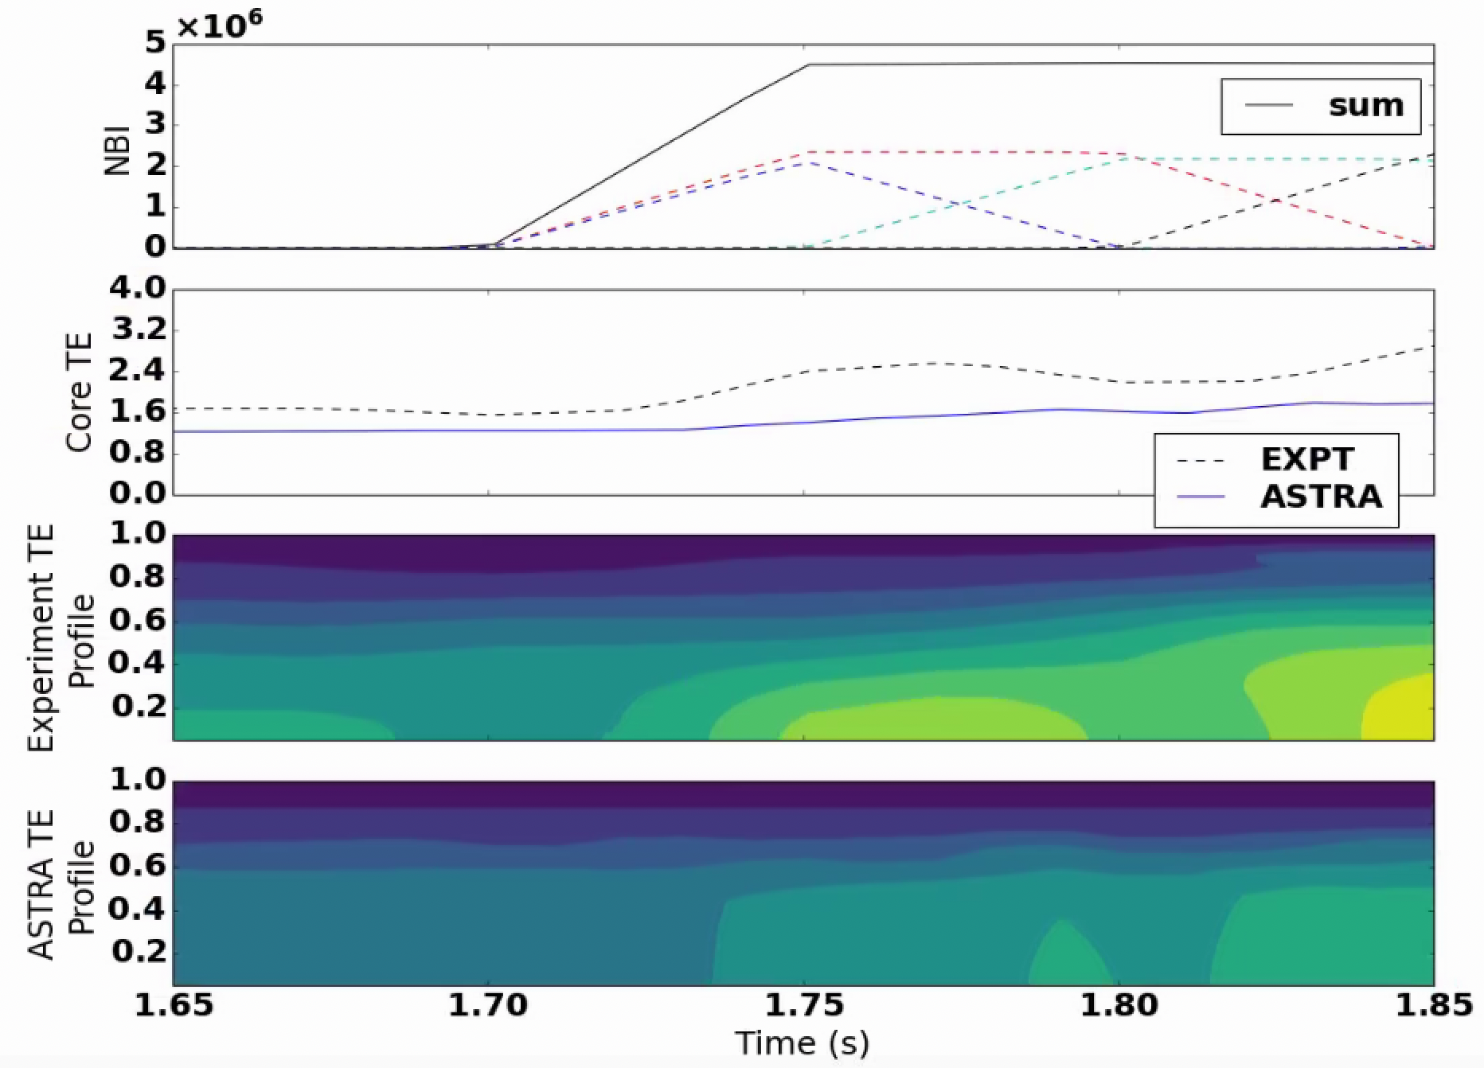
Future: Better underlying model by leveraging physics sims
“ASTRA” module in private branch for
DIII-D shot 131491
Notes:
Extrapolability
Causality (more sensible responses to actuators)
More data (larger sample-space coverage)
setup and ran latest ASTRA version on DIII-D’s servers for the first time, and built an OMFIT module for people to
this is a very simple way to do predictive runs with ASTRA
for one thing, this is a great way to baseline predictive models

Slide 14
Model under-the-hood: data-driven
Black Box
LSTM “memory” network
Actuators
Dense
CNN “convolution” network
Profiles @ t
Predicted Profiles @ t+Δt
Notes:
Profiles at the present timestep, along with shape parameters encoding the equilibrium boundary shape, were fed in at the present timestep. We are trying to predict profiles delta t into the future, which based on the DIII-D energy confinement time being between 50 and 200ms we chose to be 200ms - just enough time for there to be a significant change in profiles due to changing actuators
This black box can be anything, and indeed we tried a variety of techniques

Slide 15
Model under-the-hood: data+sim-driven
Black Box
LSTM “memory” network
Profiles @ t
Actuators
Dense
Physics Predictions @ t+Δt
CNN “convolution” network
Predicted Profiles @ t+Δt
Notes:
Now we just need to make the database, have about 30 samples so far and adding daily

Slide 16
Overview + Tools to Share
Neural Net profile predictor has been used for simple DIII-D control
Conlin et al 2021 Keras2C used to put realtime neural net onto device
Infrastructure in place in PCS for generic profile control
Workflow developed to generate database of ASTRA+TRANSP+Experiment
Fully-predictive evolution of plasma
Available in OMFIT on private branch
In process of training model with data+simulation
30 samples in database so far, growing weekly
Testing variety of architectures and techniques
See Rory’s talk next for how we’re improving the control algorithm

