Slide 1
Feedback Adaptive ELM Control towards (ITER) long pulse ELM suppression and its application to KSTAR
R. Shousha ¹, S.K. Kim ¹, S.H. Hahn ³, A.O. Nelson ⁴, S.M. Yang ², J.-K. Park ², J. Wai ², Y. M. Jeon ³, Y. In ³, E. Kolemen^{1,2}, the LPT team and KSTAR team
¹Princeton University, USA
²Princeton Plasma Physics Laboratory, USA
³Korea Institute of Fusion Energy , ROK
⁴Columbia University, USA
Presented at the 63rd Annual Meeting of the APS Division of Plasma Physics
Pittsburg, PA
November 8-12, 2021

Slide 2
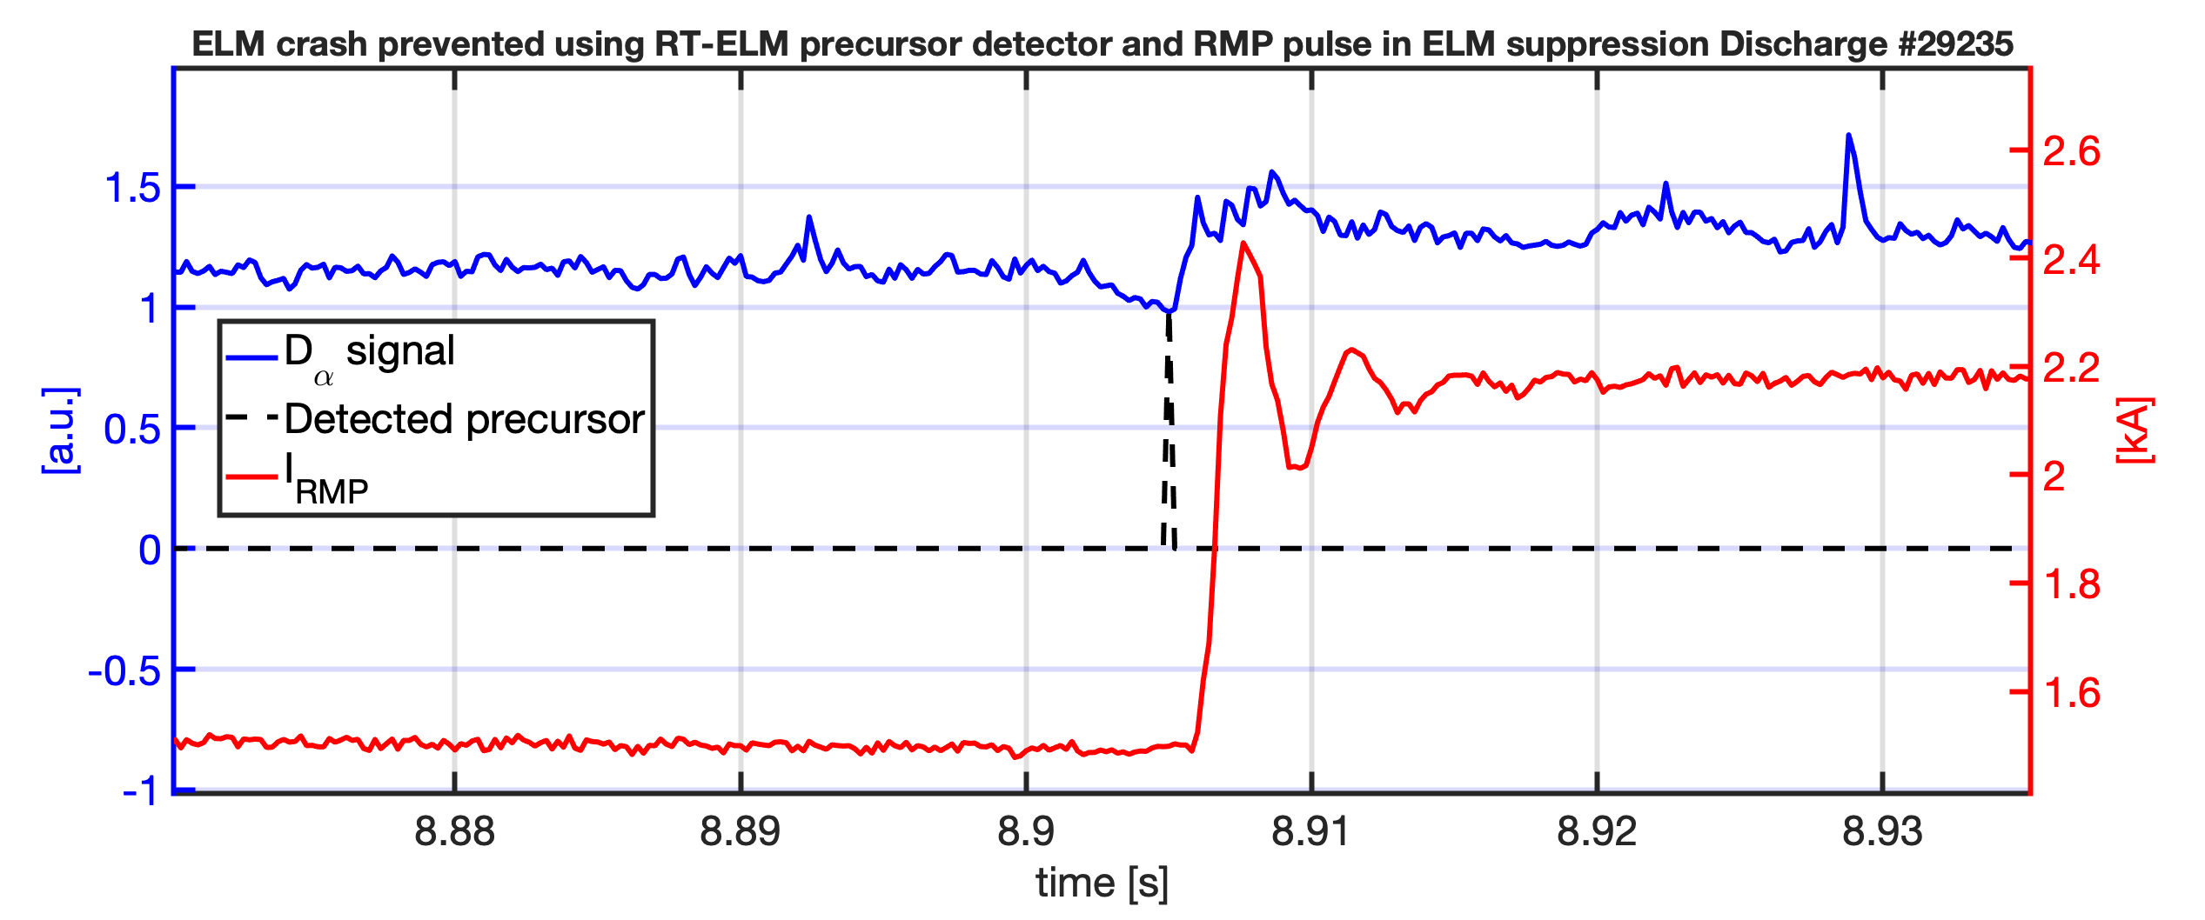
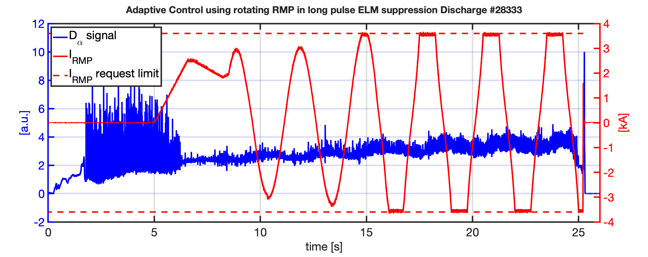
Highlights: Feedback Adaptive ELM Controller RT ELM precursor detection and pulse control action to prevent imminent ELM
Imminent ELM crash prevented by short RMP pulse following RT-ELM precursor detection
Rotating RMP enabled in Amplitude feedback to distribute divertor heat load

Slide 3
ELM Control through feedback application of RMP might prove vital to ITER-scale devices, but there are challenges
ELM suppression through resonant 3D magnetic perturbations
But there are challenges:
Plasma performance (pedestal properties) degraded by RMP
Sustained ELM suppression under (narrow) ELM suppression window evolution
Heat load to divertor
[T. Evans JNM 2004]
[J.-K. Park NP 2018]

Slide 4
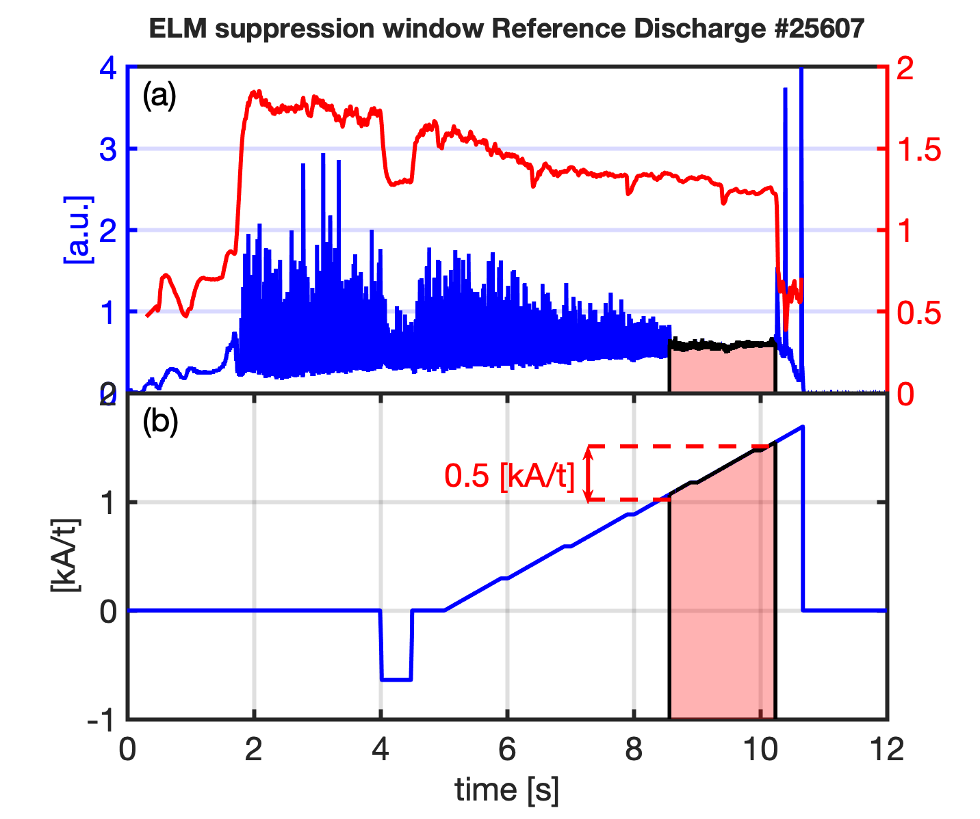
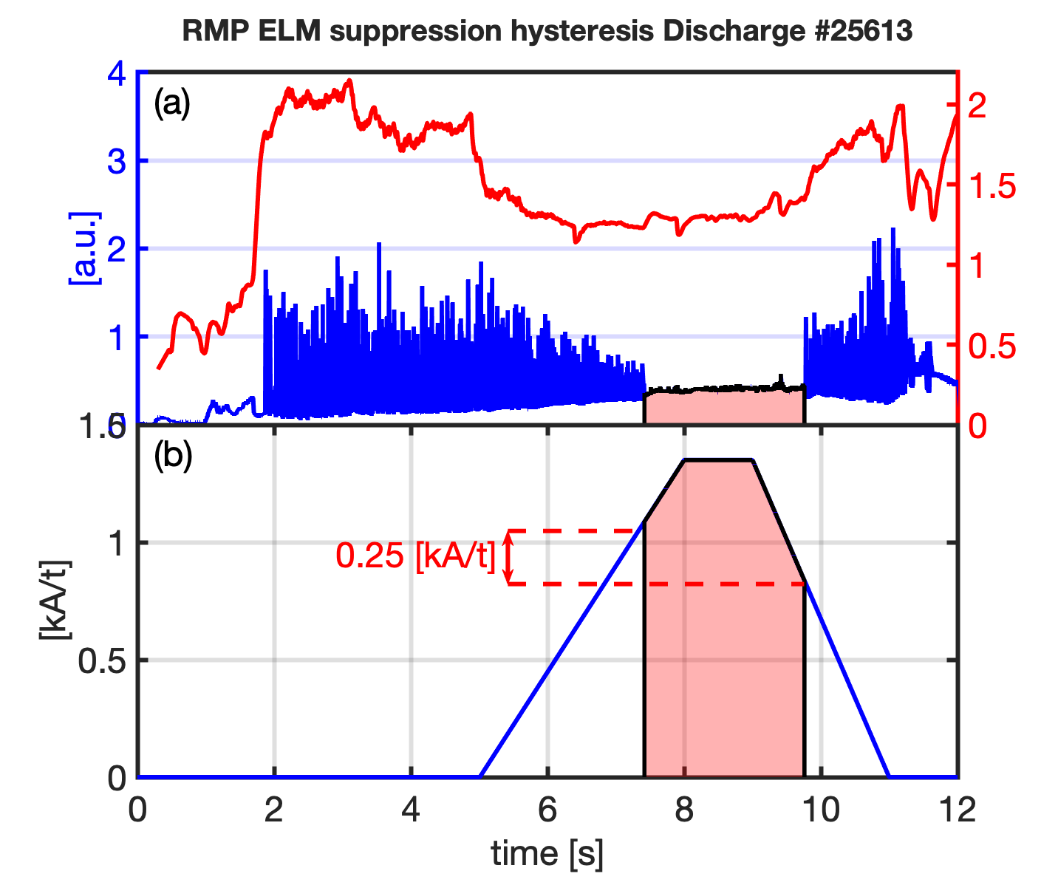
Phenomena observed in feedforward RMP ELM suppression discharges are leveraged for design of Feedback Adaptive RMP Control
Increasing RMP amplitude reduces plasma performance
Once ELM suppression achieved, less amplitude required to sustain ELM suppression → RMP minimization for plasma performance optimization

Slide 5
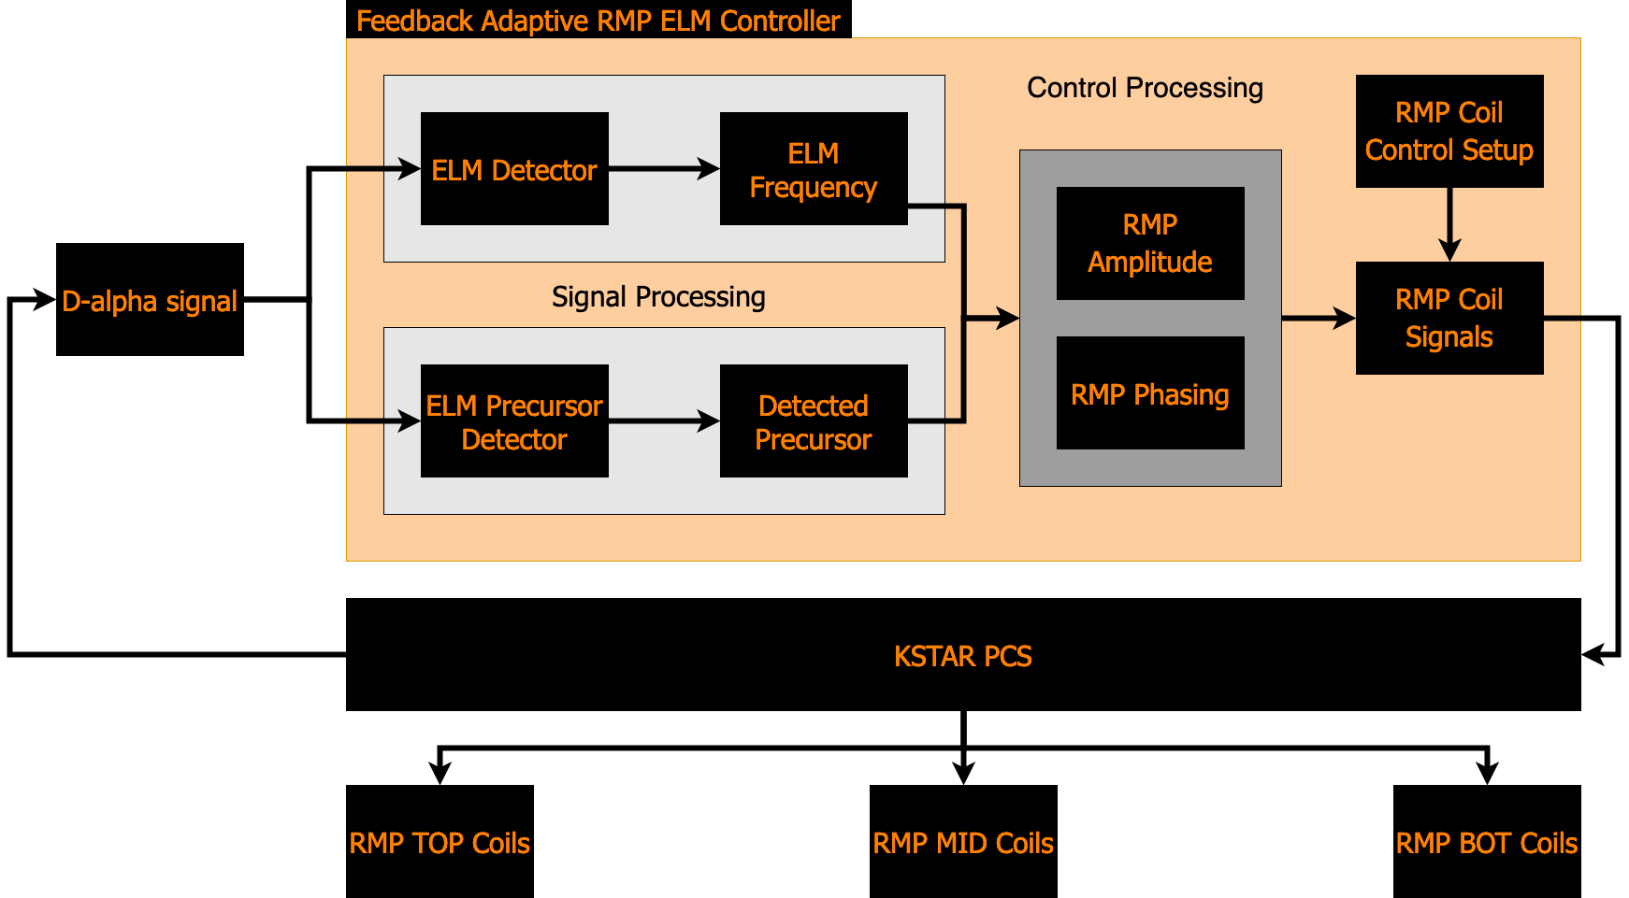
The D-alpha signal is used by the ELM detector to monitor ELM activity and inform the controller. The controller adjusts requested coil currents in feedback

Slide 6
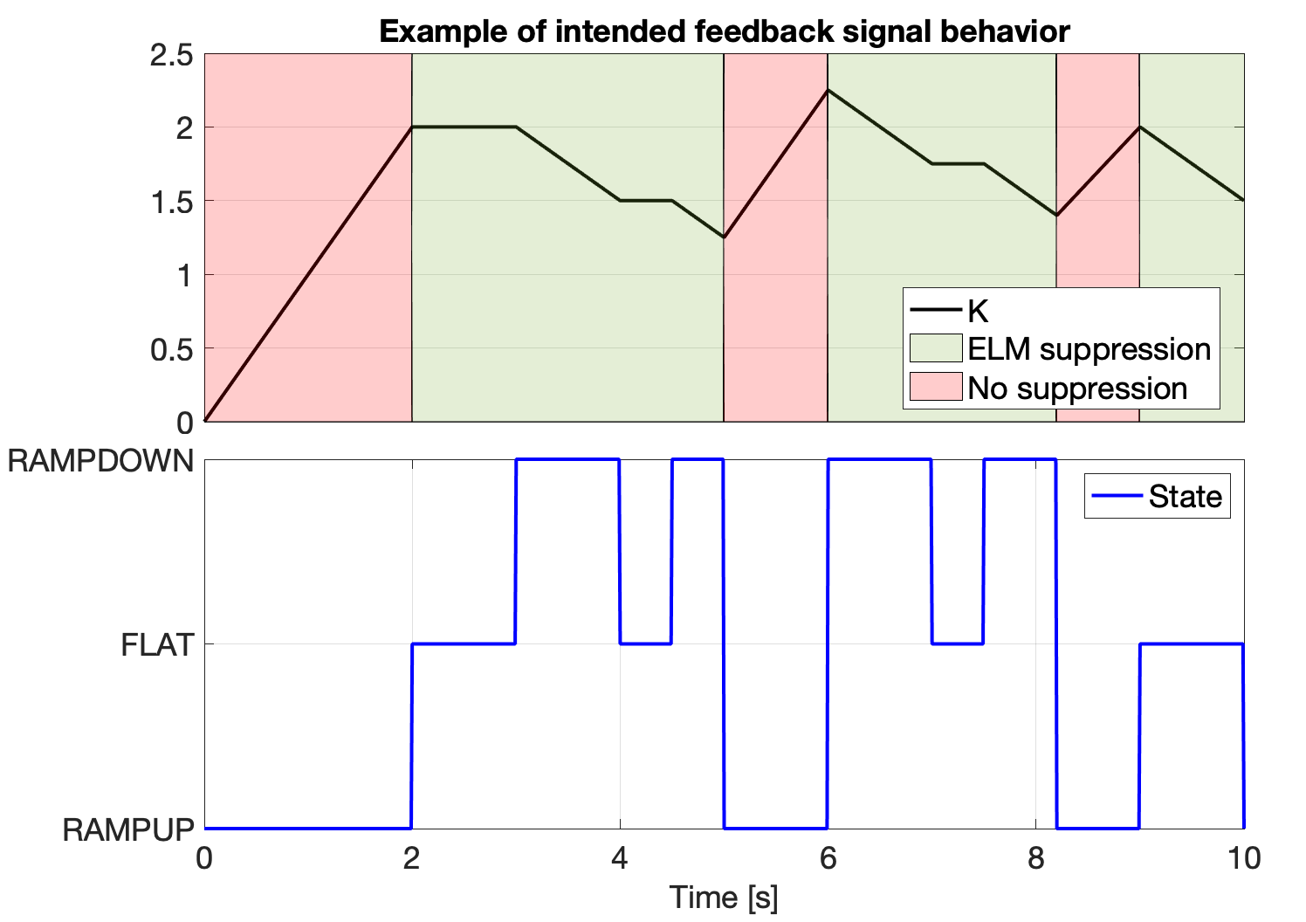
The feedback calculation for each feedback mode is essentially the same and can be modeled as a single state machine

Slide 7
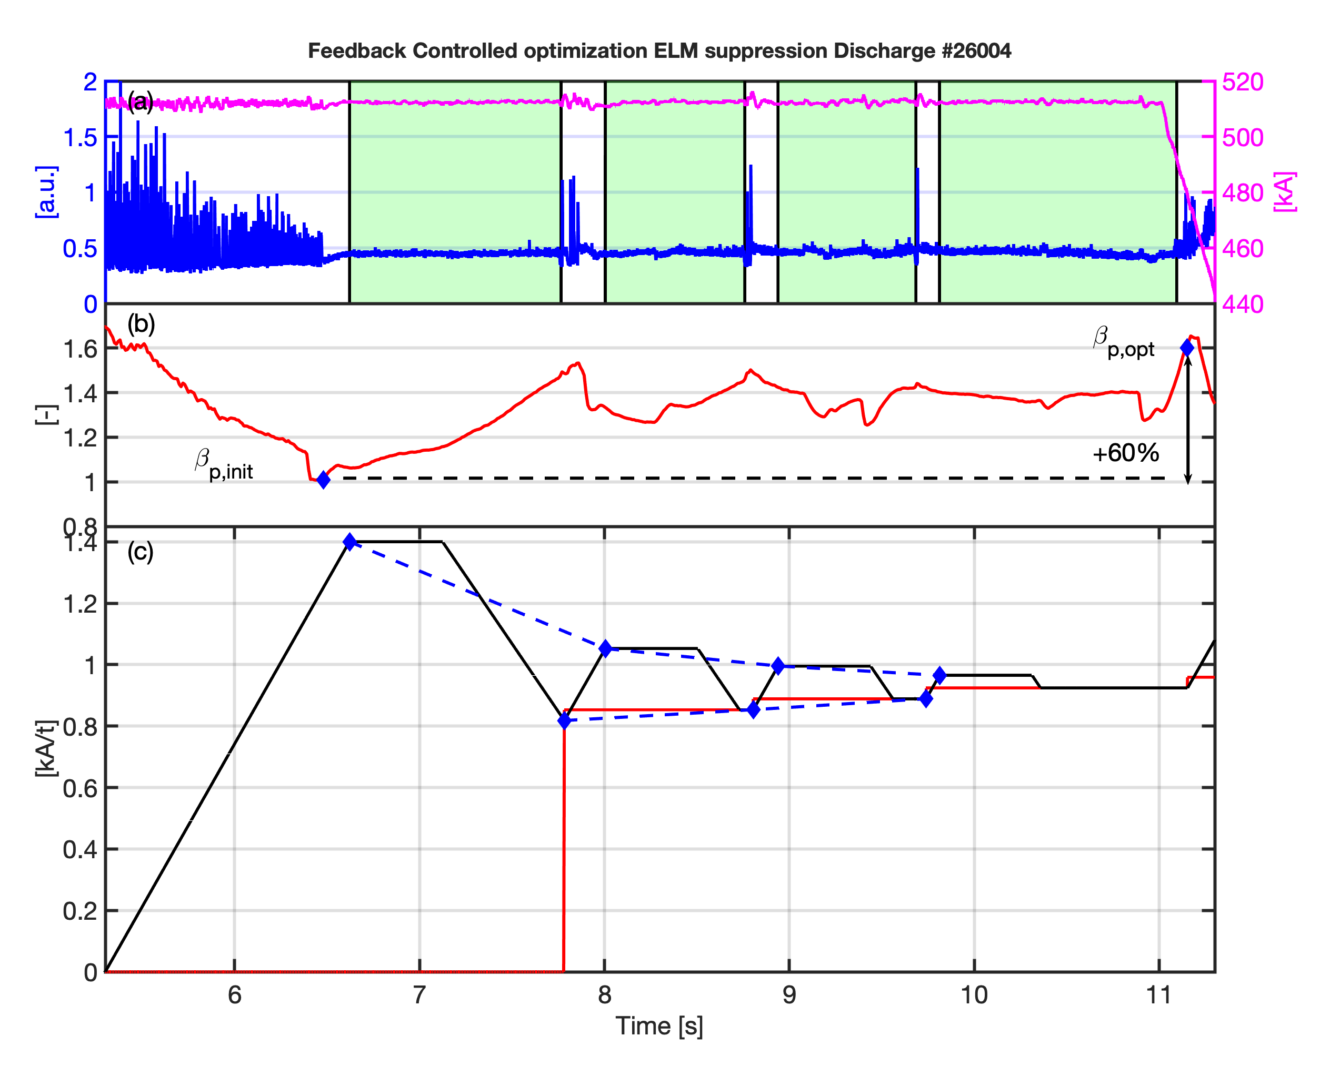
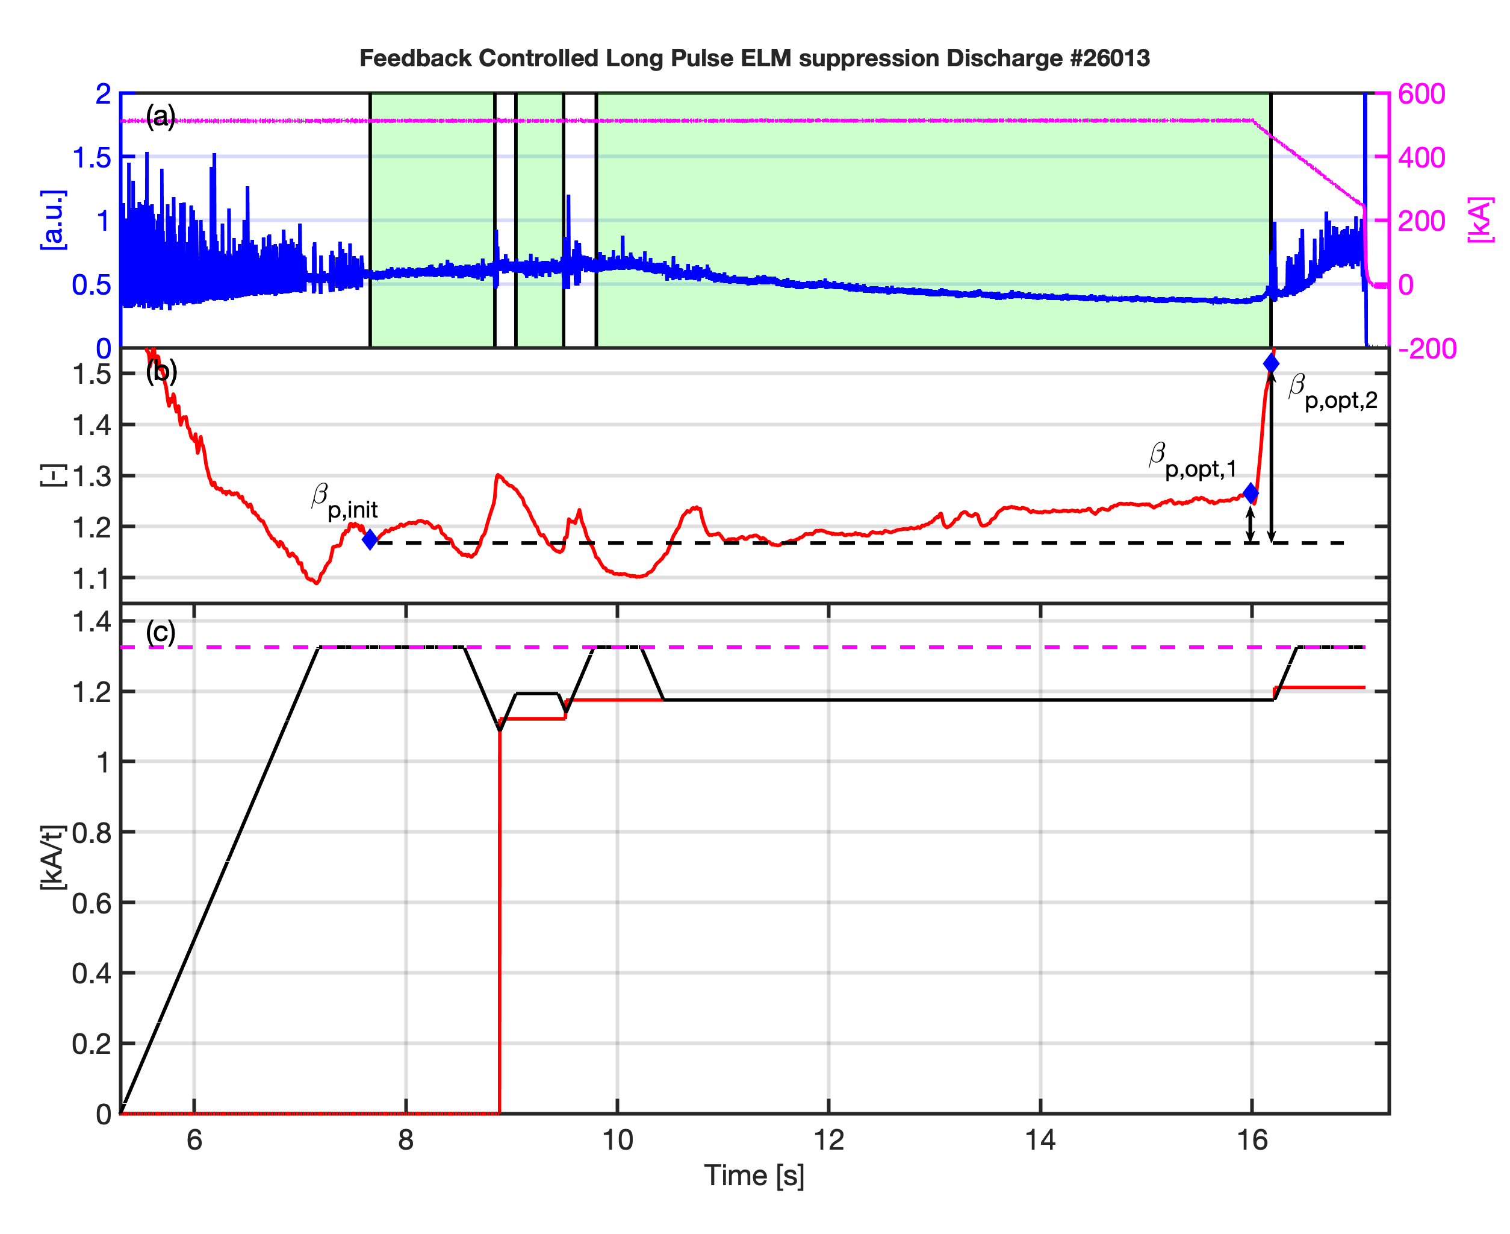
During the 2020 KSTAR campaign the controller was able to optimize the applied RMP using the adaptive lower bound, and had reasonable success sustaining complete ELM suppression in a longer pulse

Slide 8
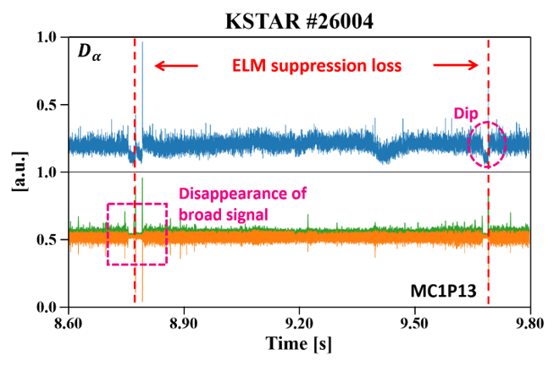
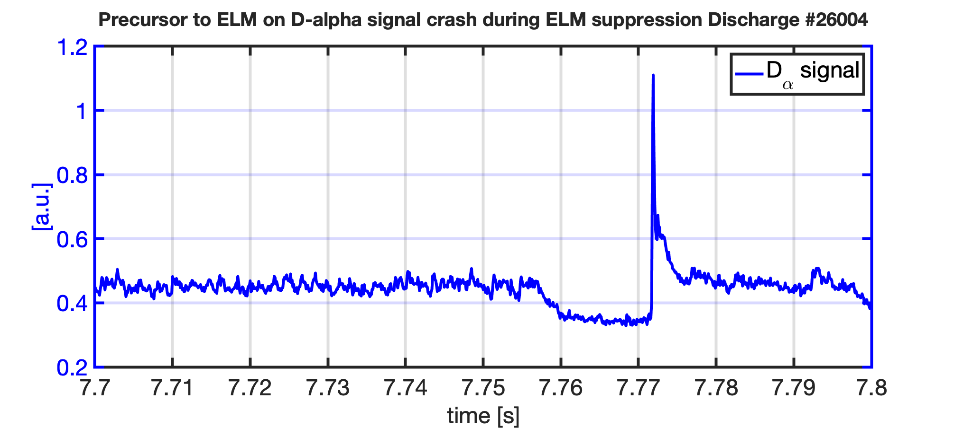
It is inherent to the current method that ELM suppression will be lost at least once during optimization—The next step is to try to solve this
No RT-capable, accurate ELM predictor available yet
However,
ELM crash precursors on several diagnostics
If detected, controller action to avoid imminent ELM
Precursor Detection:
Interacting Multiple Model Kalman Filter
Additional RT diagnostics can be added for robustness
Controller Action:
RMP pulses
Shape of pulses can be modified (height , width, offset)
Pulse shape
width
20 [ms]
height
offset

Slide 9
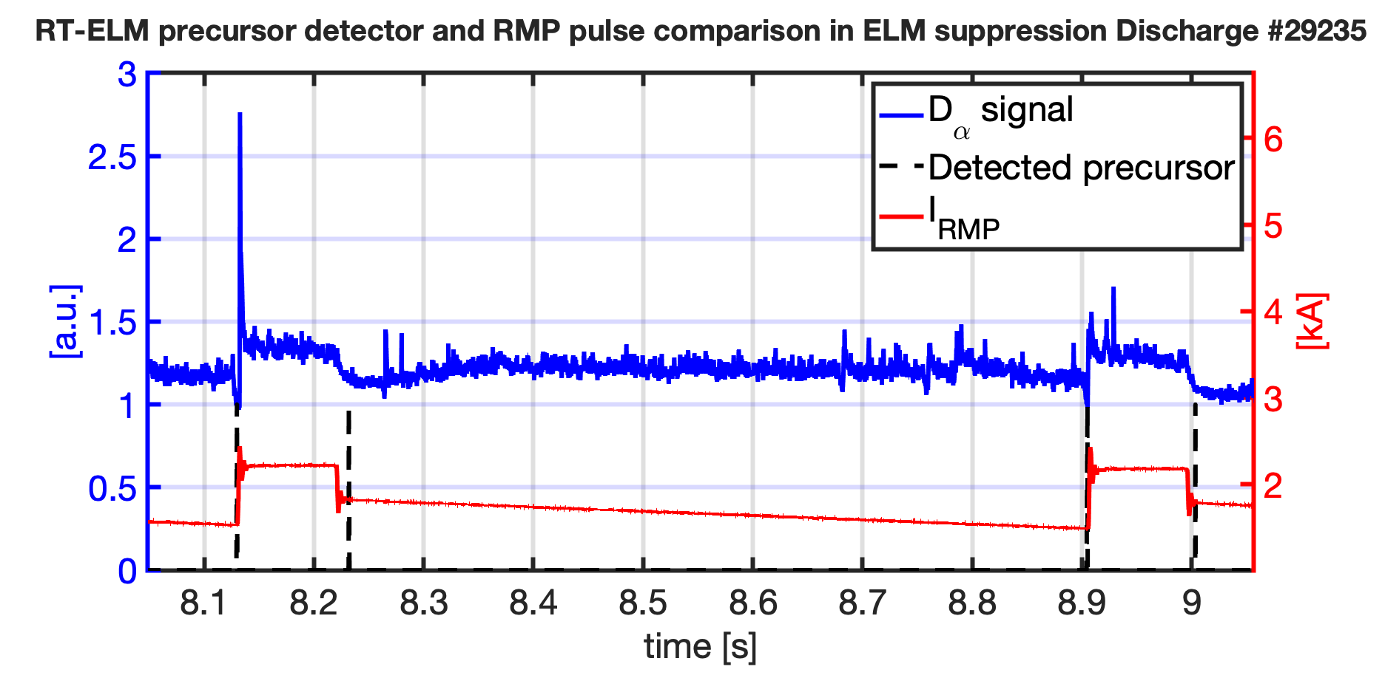
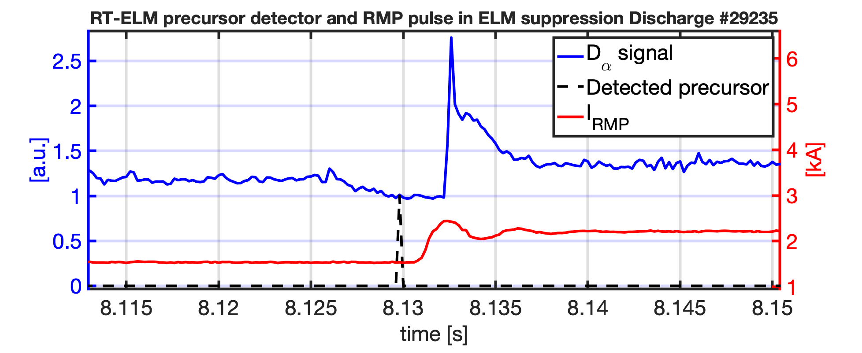
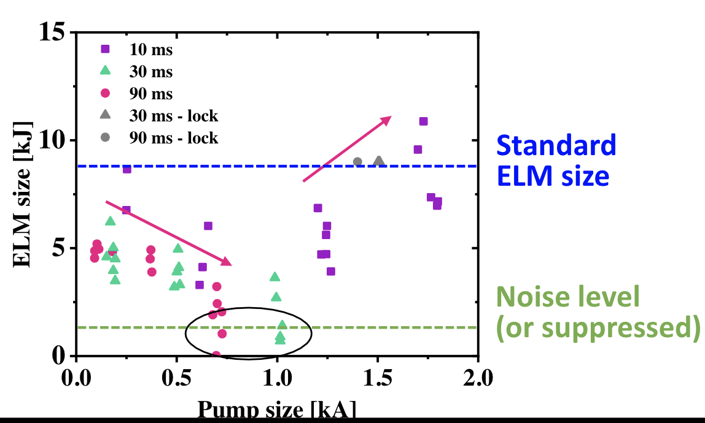
The RT-precursor detector performs well and the finite pulses are triggered successfully. ELM crashes can be completely prevented by this scheme or associated heat load significantly reduced
2.6 [ms]
”fast” ELMs in this discharge:
Little time to detect and react, but still observed complete prevention and significant mitigation

Slide 10
Controller extended capability to apply rotating RMP to toroidally distribute heat load (important for long pulse) successfully tested during 2021 KSTAR campaign long pulse discharge
Amplitude Feedback
FF phasings
FF rotation frequency
ELM suppression achieved
Broad D-alpha signal tricks controller into thinking ELM suppression is LOST
→RMP amplitude is ramped up but not beyond threshold.

Slide 11
Conclusions: New controller capabilities tested successfully. Next step is to start thinking about more informed decision making process
RT-ELM precursor detection + RMP pulses can completely prevent imminent ELM, or at least significantly reduce ELM associated heat load → Heat load to ITER Wall should be sufficiently small!
Rotating RMP capability in Amplitude Feedback mode to distribute heat load to divertor successfully tested in KSTAR
Discharge length limited by flux consumption → Size of applied RMP influences pulse length → Minimization of applied RMP crucial for long pulse

Slide 13
Minimizing the amplitudes of the applied RMP conserves flux consumption, which allows for longer pulses
Threshold level of RMP needs to be met to enter ELM suppression
Exceeding the threshold sufficiently leads to:
more robust ELM suppression
more flux consumption (finite flux swing)
Therefore:
→ need to minimize applied RMP as much as possible to extend pulse length
KSTAR #28454
2.0
35 s
52 s
48 s
40 s
$$I_{RMP}$$
$$β_{p}$$
1.0
60 s
Lower bound
$$D_{α}$$
0
5
10
15
20
25
30
Time [s]

Slide 14
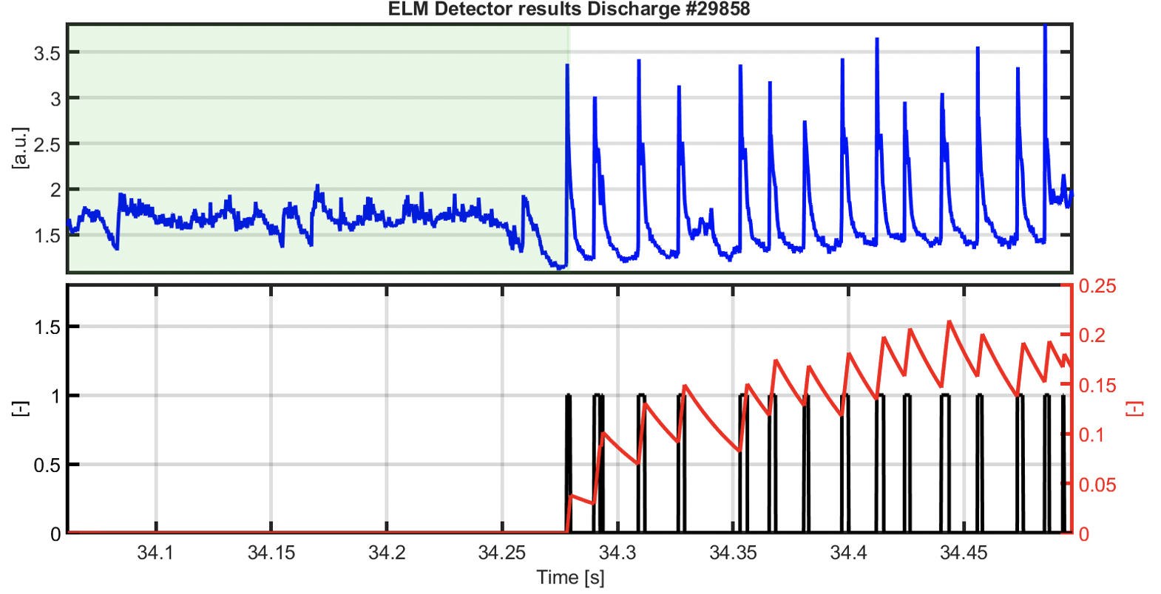
The Real-time ELM detector consists of a set of lowpass and highpass filters and thresholds applied to the D-alpha signal–This enables taking into account ELM size
[D. Eldon NF 2017]

Slide 15
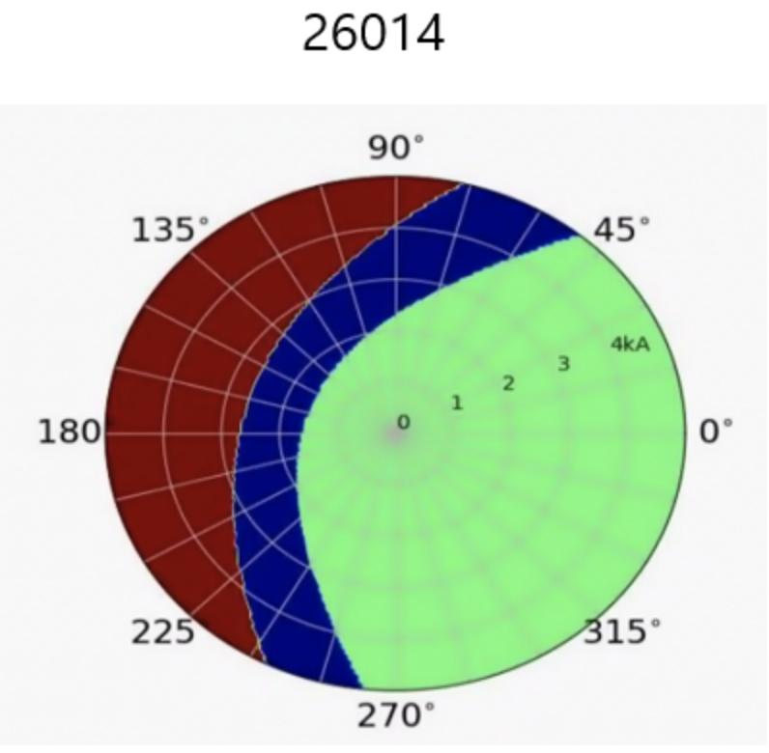
Phenomena observed in feedforward RMP ELM suppression discharges are leveraged for design of Feedback Adaptive RMP Control
Increasing RMP amplitude reduces plasma performance
Once ELM suppression achieved, less amplitude required to sustain ELM suppression → RMP minimization for plasma performance optimization
Different possible paths through phase space (non-resonant,suppressed,Locking)

Slide 16
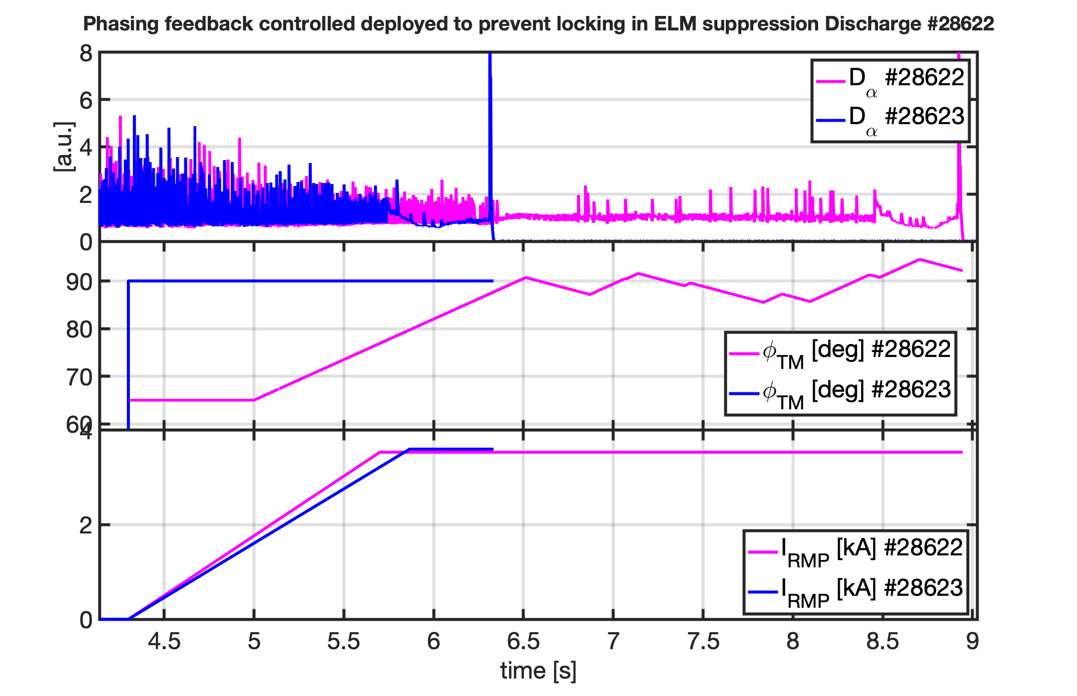
By changing the phasing in feedback, the suppression window can be expanded– Locking can be prevented
At t = 5 [s] Phasing Feedback Control activated
Phasing ”ramped up” until suppression detected
Phasing “ramped down” during ELM suppressed phase
Total RMP: Feedforward amplitudes, Feedback phases (trig functions)
→ Suppression window expanded

Slide 17
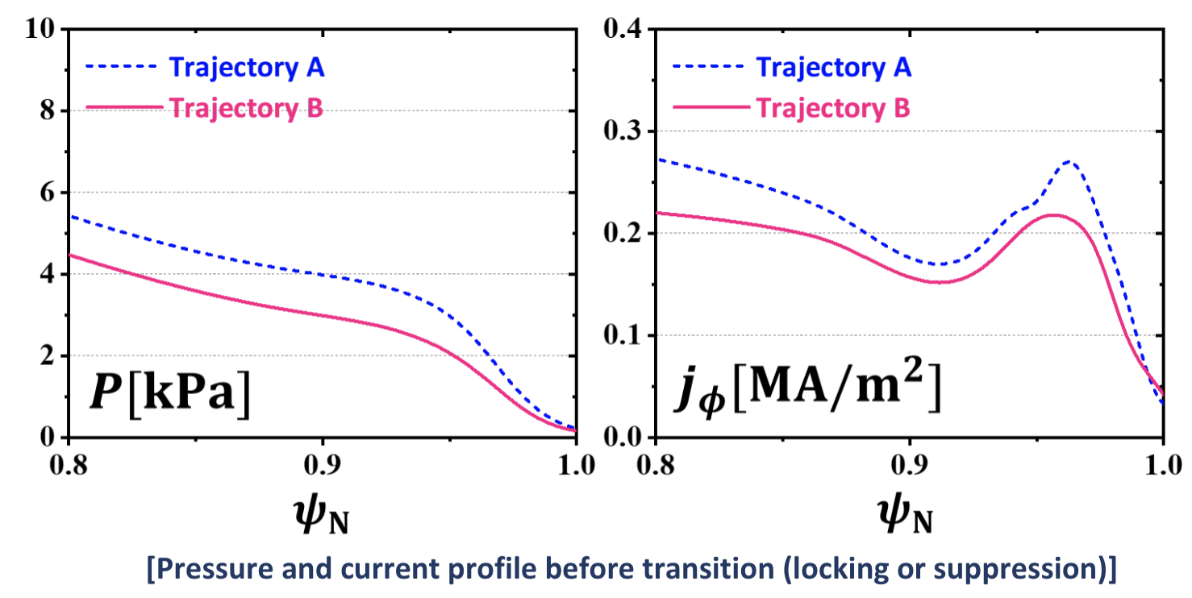
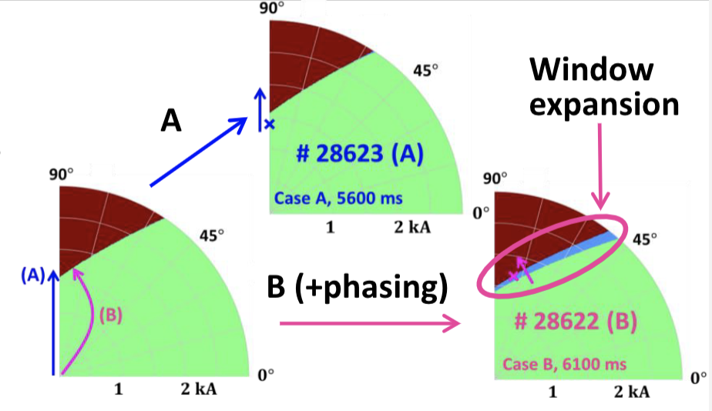
The suppression window is likely expanded due to drop in pedestal density in the phasing control discharge
(ask SK)
Feedback Phasing Control enables trajectory B in accessing ELM suppression
Trajectory A results in locking, while B results in suppression (other conditions are same)
Trajectory B results in larger pedestal density drop before locking
→ Suppression window likely expanded due to larger $δB_{r}$ response due to smaller pedestal

Slide 18
The controller is designed with two objectives: To be capable of achieving and sustaining ELM suppression, and to be flexible enough for physics exploration
Adaptive RMP ELM Controller
ELM detector

Slide 19
The D-alpha signal is used by the ELM detector to monitor ELM activity and inform the controller. The controller adjusts requested coil currents in feedback

