Slide 1
Practical Techniques for Machine Learning Control of Fusion Plasmas
Rory Conlin (PU/PPPL)
Joseph Abbate (PU/PPPL)
Laura Fang (PU)
Azmaine Iqtidar (PU)
Yunona Iwasaki (PU)
Aaron Wu (PU)
Egemen Kolemen (PU/PPPL)
APS DPP 2021
Mini-conference on Machine Learning in Plasma Sciences

Slide 2
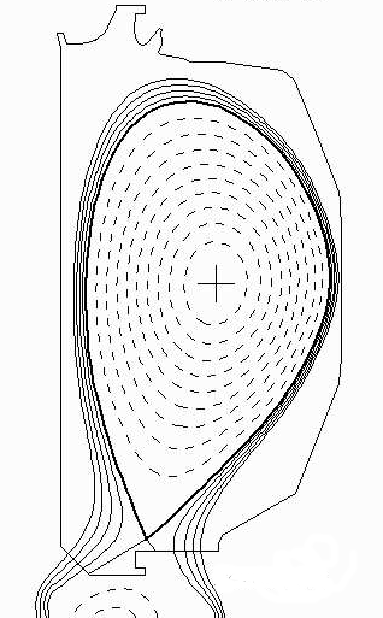
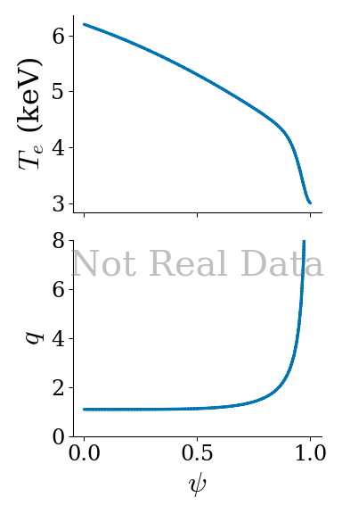
Want to control plasma state
Questions:
How do we control profiles?
Control oriented modelling via recurrent autoencoders
Can we be confident in our modelling?
ML uncertainty analysis
How do we infer the state of the plasma?
ML driven dynamical state estimation
𝜓
Full state of plasma determined by 1D profiles:
Pressure (P)
Current (J)
Electron temperature and density (T_{e}, n_{e})
Ion temperature and density (T_{i}, n_{i})
Rotation (𝛺)

Slide 3
Control oriented modelling
Neural nets can provide accurate models of plasma dynamics
Abbate, Conlin, Nuclear Fusion, 2021
Highly nonlinear models difficult to control
Number of possible actions grows exponentially with time horizon
Expensive to search for optimal action, limited real time applicability
Ideally want a simpler method for designing controller
Could learn controller directly - ie Reinforcement Learning
See GP11.00037, PP11.00150
Or take advantage of existing linear control theory
Lots of methods for optimal, robust control design
But need a linear model...

Slide 4
Plasma dynamics are nonlinear - use ML to get linear model
Traditional linearization uses Jacobian of f
Only valid locally (perhaps very locally)
Alternative - Learn nonlinear embedding to linear space
Linearly Recurrent Autoencoder Network (LRAN)
Can be valid globally
S. E. Otto and C. W. Rowley, 2019
Mezic, 2019.
Learn

Slide 5
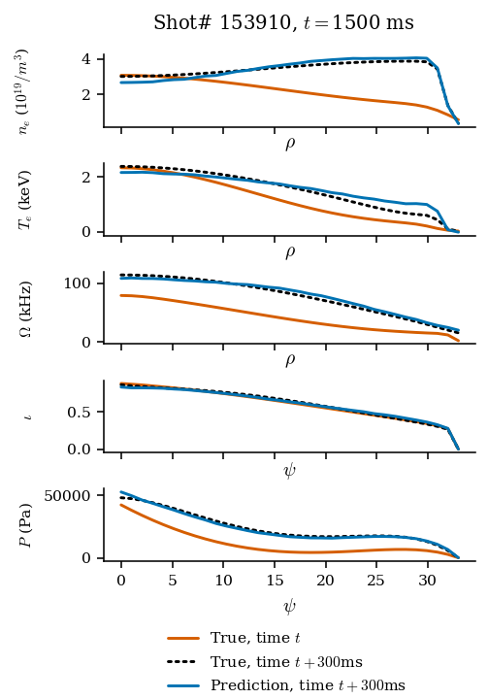
LRAN applied to profile prediction
Model trained on experimental data from DIII-D 2013-2018
Similar predictive performance to other models
cf Abbate, Conlin, 2021

Slide 6
Can apply linear control law in latent state
Encode both current state x_{t} → z_{t} and target state x_{ref} → z_{ref}
Apply standard linear control (eg LQR, H∞) techniques to find input u
Linear MPC framework is efficient (only requires solving small QP)
Can easily incorporate actuator and state limits

Slide 7
Offline tests demonstrate proof of concept
Test method
x_{ref}
z_{ref}
Encoder
x
z
NN simulator
u
MPC Controller
Initial
Target
Planned online test during upcoming DIII-D campaign
Autoencoder + MPC

Slide 8
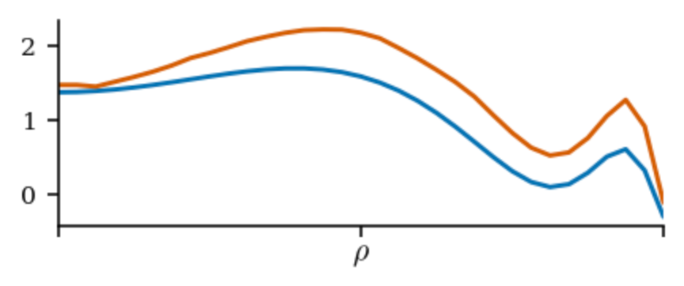
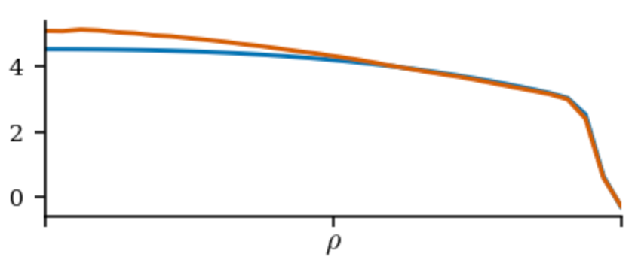
Predictions without uncertainty don’t mean much
Bad
How confident should we be?
How to tell good from bad without knowing ground truth?
Good
Notes:
Overall goal: how much can we trust the model?
Insert good vs bad plot
Then background

Slide 9
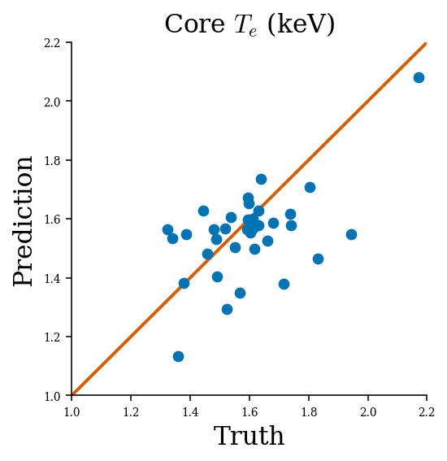
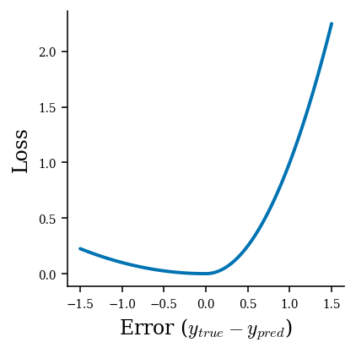
Train 2nd NN on magnitude of residuals
Loss function:
err = true - predicted
If error > 0: loss = err²
If error < 0: loss = 0.1*err²
Uncertainty estimate usually requires ensemble or Bayesian NN
expensive training and inference
Instead, train 2nd NN to predict distance to “true” value
“Swoosh” loss function similar to pinball for quantile predictions
Trained to estimate 95% confidence interval, can be modified to any quantile

Slide 10
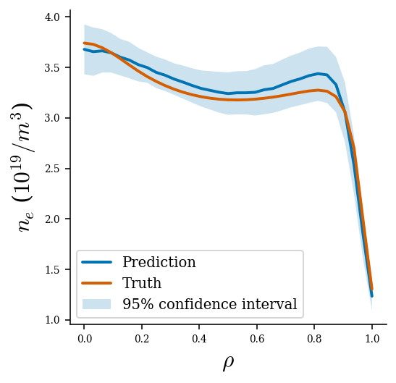
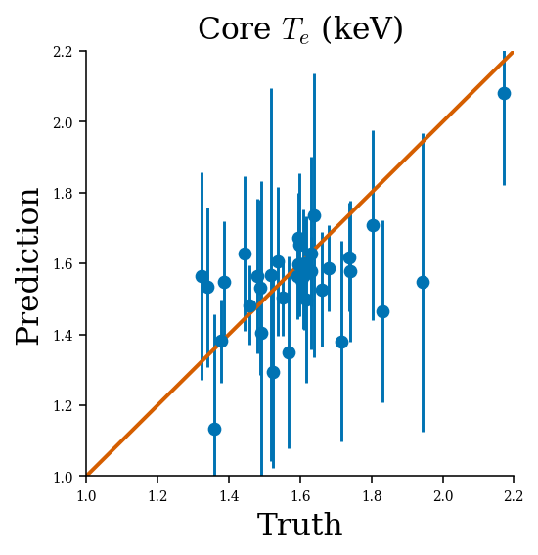
Confidence intervals overlap true values
Profile value
Scalar value

Slide 11
Uncertainty estimates are well calibrated
Probability Density
Predicted CDF matches well with true CDF
Predicted uncertainty neither over- or under-estimated
Predicted uncertainties lead to well normalized errors
CDF of true errors
CDF of predicted uncertainty
Notes:
Used the DNN predictions as approximations of the uncertainty of the ML predictions aka the std. Dev.
We can use this std. Dev to normalize the errors in the predictions the ML model was giving, and compare the distribution of these errs to a standard normal distribution. We want the err distribution to be as close to std Normal as possible, bc that means that there are no patterns in the mistakes our model is making that we could’ve accounted for, and our model isn’t consistently over or under predicting, which means our ML model is trustworthy/accurate
Calibration curve red line is what we want and ours is pretty close
And as a dif way to visualize we have the errs in a histogram, where the y axis is how frequently the err is a certain amount
Red is again a normal gaussian distribution and we see that ours are v close to that
Red line is what we’re targeting in the distribution
Model predicts correct distribution of uncertainties

Slide 12
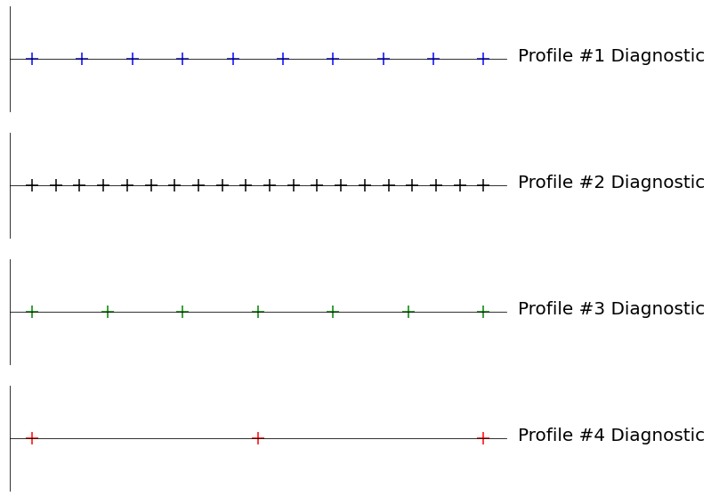
Prediction & Control requires accurate state estimate
Beyond single diagnostic “snapshot” analysis
Physics based models can be too slow / inaccurate
Can use ML dynamics model to infer state between sensor measurements
Bayesian inference too expensive for real time
use ML to approximate Bayesian inference for combining multiple diagnostics
Need efficient way to combine diagnostic information
Need dynamical model to estimate between measurements

Slide 13
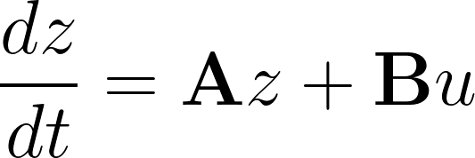
Use existing Autoencoder ODE to model dynamics
Instead of discrete time model
learn continuous time ODE:
Can integrate to predict state at any point in time
Output (measurement)is nonlinear function of state
Want to compute Bayesian update to z given y
very expensive
UKF, particle filters, etc
Can approximate using a NN

Slide 14
NN update can approximate Bayesian inference at low cost
Still WIP, early results promising
Bottleneck :
training continuous time models is slow
Limited parallelism, needs to be processed sequentially
Learn by minimizing
difference between prediction and measurement
difference between NN update and true Bayesian update

Slide 15
Summary & Future Directions
Using NN to find linear models opens many new (old) doors for designing controllers
Can also generate accurate uncertainty estimates at low cost
Can incorporate into controller via H∞ or PAC-Bayes framework
ODE based model has potential as basis for state observer
Accurate estimates needed for good control
Other related talks/posters:
TM10.00003 : Novel aggregate machine learning and transport modeling profile predictions
UM10.00003 : Machine Learning for Real-time Fusion Plasma Behavior Prediction and Manipulation
JP11.00140 : Uncertainty Quantification for Machine Learning Models in Plasma Physics
GP11.00037 : Controlling Plasma Profiles in a Learned Model via Reinforcement Learning
ZP11.00011 : Neural Dynamical Systems: Balancing Structure and Flexibility in Physical Prediction

Slide 16
Minimize combination of
encode/decode error
recurrent error in latent space

