Slide 1
Neural net modeling of equilibria in NSTX-U

Slide 2
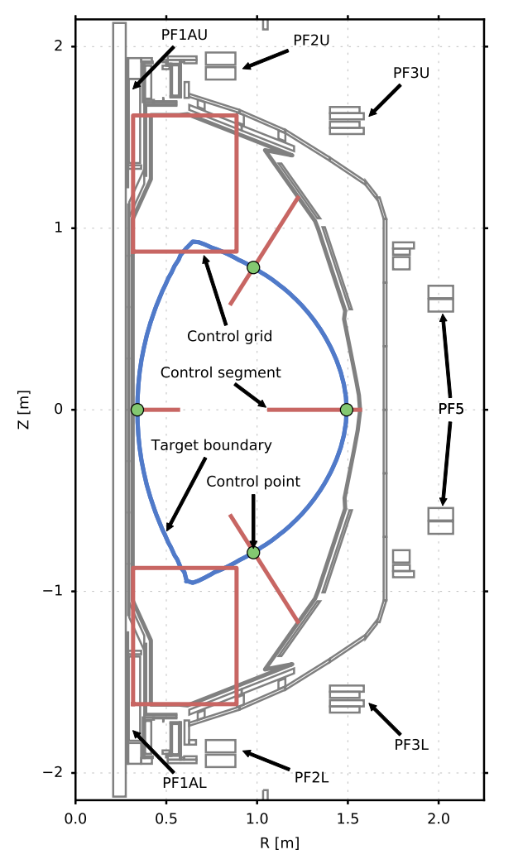
Background and definitions:
plasma equilibrium:
Description of the {plasma position, magnetic flux surfaces, currents, internal pressure, etc.} needed to characterize force balance.
shape control:
Model for controlling the plasma’s position and boundary shape, using external coils as actuators.
neural network (NN):
Computational tool that uses data to learn complex functions. Can approximate complex calculations quickly and accurately.
NSTX-U shape control elements. [1]

Slide 3
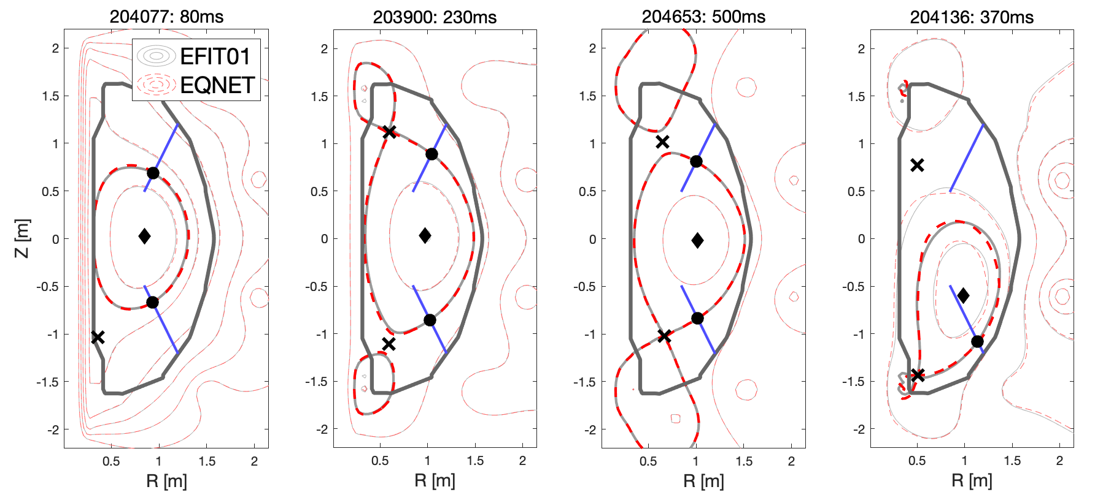
Trained two neural networks relevant to plasma control
J.T. Wai, M.D. Boyer, E. Kolemen, “Neural net modeling of equilibria in NSTX-U”, submitted to Nuclear Fusion, 2022.
Eqnet: NN capable of predicting the plasma equilibrium from either: diagnostics, or coil currents + plasma internal profiles. Trained on EFIT01 [13,14] data.
Pertnet: NN capable of predicting the plasma response—a critical component of the shape control model. Trained on Gspert code [15,16].
Motivation: Physics-based models for equilibrium design/estimation/control not fast enough or applicable to all desired use cases.

Slide 4
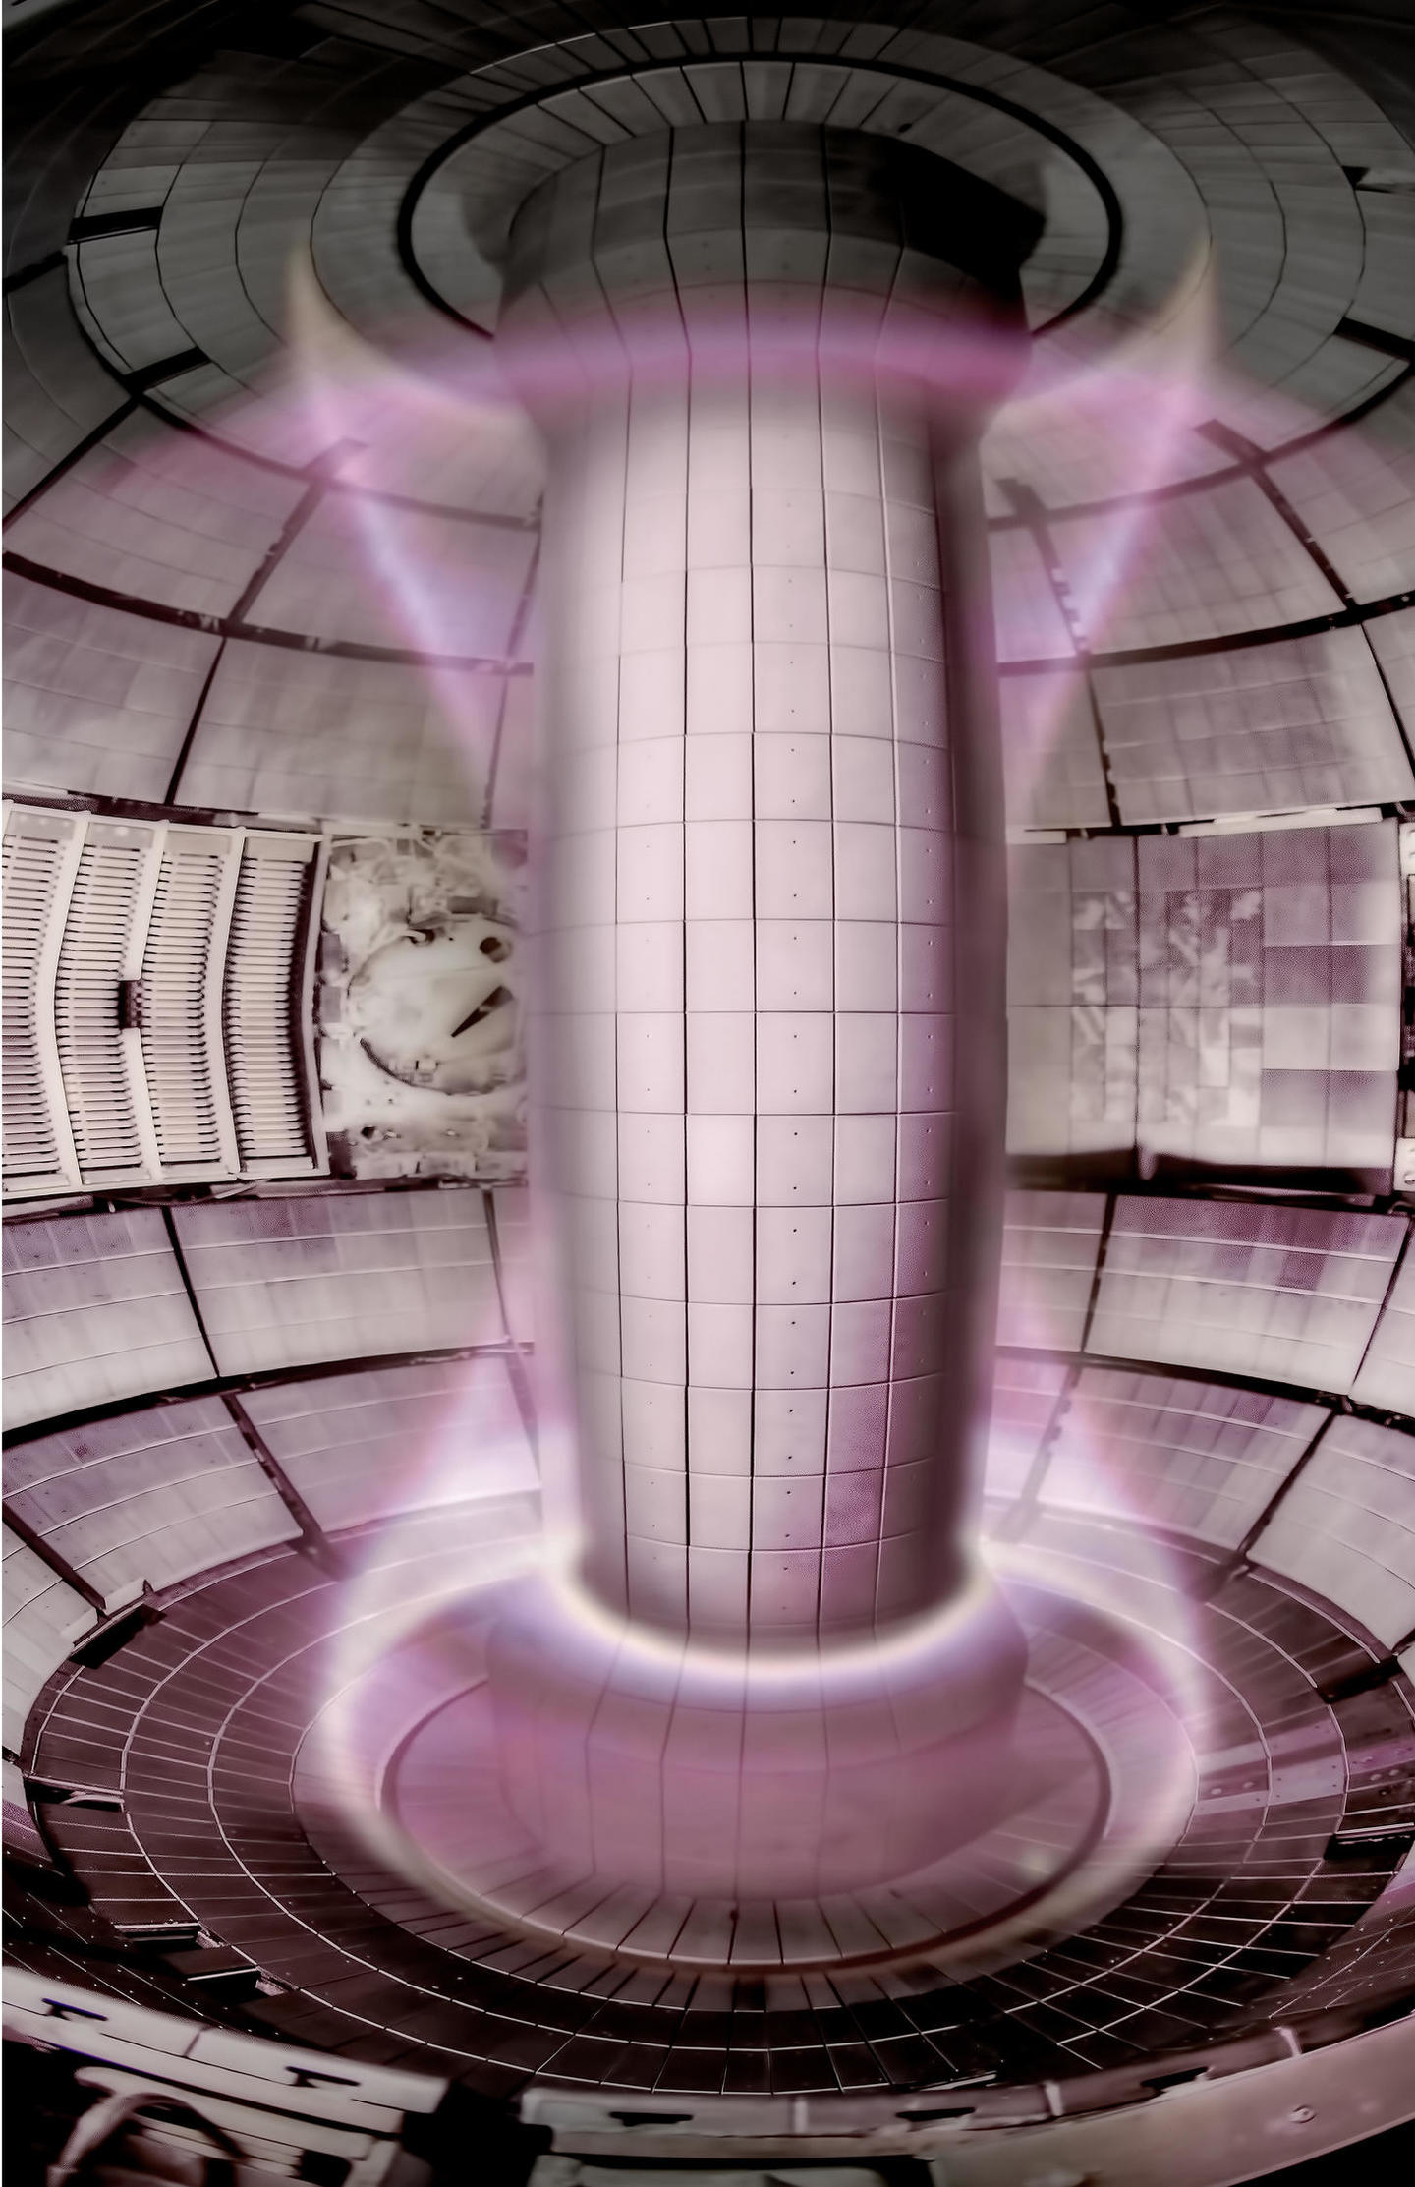
NNs will be integrated into several desired control applications
Between shot scenario design (Eqnet + Pertnet):
  Fast plasma simulator can inform physics operators, enables numerical optimization of actuator trajectories.
  Current ‘flight simulators’ not fast enough to run between shots.
  Integrate & supplement previous NN profile predictors [1,2]
Increased availability of equilibrium reconstruction (Eqnet):
  Real-time EFIT reconstruction unavailable early in the shot. Workaround uses a hybrid gap controller and isoflux controller but suffers oscillations during controller transfer.
  Simpler method to use a single isoflux controller – measurements can be supplied by NN when rt-EFIT not available.
Continuously monitor and update shape controller (Pertnet):
  Monitor vertical growth rate directly (as opposed to proxy parameters like elongation) and take corrective action if too unstable
  Provide real-time updates of the shape control model for better controller performance
NSTX-U tokamak with plasma. Source: pppl.gov

Slide 5
Eqnet: NN plasma equilibrium solver

Slide 6
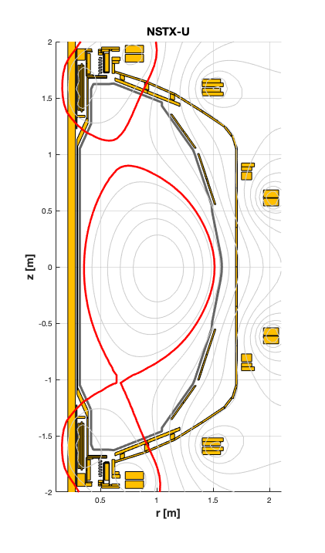
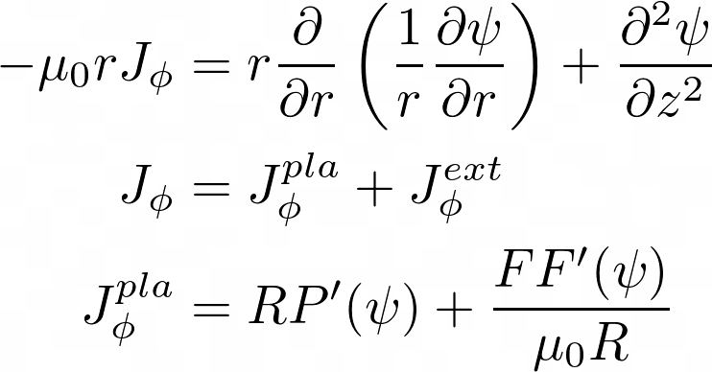

Plasma equilibrium describes force balance condition
The equilibrium describes the magnetic field structure of the plasma. Balance between outward pressure force and inward JxB force.
In a tokamak, the equilibrium is described by the Grad-Shafranov equation
$$J × B= ∇P$$
Magnetic field lines lying on flux surfaces.
204653 NSTX-U equilibrium

Slide 7
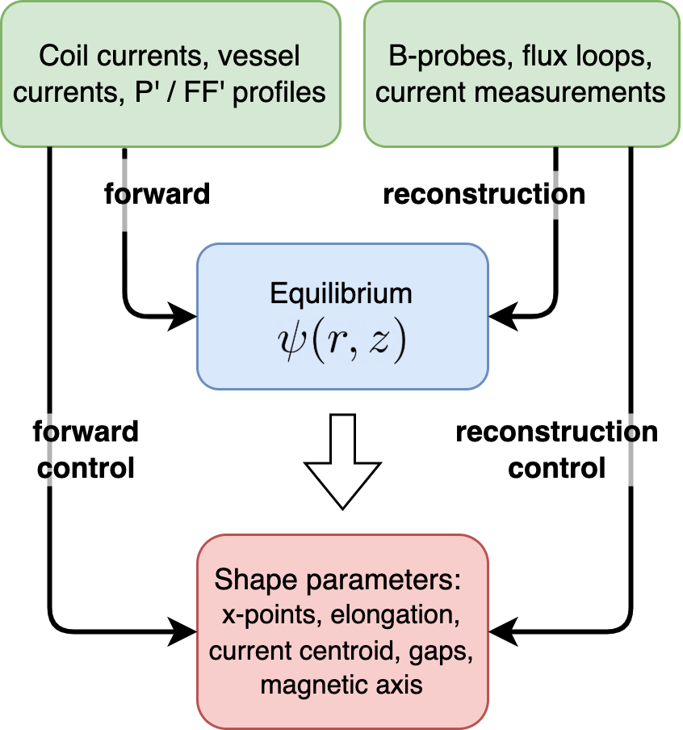
Eqnet: a neural network equilibrium solver
Solving the free-boundary Grad-Shafranov equation is a nonlinear, iterative computation.
  Iterate between updating the plasma current, externally applied field, and flux.
Eqnet is a neural net version of this process. Can work in different modes (data inputs and outputs): forward solver and reconstruction.
Also trained to predict parameters directly, for use as a control estimator. Similar to previous NNs [3-11]

Slide 8
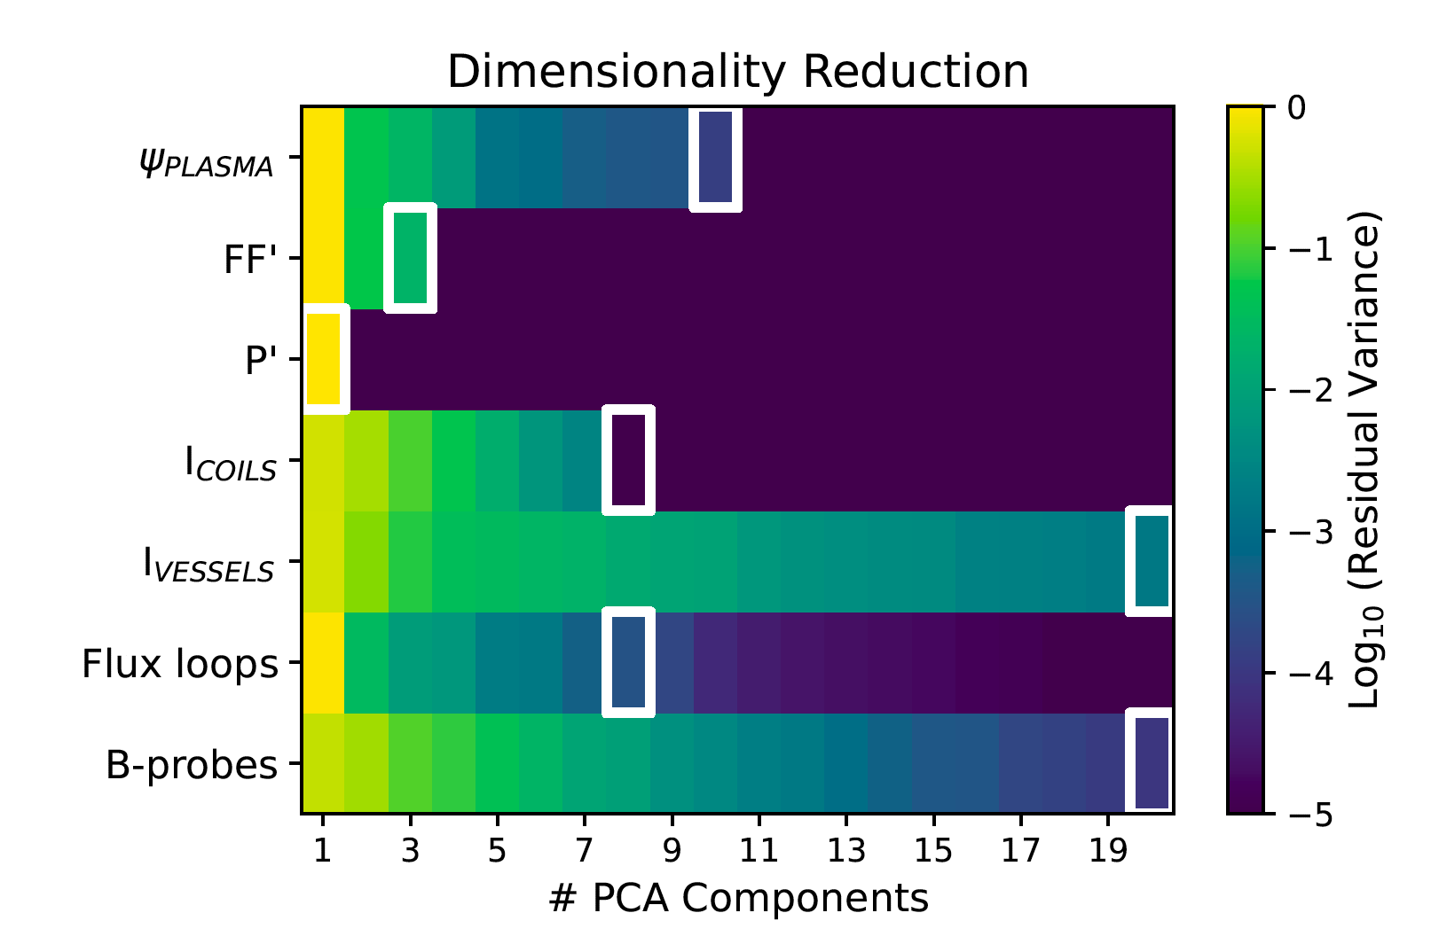
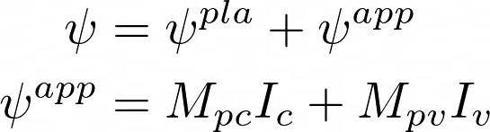
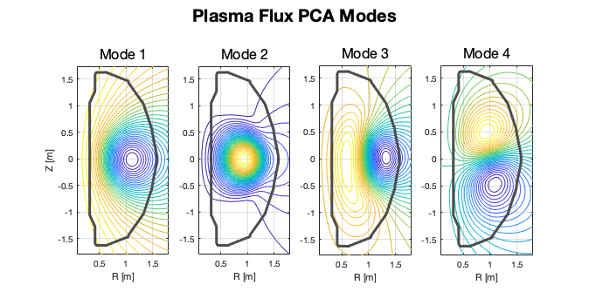
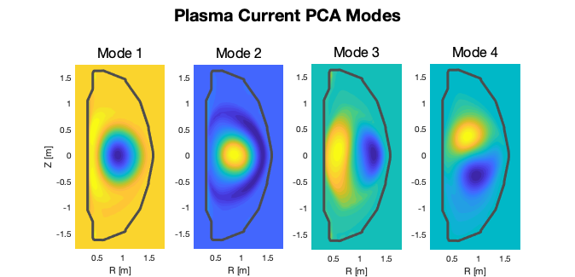
Data inputs and outputs are compressed using Principal Component Analysis (PCA)
Data inputs and outputs are compressed using PCA to capture 99.5% variance
Goal is to predict equilibrium ѱ but more accurate to predict ѱ^{pla} since applied flux is known.
PCA on ѱ^{pla} : (65x65 grid) → 11 modes
  Results are intuitive and can match a wide range of equilibria (limited, lower null, upper null, off-normal)
Number of PCA components used. Outlined box indicates >99.5% captured variance.

Slide 9
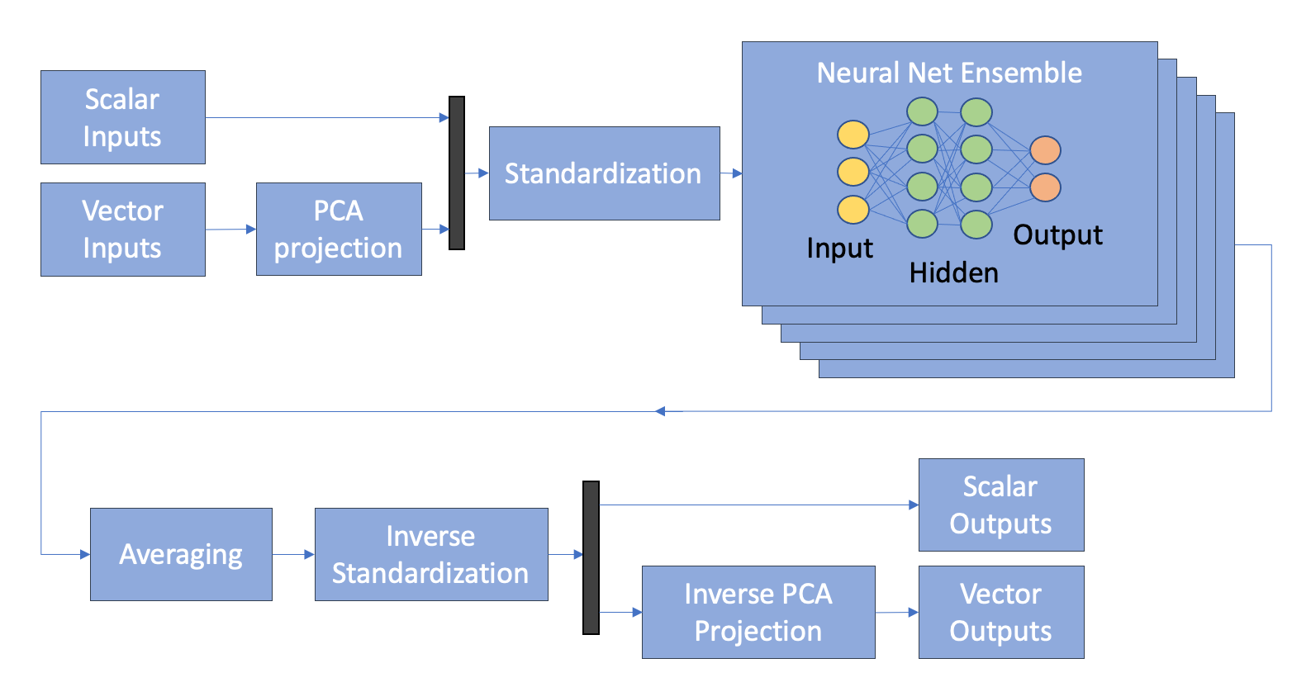

Eqnet architecture is based on a fully-connected NN
Neural network – tool for approximating many types of functions y = f(x). Has many parameters or weights, w. During training weights are tuned so that predicted outputs match target outputs.
X_{train} = coil currents, vessel currents, P’ / FF’ profiles
Y_{train} = ѱ^{pla}
Data is from EFIT01 [13,14] magnetics-only reconstruction of 2015-2016 NSTXU campaign. 220 shots & 25,000 equilibria
Divided 80-10-10 by shot number into train, validation, test datasets
Fig 1: Neural net and data architecture. The core of the model is a fully-connected NN.

Slide 10
Grid scans used to optimize hyperparameters
Hyperparameters of the neural network found by performing grid scans
Final result is a fully-connected network
  8 hidden layers, size 800, ELU activation
Hyperparameter grid scans
Typical loss curve from NN training

Slide 11
High agreement of flux surfaces is verified visually
204125
Flux surfaces predictions capture a wide range of equilibria with high accuracy (median x-point error 4mm)
Shape parameter predictions.
Eqnet Fwd = parameters extracted from NN flux predictions.
Eqnet Fwd-Ctrl = parameters predicted directly by NN.
Notes:
What are the inputs? Completely describe figure – crosses, dots, etc

Slide 12
Eqnet predictions of features have errors <1cm
Majority of predictions <1cm and within the range of EFIT01 accuracy
Multiple-cm errors do occur:
larger than desired for control and simulation purposes
however, these happen during oscillatory dynamic phases (e.g. 68% errors >3cm occur within first or last 100ms)
Shape parameter prediction performance
 | Rx, lo | Zx, lo | Rcur | Zcur
Root-Mean-Squared-Error | 5.6mm | 7.5mm | 9.0mm | 9.0mm

Slide 13
Pertnet: NN calculation of the plasma response

Slide 14
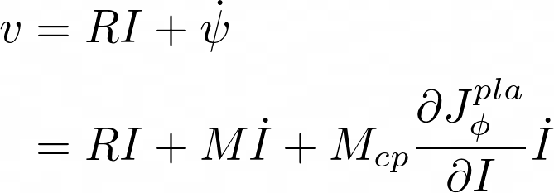
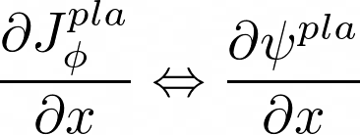
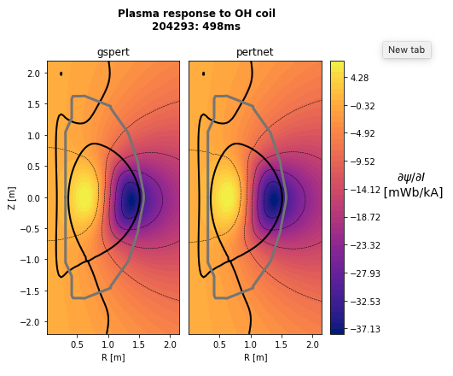

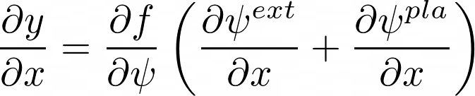
The plasma response describes how the plasma redistributes in response to external perturbations
If a coil current is perturbed slightly, it changes the magnetic field so that there is a force exerted on the plasma. Response = how does the plasma current shift and redistribute in response to this force.
Plasma response is an integral part of the shape control circuit model, which describes the evolution of coil and vessel currents.
Also needed to describe how shape parameters respond to actuators.
Can also be used to calculate the growth rate of the plasma vertical instability (related to eigenvalue of circuit equation).
Notes:
Streamline delivery
SEED CURIOUSITY GROWTH RATE

Slide 15
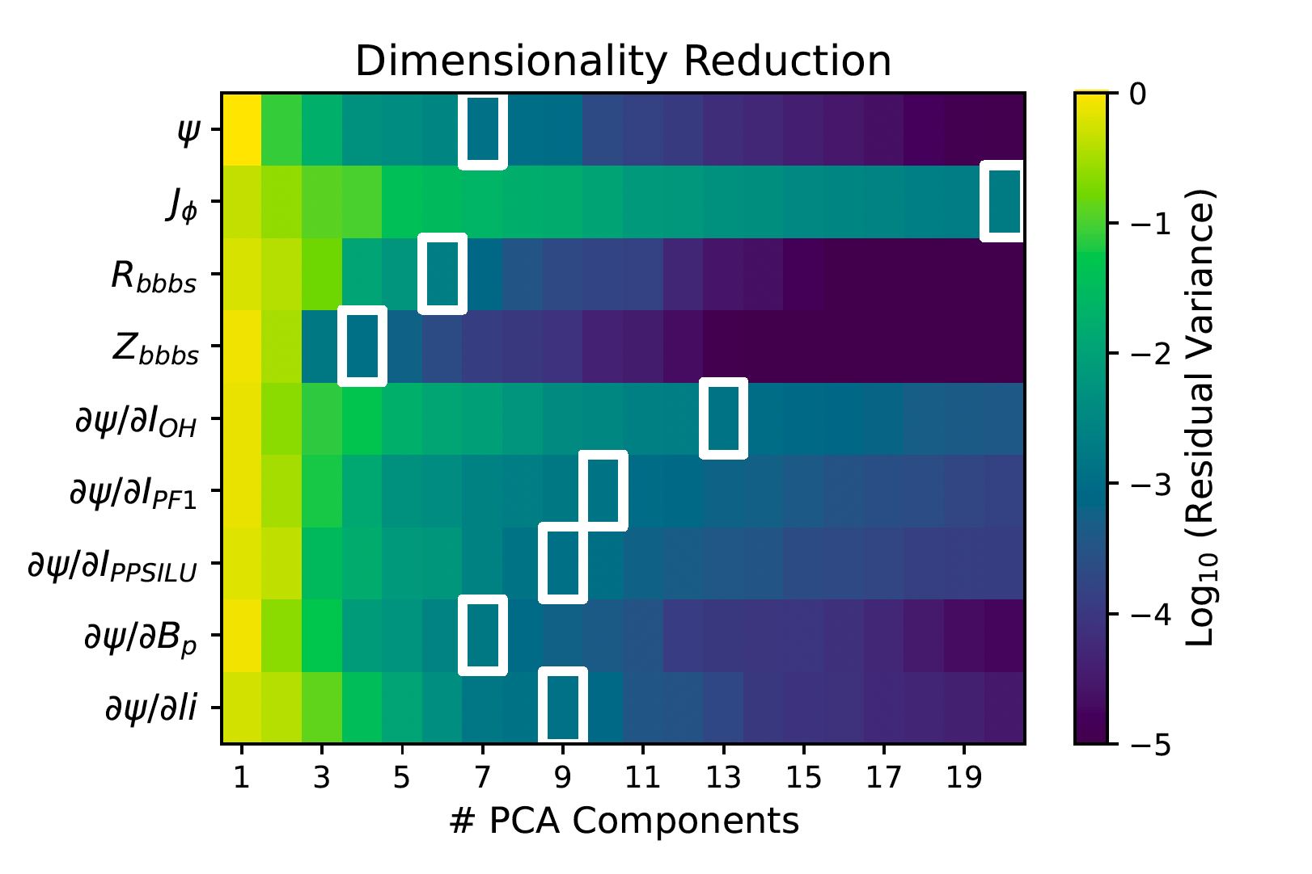
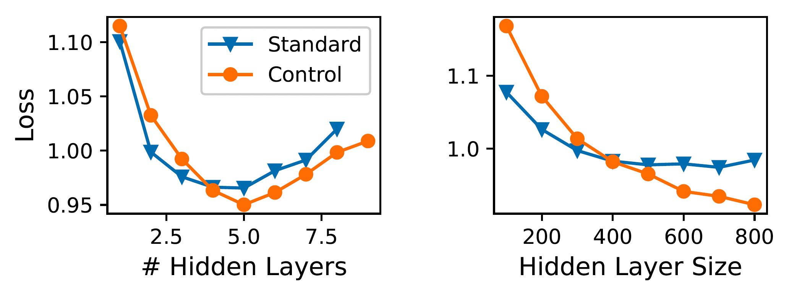
Pertnet utilizes similar data and network architecture to Eqnet
Ground truth is taken from gspert code [15,16] applied to EFIT01 equilibria.
Similar data and NN architecture to Eqnet. Input is a full description of the equilibrium.
Pertnet hyperparameter tuning
Notes:
Controller will bring y to a target value, having access to dy/dx describes the complete model!

Slide 16
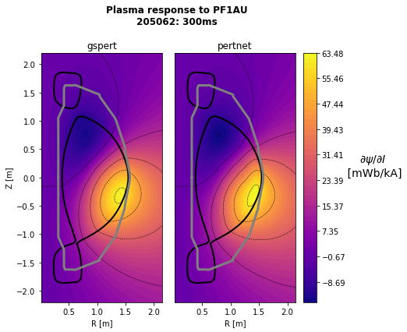
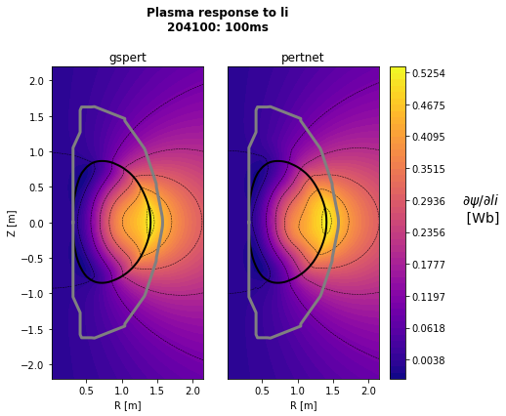
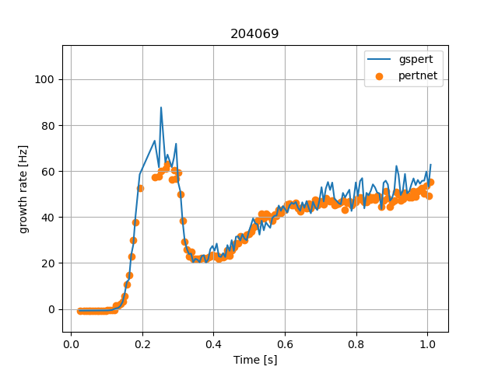
Flux response gives high visual agreement with Gspert code

Slide 17
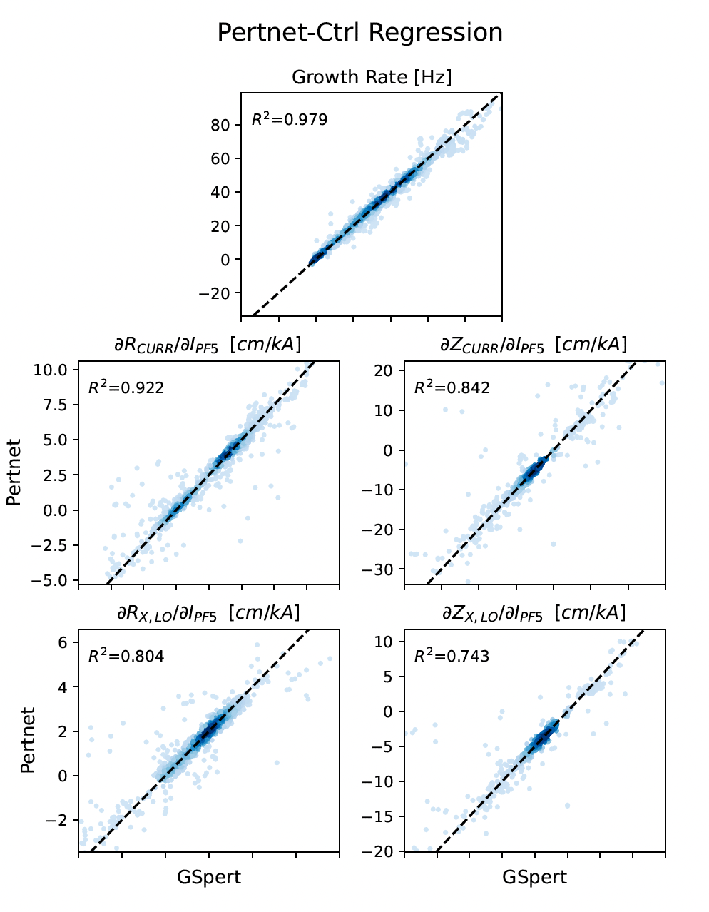
Vertical growth rate predicted within 3Hz deviation from Gspert
Neural net captures most trends, some scatter in predictions.
Again, worst predictions occur during dynamic oscillatory periods of shot. (5% worst predictions all within 200ms of shot start/end)
RMSE: growth rate=3Hz, dzx/dI = 2.7cm/kA.
Pertnet
GSpert

Slide 18
Next steps

Slide 19
Conclusion & next steps
Successfully demonstrated reliability and performance of equilibrium and plasma response neural networks.
Couple these to profile predictors for fast integrated transport+shape simulation capabilities.
Integrate into optimal planning of feedforward coil current trajectories to achieve a target shape evolution.
Online shape control updates and vertical stability monitoring – when NSTXU is ready!
J.T. Wai, M.D. Boyer, E. Kolemen, “Neural net modeling of equilibria in NSTX-U”, submitted to Nuclear Fusion, 2022.
[1] M. Boyer, J. Chadwick, Nuclear Fusion, 61 (2021) 046024.
[2] M. Boyer, et al., Nuclear Fusion, 59 (2019) 056008.
[3] E. Coccorese, Nuclear Fusion 34 (1994) 1349-1363
[4] J. Lister, Nuclear Fusion 31 (1991) 1291-1300
[5] R. Albanese, Fustion Technology 30 (1996) 219-236
[6] C.M. Bishop, Neural Computation 7 (1995) 206-217
[7] L. Lagin, Elsevier, (1993) 1057-1061
[8] Zhu, Chinese Physics B 28 (2019), 125204
[9] A.A. Prockhorov, IFAC 53 (2020) 857-862.
[10] B. Wang, J. Fusion Energy 35 (2015) 390-400.
[11] S. Joung, Nuclear Fusion 60 (2019) 016034.
[12] B.P. van Milligen, PRL 75 (1995) 3594-3597.
[13] L.L. Lao, Nuclear Fusion 25 (1985) 1611-1622
[14] S. Sabbagh, Nuclear Fusion 41 (2001) 1601-1611
[15] A. Welander, Fusion Science and Technology, 47 (2005) 763-767.
[16] A. Welander, Fusion Engineering & Design 146 (2019) 2361-2365.
Acknowledgements:
This work supported by DOE contract DE-SC0015878 and DE-AC02-09CH11466.

