Slide 1
Stellarator Optimization with DESC
R. Conlin, D. W. Dudt, D. Panici, E. Kolemen
August 1, 2022
2022 Conference on Computational Physics

Slide 2
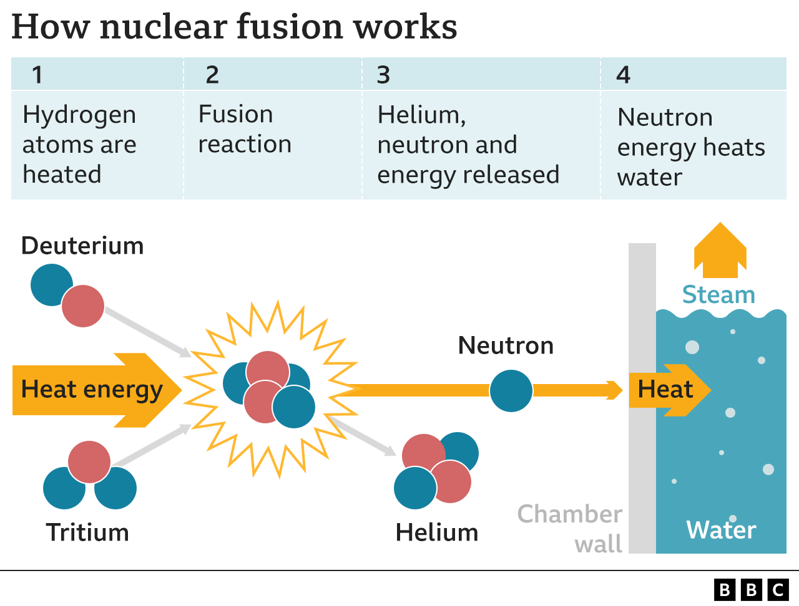
Nuclear fusion could help solve the global energy and environmental crises
Sustainable fuel supply
No greenhouse gas emissions
No long-lived radioactive waste
No risk of runaway reactions
No risk of nuclear proliferation
Firm generation source

Slide 3
How to confine a plasma
Fusion reaction requires extremely high temperatures (O(1e8 K))
How to confine hot fusion plasma in place?
Magnetic confinement - use Lorentz forces
Charged particles orbit magnetic field lines
charged particle motion with magnetic field
without magnetic field
Jason Ginsberg
Notes:
Carbon free energy source where two isotopes of hydrogen are fused together, releasing energy
This reaction requires very high temperatures, on the order of 100 million deg C
gas -> plasma
This means they react to electric and magnetic fields, so…
Click
can use magnetic fields to confine them without physical contact

Slide 4
Magnetic Confinement Geometry
B
B
B
𝛁B
B
X
+++++++++++++
+-+-+-+-+-+-+-+-
E
v_{ExB}~ E/B
-----------------------
Notes:
What geometry should we use to confine plasma?
Simplest is a solenoid, but there is a problem: the Lorentz force only acts on a particle moving perpendicular to B
so the plasma is free to stream along the field lines and out the ends of the device
A solution to this is to plug the end losses by wrapping the solenoid on itself -> toroidal confinement
BUT, still have issues!
curvature and B gradient introduced lead to vertical drifts of the ions and electrons
this causes charge separation to build in the plasma, forming an E field
the particles in a crossed E and B field experience an ExB drift, causing them to drift out of the plasma and into the surrounding walls (which normally don’t contact the bulk plasma) very quickly -> loss of confinement
The solution: twist the B field poloidally
this effectively averages out the vertical drifts, preventing the charge separation
this Rotational transform can be created 2 ways:
----------------------------------------------------------------------------------------
Curvature force is Mv_parallel ^2 / R, pointing in curvature radius direction (outwards!!)

Slide 5
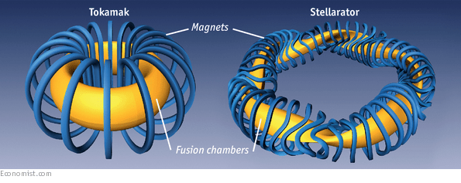
Magnetic Confinement Devices: Tokamak vs. Stellarator
https://www.economist.com/science-and-technology/2015/10/24/stellar-work
Tokamaks
Axisymmetric
Simpler geometry
Guaranteed particle confinement
Due to Noether’s Theorem
Requires substantial plasma current
Must be driven
NOT steady state!
Source of free energy for instabilities -> disruptions
Stellarators
Inherently 3-D
Complex geometry and coils
Confinement not guaranteed
certain fields exist which recover this (Quasisymmetry)
Larger design space
Does not need plasma current
Steady state
No disruptions
Notes:
Read bullet points from left to right
Tokamaks – current is NOT steady state, inherently pulsed device

Slide 6
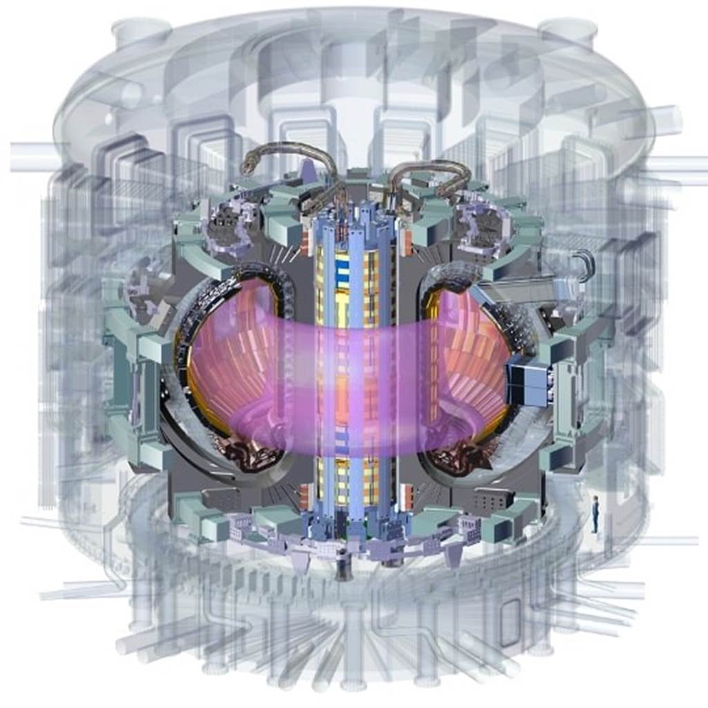
Plasma Equilibria: What and Why?
Plasma Equilibrium: Configuration of magnetic fields that describes a plasma in steady-state
Reactor Design and Optimization
Experimental Reconstruction
Necessary for ANY plasma physics studies
Particle Transport
Stability
https://www.ansys.com/news-center/press-releases/ansys-enables-iter-organization-design-worlds-largest-highly-sustainable-nuclear-fusion-power-plant
Notes:
Optimize equilibrium for desirable properties like fusion power etc -> need to be able to calculate equilibria
Then when you have a built experiment, you can only measure a subset of the plasma parameters directly
calculating plasma equilibria allows you to infer what the unmeasured quantities are based off of what you can measure
It provides the magnetic field geometry which you need before doing any other analysis
Bottom line: Using magnetic equilibria are an everyday task in the life of a plasma physicist, so we want to be able to calculate them quickly and accurately

Slide 7
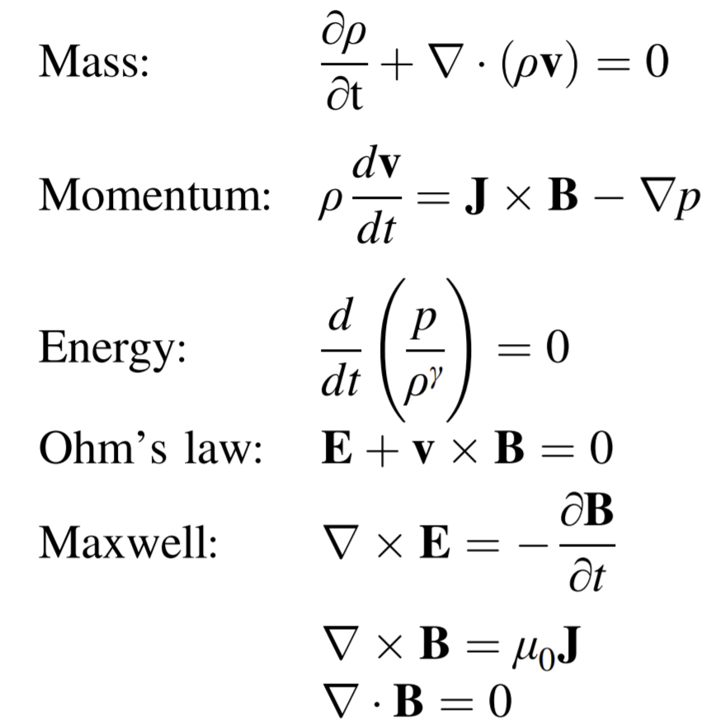
Plasma Model – Ideal MHD
𝜌 | Ion Mass Density
v | Ion Flow Velocity
p | Pressure
B | Magnetic Field
J | Current Density
Freidberg Ideal MHD (2014)
Notes:
Is essentially Navier-Stokes coupled with Maxwell’s equations, with a large list of assumptions made to render the equations tractable to solve
The main assumptions are:
Low-frequency meaning we neglect the displacement current (interested in frequencies lower than the scale at which light waves propagate)
So we are using the low-frequency Maxwell’s equations, without displacement current
We do this to restrict ourselves to the macroscopic motions on the timescale of the ion movement (which is much slower than electrons
Timesacle is a/v_ti ~ 1 microsecond (I think), while the scale we ignore is 2pi/w_pe ~ 1E-11 s (much faster)
Long Wavelength – length scale is larger than the plasma debye length, (ion debye length is the dominant one), so the fluid is quasineutral
Neglecting electron inertia
mass is ion mass density
velocity is ion fluid velocity
so we consider timescales on which electrons react infinitely fast
Debye Length

Slide 8
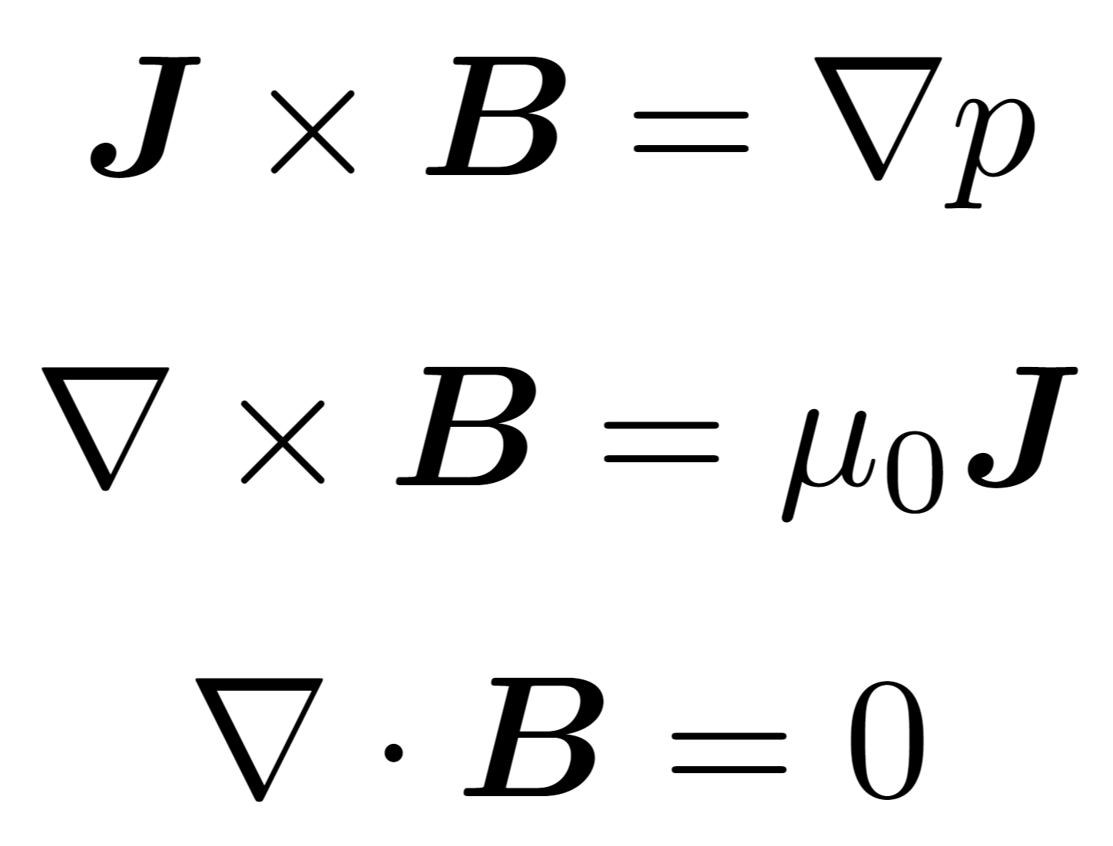
Plasma Model – Ideal MHD Equilibrium
Freidberg Ideal MHD (2014)
Notes:
Ideal MHD equilibrium further assumes steady state and no macroscopic flows
Experiments have flows
Model has proven to predict experiments well
And at the end of the day that is what you want from a model
This is what is used for the majority of plasma equilibrium calculations
And what we will focus on
Transition, shows the LHS then RHS appears?
Static – no macroscopic flows
Is a simplifying assumption, problem is much more complex with flows
Although experimentally, substantial plasma flow has been measured
Static equilibria have been used with great success in describing experiments
Mass continuity is now decoupled because rho no longer appears in the other equations, so we do not need to consider mass continuity in our system

Slide 9
Ideal MHD Equilibrium - What Do the Equations Tell Us?
Notes:
Physically, the force balance tells us…
Simple 1D example is an infinitely long, rotationally symmetric cylindrical plasma with current running axially, called a Z-pinch
Additionally, we can see that by taking dot products with B and J, that both these fields lie on surfaces of constant pressure CLICK
these are called ‘flux surfaces’, and are surfaces upon which the B field is everywhere tangential. Shown here are the flux surfaces for this 1D example
Read words

Slide 10
Solve the “inverse” equilibrium problem for the shapes of the flux surfaces

Slide 11
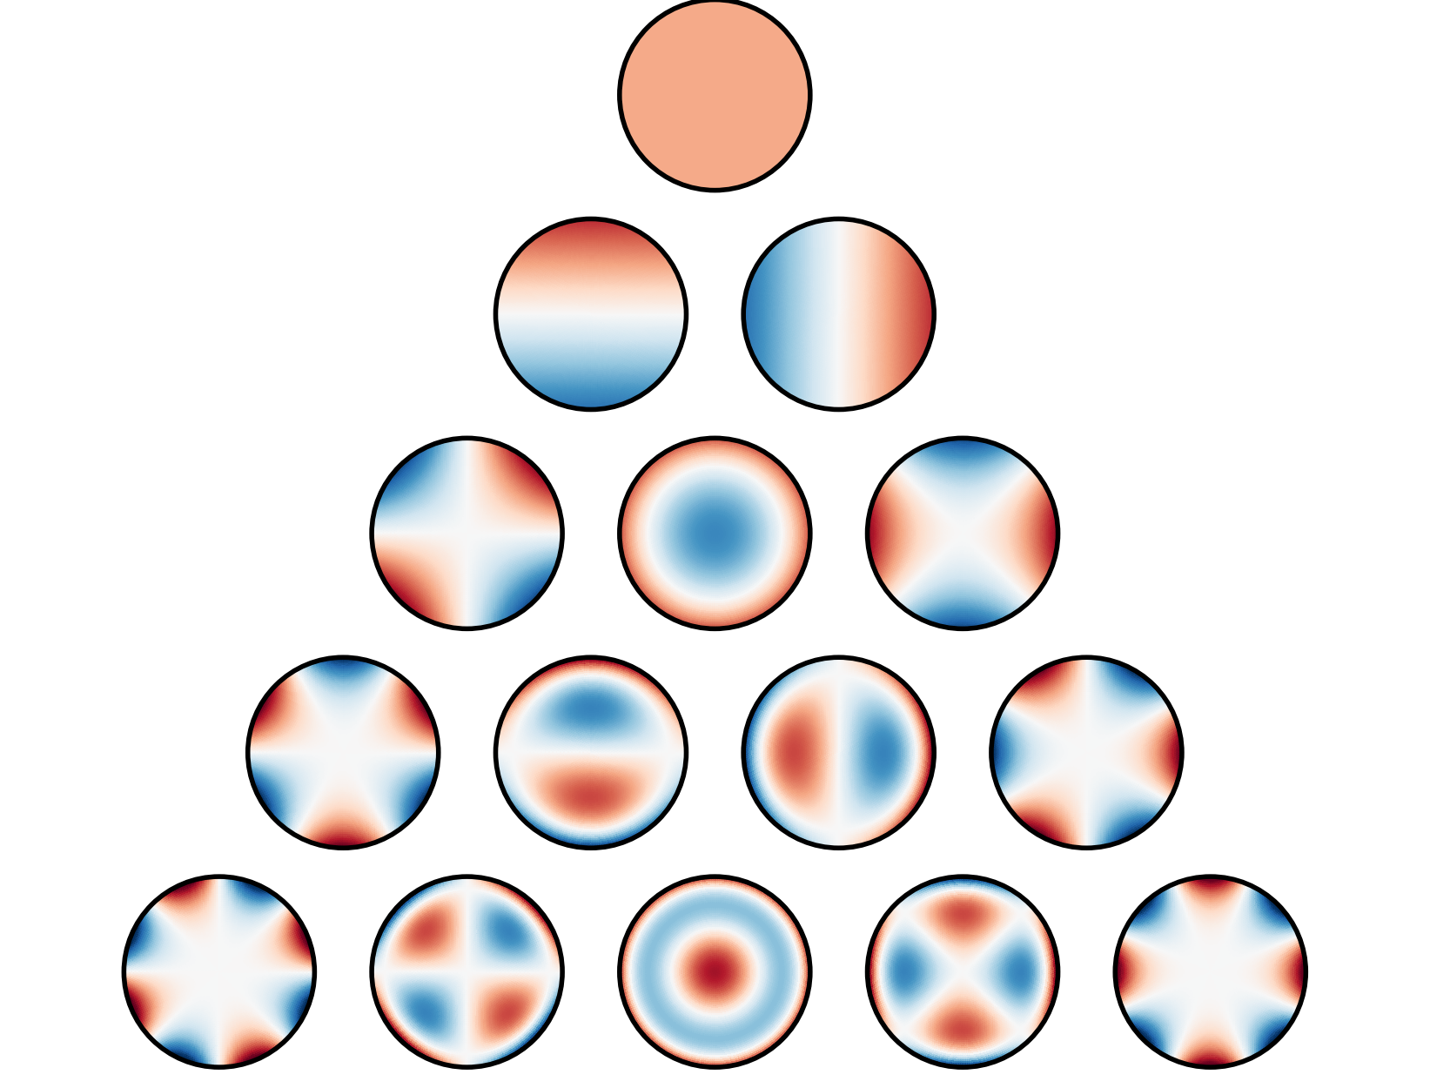
Solution is represented with global Fourier-Zernike^{1,2} spectral basis functions
spectral coefficients
Zernike polynomials
Fourier series
one-sided Jacobi polynomials
¹Zernike, Mon. Not. R. Astron. Soc. (1934).
²Loomis, ASTM STP (1978).

Slide 12
The global Fourier-Zernike basis is well suited for the toroidal domain
³Boyd et al., J. Comput. Phys. (2011).
⁴Lewis et al., J. Math. Phys. (1990).

Slide 13
The MHD equilibrium equation is solved using a pseudo-spectral collocation method
equilibrium force balance equations evaluated in real space
errors evaluated at a set of collocation points
spectral coefficients
boundary conditions

Slide 14
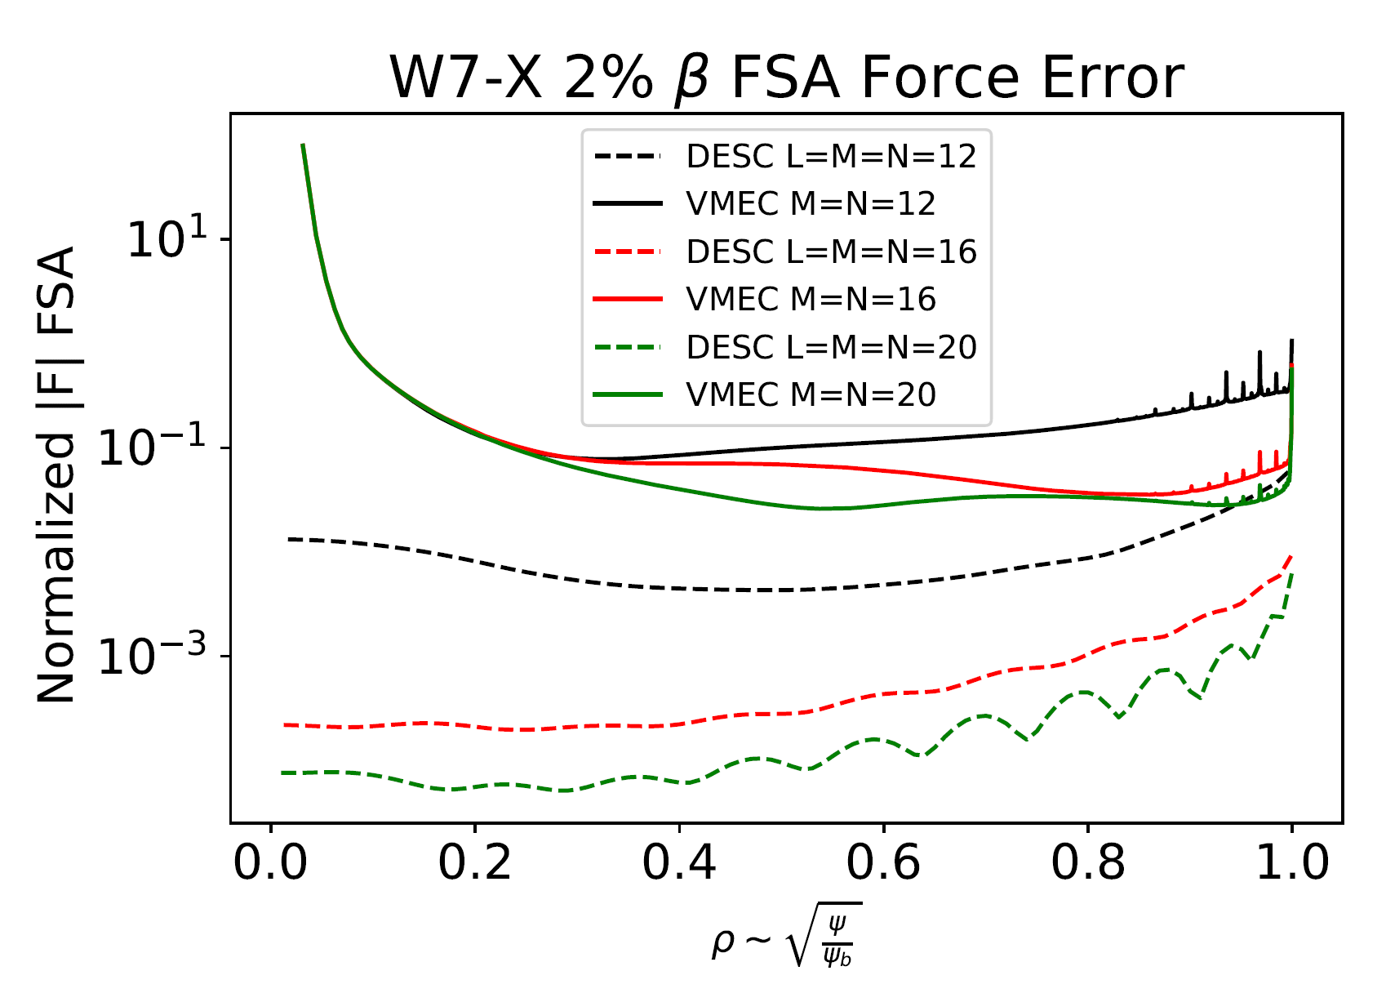
DESC achieves lower error than VMEC
Comparison to VMEC [Hirshman, 1983]
Orders of magnitude lower error, especially near the axis
For more details, see D. Panici, Quick and Accurate 3D MHD Equilibria with DESC
this session

Slide 15
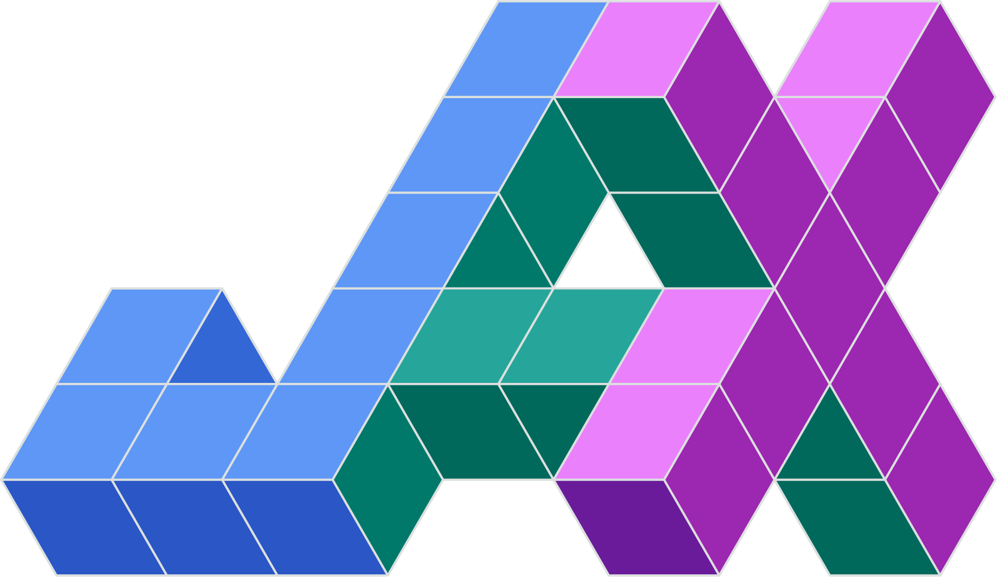
Utilize JAX for automatic differentiation and JIT compilation
https://github.com/google/jax

Slide 16
Automatic differentiation enables efficient perturbations about equilibrium solutions
1st-order Taylor expansion:
Jacobians computed with AD
new equilibrium solution

Slide 17
Autodiff allows efficient computation of high order expansions

Slide 18
Example: perturbations compute parameter scans "for free"
Conlin et al. Nuclear Fusion (under review)

Slide 19
Continuation method example: from axisymmetry to 3D stellarator boundary
Intermediate solutions
Initial solution axisymmetric boundary (tokamak)
Final solution
strongly shaped stellarator
Strength of 3D modes
Conlin et al. Nuclear Fusion (under review)

Slide 20
Can optimize parameters while maintaining the equilibrium constraint
Taylor expansion:
equilibrium perturbation
least-squares problem:

Slide 21
Quasisymmetry
Quasisymmetry is a minimal property of the magnetic field for the dynamics of charged particles to exhibit an approximately conserved momentum (in gyro-ordering) [Rodriguez 2022]
Can be described by the appearance of magnitude of B in Boozer coordinates
Quasi-poloidal Quasi-helical Quasi-axial

Slide 22
Multiple Quasi-Symmetry (QS) metrics

Slide 23
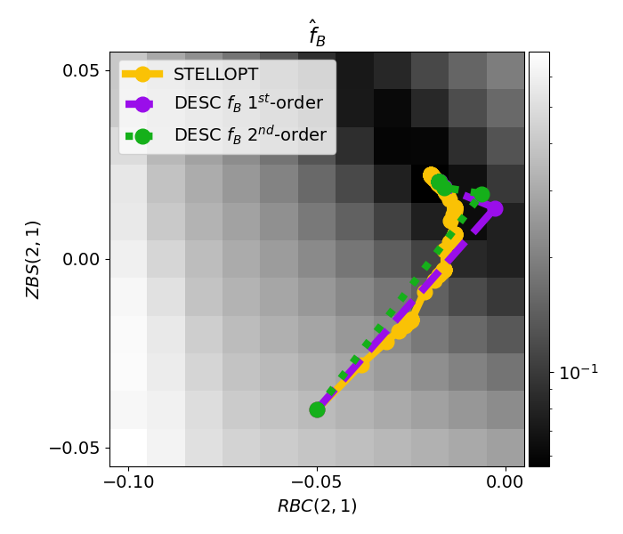
Optimization example: optimizing two boundary modes to improve quasi-symmetry
Benchmark code: STELLOPT⁶
Levenberg-Marquardt optimization algorithm
Finite differences through VMEC equilibria + other code to compute quasi-symmetry cost
“1st-order” expansion is 2nd-order in the scalar optimization cost
Dudt et al. Nuclear Fusion (under review)
⁶Spong et al., Phys. Plasmas (1998).

Slide 24
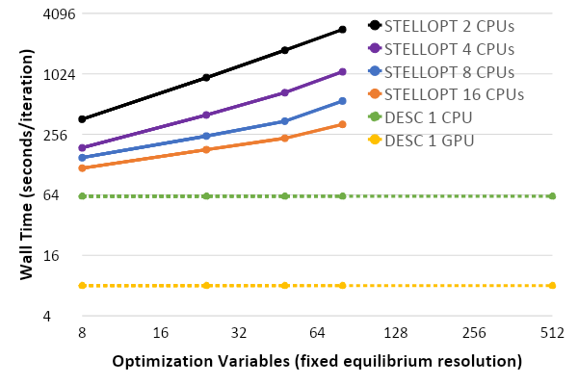
DESC achieves orders of magnitude faster stellarator optimization times
Finite difference gradients scale with the number of optimization variables
Automatic differentiation time is only dependent on spectral resolution
CPU/GPU time per iteration (80 variables)
STELLOPT | ~ 1.4 hrs
DESC (CPU) | ~ 1 min
DESC (GPU) | ~ 8 sec

Slide 25
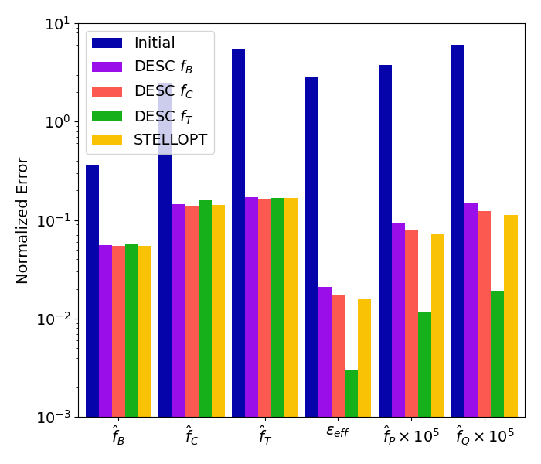
QS has a complex correlation with transport
Neoclassical ripple ε_{eff} computed from NEO
Particle & heat fluxes f_{P} & f_{Q} computed from SFINCS
Similar levels of QS don’t always mean similar levels of transport
Triple product metric may give better results

Slide 26
Reproduce “precise QH” SIMSOPT result
Example QH optimization adapted from Landreman and Paul, Phys. Rev. Lett. (2022)

Slide 27
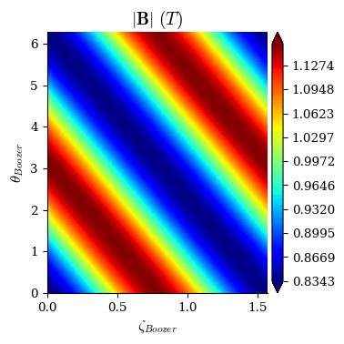
Reproduce “precise QH” SIMSOPT result
Achieved same order of magnitude of QS error
Compute time:
SIMPSOPT (CPU): ~ 5 hrs
DESC (CPU) : 22 min
DESC (GPU): 7 min

Slide 28
Summary
Equilibrium solver is more accurate than VMEC
Optimization is faster than STELLOPT
Automatic differentiation enables advanced analysis tools
Easy to install and use
Software
Open-source repository: https://github.com/PlasmaControl/DESC
Python package: pip install desc-opt
Papers
The DESC Stellarator Code Suite Part I https://arxiv.org/abs/2203.17173
The DESC Stellarator Code Suite Part II https://arxiv.org/abs/2203.15927
The DESC Stellarator Code Suite Part III https://arxiv.org/abs/2204.00078

Slide 29
Backup

Slide 30
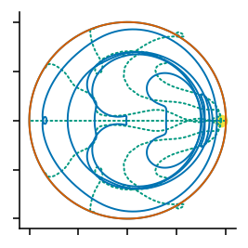
Trust region method regularizes perturbation step
When perturbations are large or curvature is strong unconstrained step can be too large, leading to non-physical results
Don’t want exact solution to approximate model

Slide 31
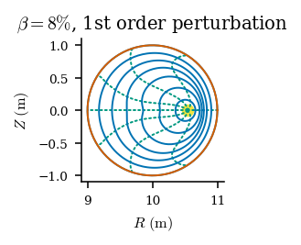
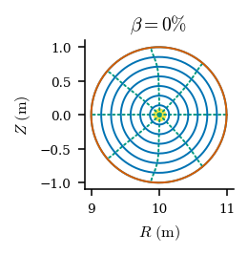
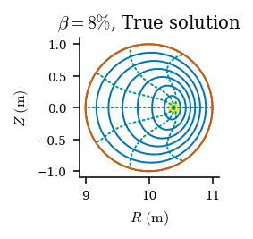
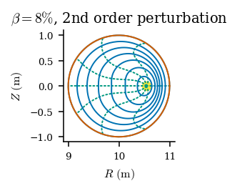
2nd order perturbations significantly reduce number of needed iterations
eq1 = eq.perturb(dp=delta_p,
order=1)
eq1.solve(ftol=1e-2)
59 optimizer steps
30 optimizer steps
eq2 = eq.perturb(dp=delta_p,
order=2)
eq2.solve(ftol=1e-2)

Slide 32
Continuation methods enable exploration of the stellarator phase space
Once a single equilibrium solution is found, varying an input parameter reveals a family of solutions
Pressure scans, boundary perturbations, etc.
Provides an efficient way to navigate the solution landscape
Exposes the connection between discrete equilibrium solutions

Slide 33
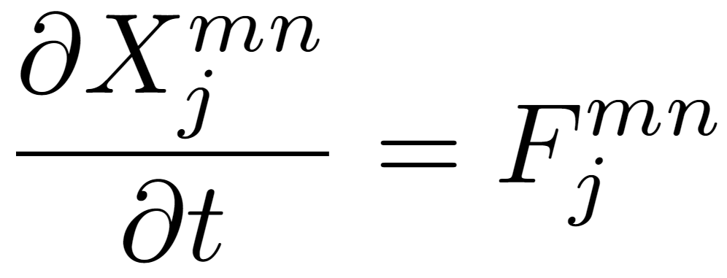
VMEC – Theory
(Hirshman and Whitson, 1983)
First variation, with t as variational parameter
Change to 2nd order for better convergence

Slide 34
VMEC Algorithm
(Hirshman and Whitson, 1983)
Main Algorithm
Initialization
Repeat until Desired Resolution
Interpolate solution onto a finer radial mesh
Repeat until converged
Notes:
Initial guess is more complicated than that but the general gist is that they are scaled
There is some 1/sqrt(s) dependence on the odd m modes but I will not go into that as I do not completely understand it
Show a pic for the Initial guess and boundary
like a simple circle, then you can show the fourier coeffs of the boundary
And profiles for iota and pressure
how does one choose these?
based off of desired boundary shape (this is fixed boundary), and desired iota, and the pressure can be chosen to match experimental-like profiles, and psi_a only scales the strength of the B field, not the geometry (I think)
And the timestepping is really a second order Richardson scheme
effectively an initial V = dX/dt is zero, and this velocity is updated at each step using the current velocity and variational forces
then X is advanced as dt*v + X_i = X_i+1

Slide 35
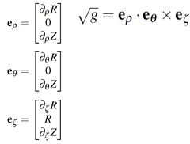
What DESC Solves
This leads to a system of equations comprised of the force balance error evaluated at the collocation nodes, which we want to make equal to zero -> Can use root-finding or least-squares to solve
x is the spectral coefficients of R,Z,λ, which is what we are changing to minimize f
Notes:
This could be on a couple slides
Lambda (rho,theta,zeta) is zero initially
Takes in a mag axis guess or assumes to be the centroid of the boundary surface given
Then R(rho,theta,zeta) Z(rho,theta,zeta) are just initially scaled from the boundary to the axis (picture)
These are given in Zernike-Fourier basis, so we know all derivatives of R,Z,lambda
So can find B,J and F on a collocation grid
This constitutes a nonlinear system of equations f(x) evaluated at our collocation grid. We want zero force error, so we can set f(x)=0 and solve the system using, for example, a Newton Raphson method, to find how to change x at this iteration in order to reduce force balance error
This process iterates until convergence at that resolution (ftol condition, xtol, etc), then repeats with a higher basis resolution/collocation grid resolution, using the solution from the previous run as the initial guess for the next in a continuation method

Slide 36
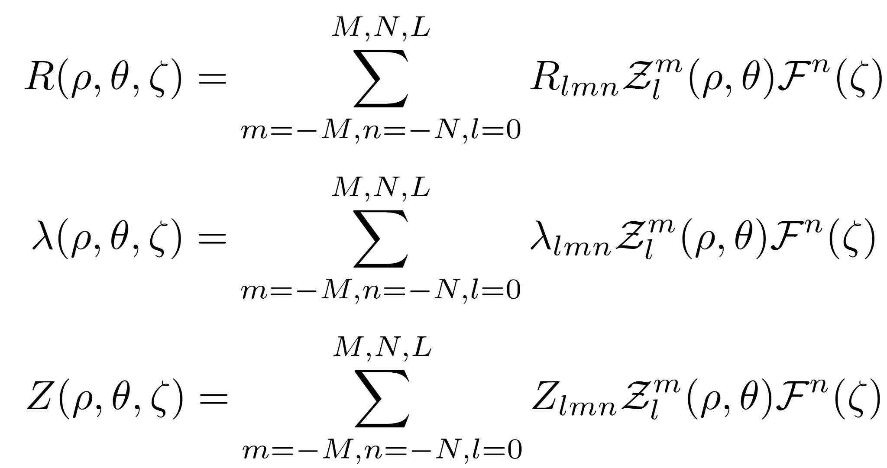
DESC Algorithm
Main Algorithm
Initialization
Repeat until Desired Resolution
Increase Collocation Grid and/or Spectral Resolution
Repeat until converged
Notes:
Show a pic for the Initial guess and boundary
like a simple circle, then you can show the fourier coeffs of the boundary
And profiles for iota and pressure
how does one choose these?
based off of desired boundary shape (this is fixed boundary), and desired iota, and the pressure can be chosen to match experimental-like profiles, and psi_a only scales the strength of the B field, not the geometry (I think)
And the timestepping is really a second order Richardson scheme
should change that
Point out differences btwn VMEC and DESC

Slide 37
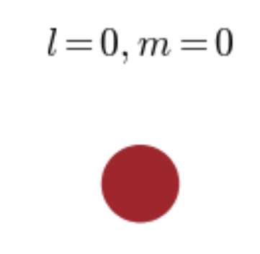
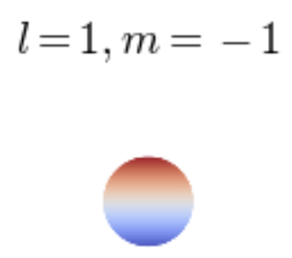
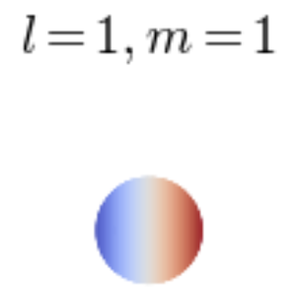
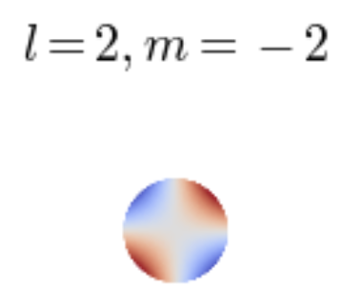
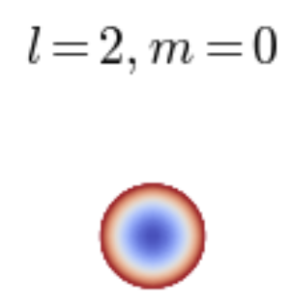
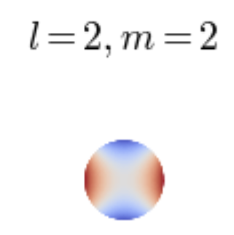
DESC - Fourier-Zernike Spectral Basis
Zernike Basis in (r,𝜽)
Zernike Polynomials
Radial Polynomial is of degree l-2s, and l=m,m+2,…, L
Toroidal Fourier Series

Slide 38
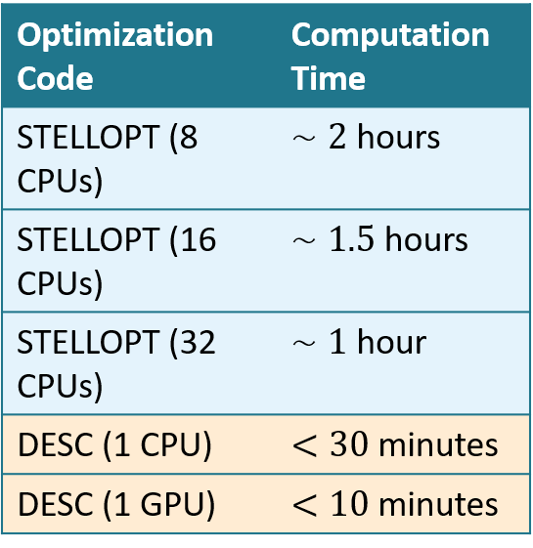
Equilibrium Optimization with DESC Automatic Differentiation (AD)
¹ Lazerson et al. (2020)
² Paul, Landreman and Antonsen (2021)
Once an equilibrium solution is found, it is desirable to optimize for some objective
Particle confinement, Quasisymmetry, etc.
Inputs to an equilibrium are pressure profile, rotational transform profile, and boundary shape
Want to optimize the objective g(x*,c) with respect to inputs, c
Requires knowing how the figure of merit changes with respect to inputs, c, i.e.
But g is not an explicit function of c
Instead an eqn (argmin of g)
Equilibrium Solution
Inputs
Challenge: How to get gradient of g with respect to c?
Typically find derivatives with finite-differences¹, requires many VMEC equilibrium solves -> expensive
Analytic gradients have been formulated recently, but only for limited number of objectives²
DESC Automatic Differentiation with JAX gives fast, accurate derivative information for arbitrary objectives
Courtesy of Daniel Dudt
Notes:
Wordy, might remove or reduce but did not talk about optimization really anywhere so I want to mention something about it.
Explicit why findif worse/why we don’t use
AD helps with newton method, VMEC does NOT use jacobian
Wordy subpoints, replace with verbals

Slide 39
Plasma Model – Ideal MHD
Simplest macroscopic plasma fluid model, assumes
low-frequency,
long wavelength,
neglects e⁻ inertia
(Freidberg 2014)
Notes:
Read Words
Is essentially Navier-Stokes coupled with Maxwell’s equations, with a large list of assumptions made to render the equations tractable to solve
The main assumptions are:
Low-frequency meaning we neglect the displacement current (interested in frequencies lower than the scale at which light waves propagate)
So we are using the low-frequency Maxwell’s equations, without displacement current
We do this to restrict ourselves to the macroscopic motions on the timescale of the ion movement (which is much slower than electrons
Timesacle is a/v_ti ~ 1 microsecond (I think), while the scale we ignore is 2pi/w_pe ~ 1E-11 s (much faster)
Long Wavelength – length scale is larger than the plasma debye length, (ion debye length is the dominant one), so the fluid is quasineutral
Neglecting electron inertia
mass is ion mass density
velocity is ion fluid velocity
so we consider timescales on which electrons react infinitely fast
Debye Length
Could start here,
Idea: transitions that go thru the purple, blue, and red?
Gauss’ Law does not appear bc is just a statement of ne=ni? CHECK GPP2 NOTES

Slide 40
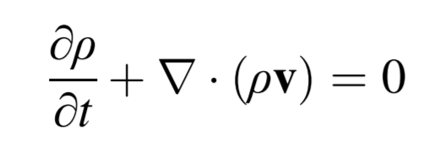
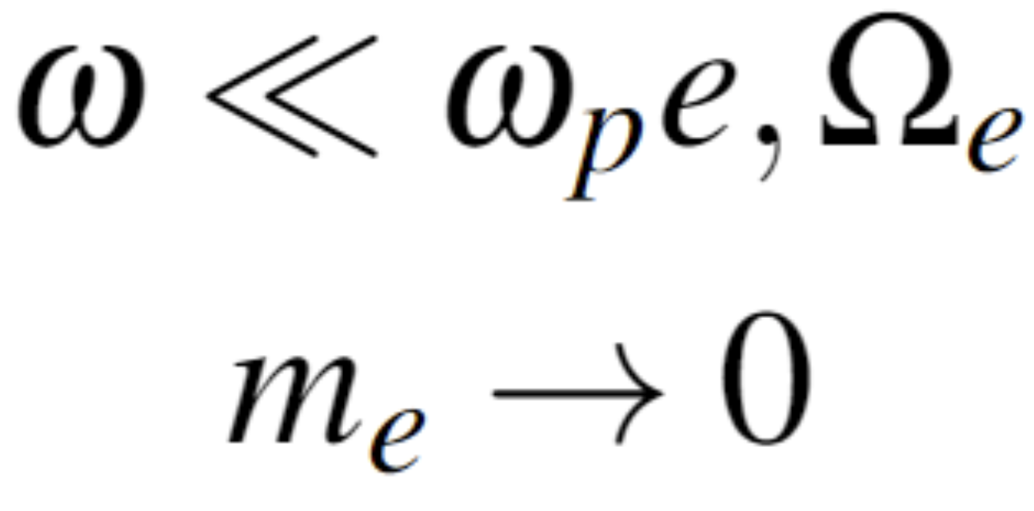
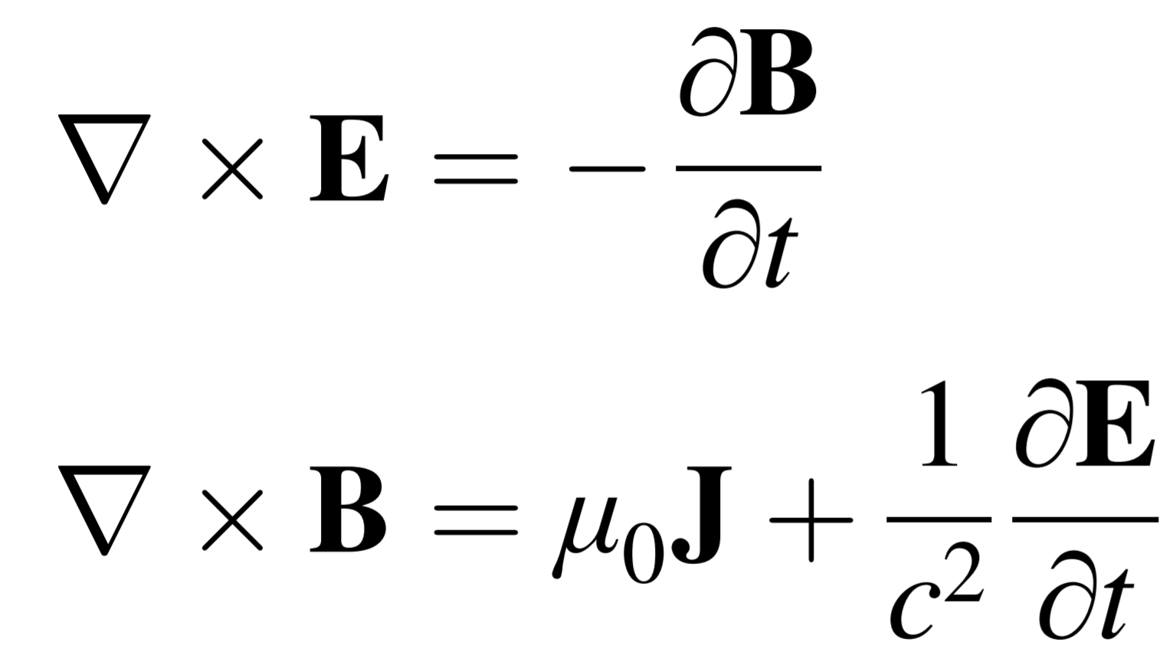
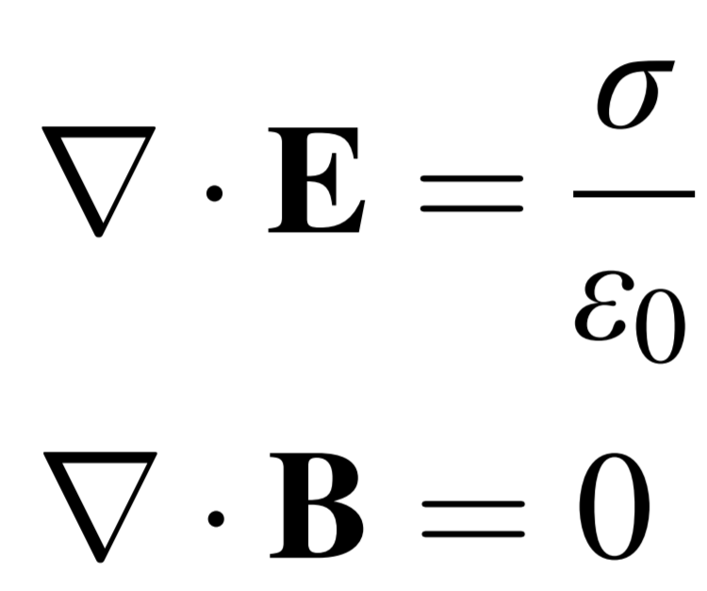
Plasma Model – Ideal MHD Derivation
Low-Frequency
Neglect e⁻ inertia
Long Wavelength
Single-Fluid Equations + Ohm’s Law
Vlasov-Maxwell Equations for ions and electrons
Collision dominated
L >> ion gyroradius
Resistivity is negligible
e⁻ -ion equil time small
Implicit assumption: enough collisions so that fluid moments are accurate reflections
(i.e. plasma is near Maxwellian)
Take 0th,1st,2nd moments
Two-Fluid Equations
Ideal MHD
(Freidberg 2014)
Notes:
Other assumptions for vlasov to 2 fluid:
Only short range collisions are Coulomb collisions
Neglect things like recombination, nuclear reactions etc

Slide 41
Straight-Field-Line (SFL) Coordinates
 | Flux Surface Label
 | Poloidal Angle
 | SFL Poloidal Angle
 | Geometric Toroidal Angle
Unravelled Flux Surface
B
B
D’haeseleer et al. Flux Coordinates (1991)
Notes:
Simpler form because now B, a vector with 3 components in (R,phi,Z), is reduced to a vector with only 2 components now, which simplifies the forms of the resulting equations
B field lines appear straight
Straight being below
This is the form
The slope of the magnetic field in these coordinates is just the rotational transform (with a factor of 2pi), which if you recall, is the number of poloidal transits per toroidal transit
So B line here has a rotational transform of
Note that these coordinates require us to assume we have nested flux surfaces (this is the reason nested flux surface codes are simpler)
The rho variable, called a flux surface label, is CONSTANT on a flux surface
so rho=constant will give a surface on which B field lines lie
this is why there is no e_rho term In B, as B dot grad(rho) is zero, grad(rho) being surface normal to a flux surface
Show how there is a special coord system where on a given flux surface, the magnetic field lines appear straight when plotted in vartheta, zeta
Say that this is a basis for many numerical codes as in these coordinates, computations are simplified?
SFL are curvilinear
I never defined flux surface label earlier… so this needs to be defined earlier

Slide 42
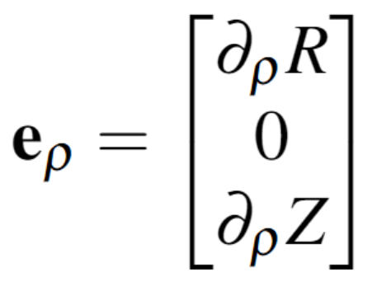
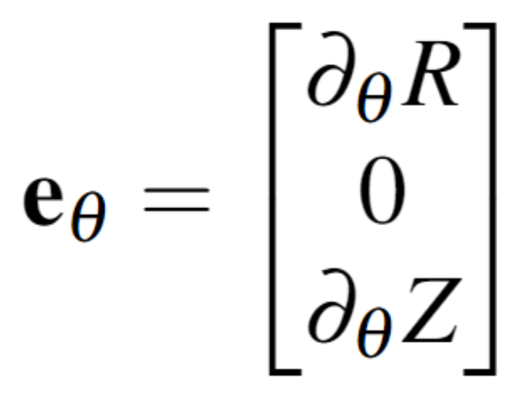
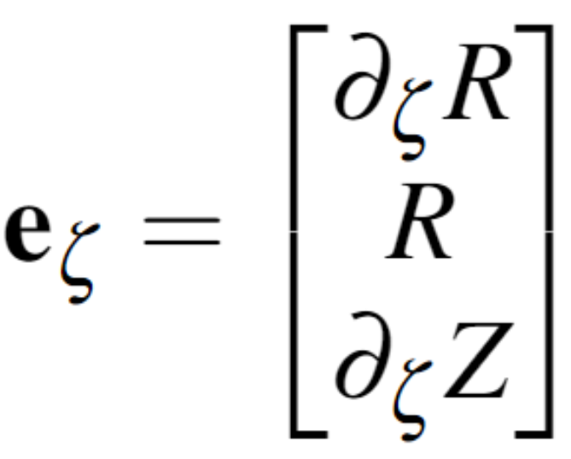
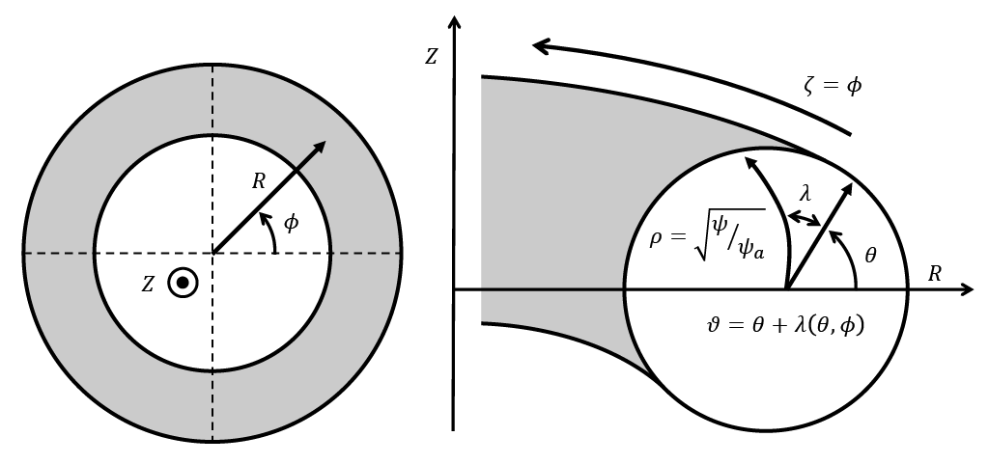
Computational Coordinate System
Notes:
In SFL, magnetic field is straight and simple
BUT, we do not know vartheta a priori
in fact, if we did, we already are prescribing the rotational transform and the boundary surface as an input, so we would already know the magnetic field on the boundary, which we are trying to solve for!
So we introduce a function lambda, which relates our poloidal angle to the SFL angle form
This allows us to use the simple form of B, at the expense of adding another unknown to solve for, Lambda
Vartheta is not known a priori, so computations are actually done in (rho, theta, zeta), and a 3rd function, lambda, is solved for during the course of computation, which is a function which when added to theta, makes the SFL angle (sweep the surface thing under the rug for now)
this allows us to use the simplified form of B, even without knowing vartheta
bc if we knew vartheta and iota, we also know phi, so we would know B on the surface (since from prev slide, B is 1/g iota evt + ephi),
but we do not know B, only the shape of the surface
Lambda is initially zero for DESC but is chosen to make spectral representation efficient in VMEC (not sure if will mention this)
This type of coordinate system is used in both VMEC and DESC

Slide 43
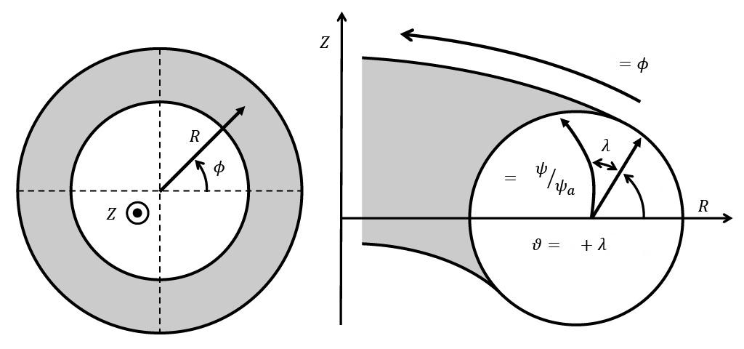
VMEC - Coordinate System
(Hirshman and Whitson, 1983)
 | Flux Surface Label
 | Poloidal Angle
 | SFL Poloidal Angle
 | Geometric Toroidal Angle
v
s
u
u
(s,u,v)
Notes:
Mention psi is the toroidal flux or something?
Could really use a picture as this is confusing, I only understand bc I worked on it for a year and a half
Something like with shells in a equil, and I say here is the ith surface, corresponds to s_i on the radial grid, and the surface shape is described by Rmn(s_i) coeffs
U is not the geometric poloidal angle
If it were a circle I think it would be
But generally no it is not a geometric angle
Geometric poloidal angle meaning that r cos(u) is NOT x – R0

Slide 44
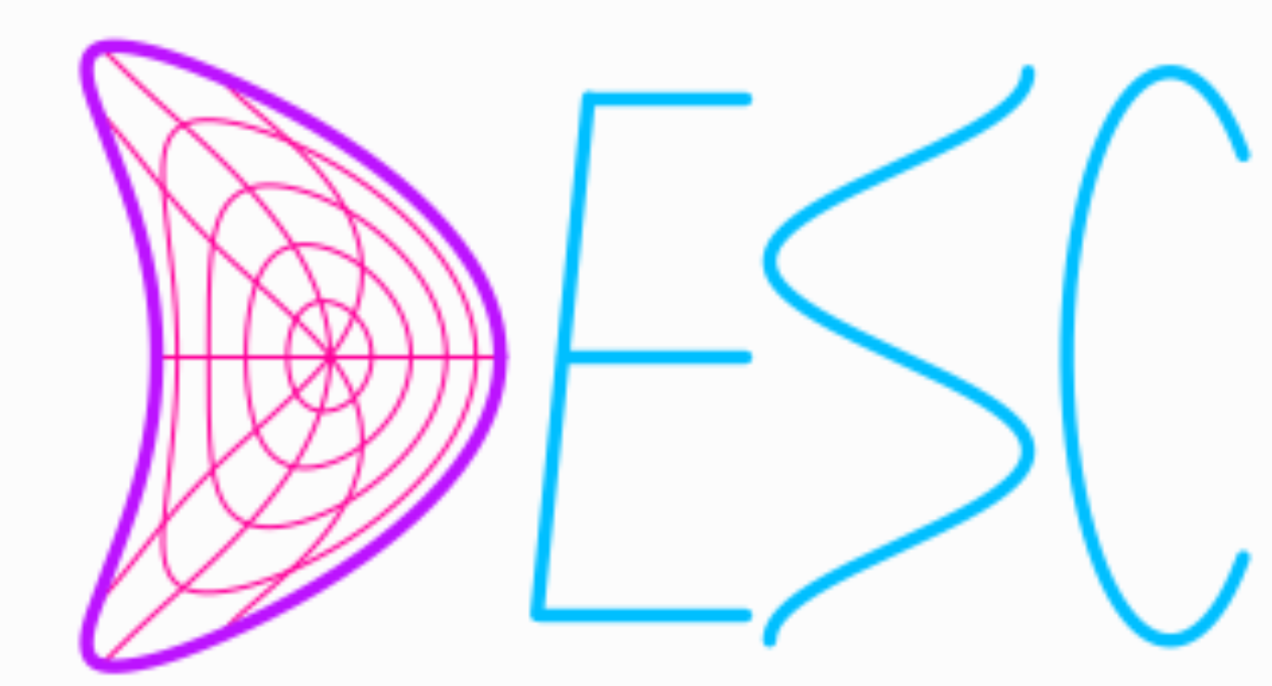
DESC - Coordinate System
(Dudt and Kolemen 2020)
Geometry represented continuously with global basis functions
 | Flux Surface Label
 | Poloidal Angle
 | SFL Poloidal Angle
 | Geometric Toroidal Angle
Notes:
Rho = sqrt(toroidal flux / enclosed toroidal flux)

Slide 45
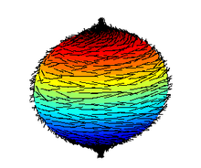
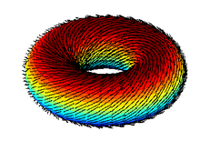
Poincare-Hopf Theorem : Mathematical Reason for Toroidal Geometry
No non-vanishing tangent vector fields on even-dimensional n-spheres (i.e. cannot have a vector field tangent everywhere to a sphere in 3D while being continuous and non-zero)
So a sphere in 3D cannot be a flux surface (remember that a 2-sphere is the normal sphere in 3D we think of)
Only physically realizable shape in 3D that allows this is a torus
Cannot comb hair flat on a coconut
Source: https://en.wikipedia.org/wiki/Hairy_ball_theorem
Notes:
Maybe do not include though, if you do not understand Euler index

Slide 46
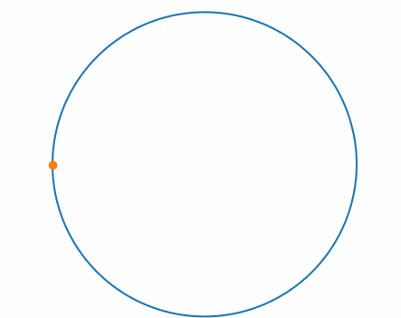
Axisymmetry and Noether’s Theorem
B_{P}
Axisymmetry guarantees particles confinement (in absence of collisions)
Consider single particle Lagrangian, axisymmetry means
For Strongly Magnetized Plasmas (true in fusion devices)
is a flux function (i.e. is constant on a magnetic surface), so this means that a particle will stay within a small distance of the flux surface it is on -> particle is confined to the surface!
Notes:
P phi is constant in axisymmetry
qRAphi >> mR^2phi dot in a strongly magnetized plasma (as RA_phi ~ R^2 B_p)
second step is we know B_p = 1/R grad(psi) (from GS), so psi ~ R^2 B_P assuming 1/R is gradient length scale% we also approx R phi dot as the thermal velocity
then v_t/R ~ the freq associated with the changes in the magnetic field (if we assume those are L length scale% then as long as B_P is large, so Omega_P is large, (ie strongly magnetized, a large B poloidal)
then p_phi is roughly just qRAphi, and
RAphi is constant on a flux surface,
therefore p_phi being constant means a particle will stay on a flux surface (i.e. will be confined to it)

Slide 47
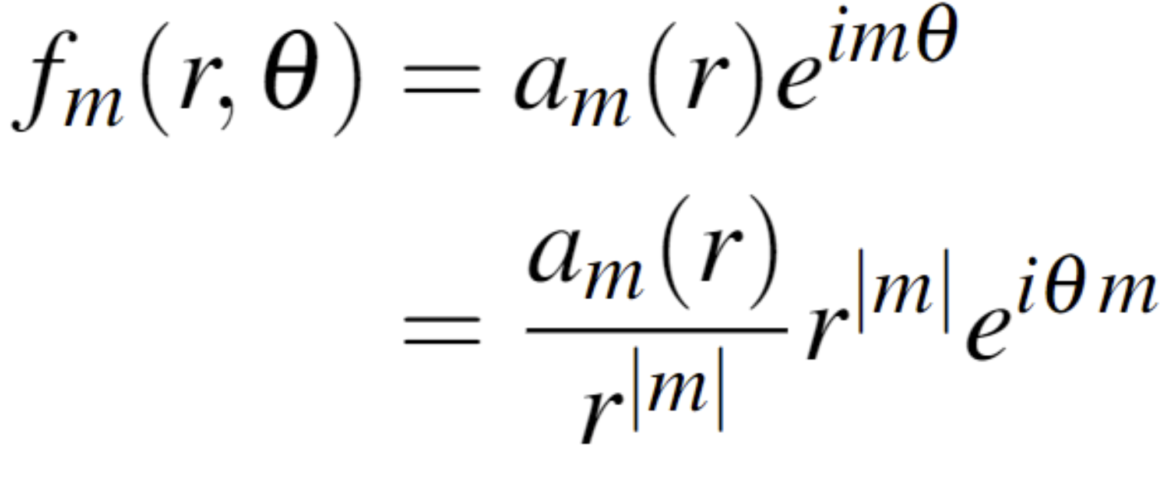
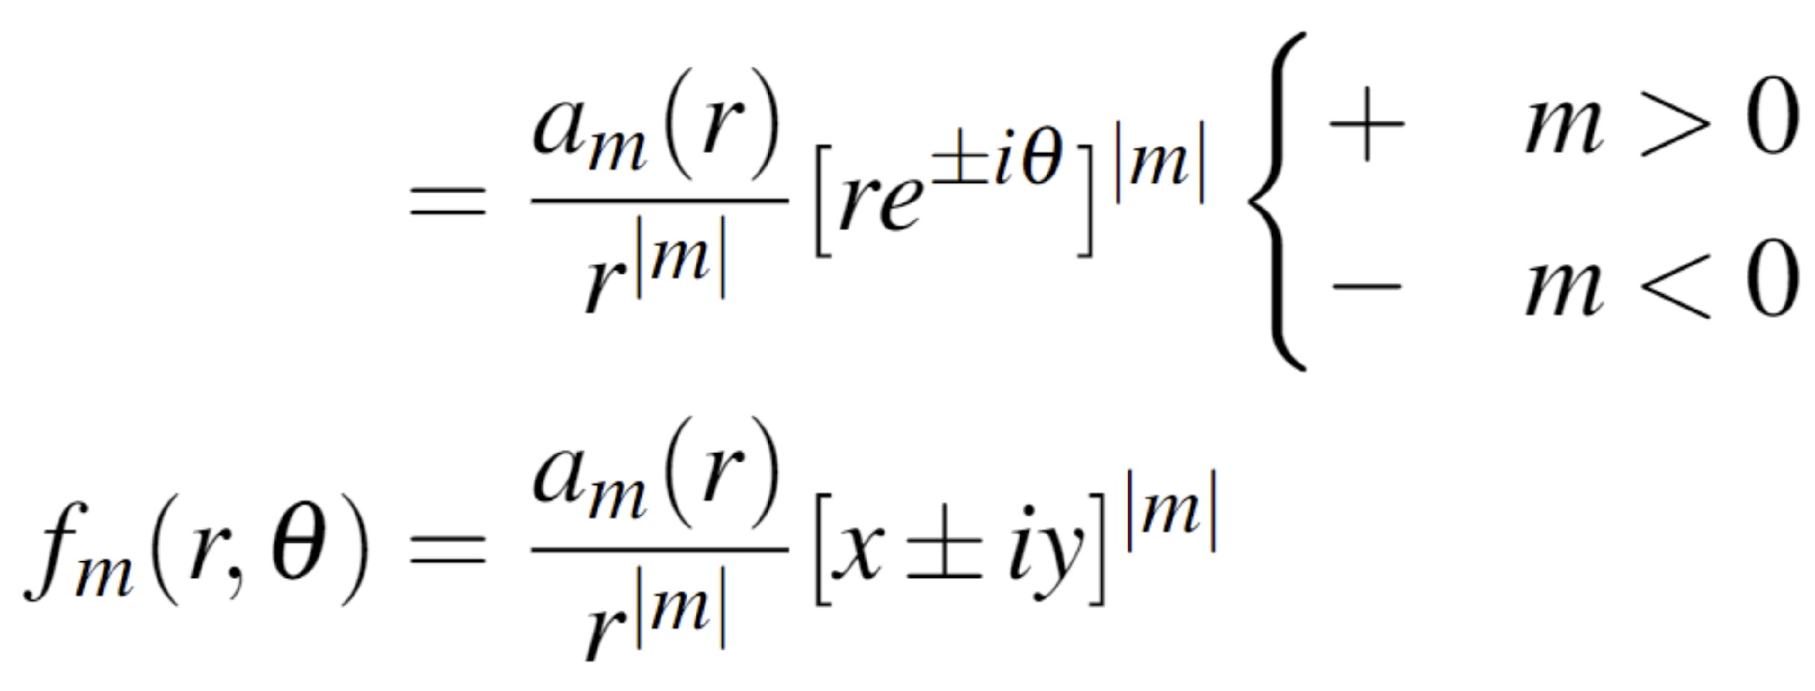
Analyticity Constraint at Polar Axis Proof
¹(Lewis and Bellan, 1990)
y
1
x
Regular at r=0
Must be regular at r=0!
Regular at r=0
Notes:
Bellan
The +2 thing is bc of symmetry, f(r) = f(-r) at r=0 right
A_(r) = (-1)^m a_m(-r)
So only way for that to be true would be if the coefficients has all even or all odd parities (?)

Slide 48
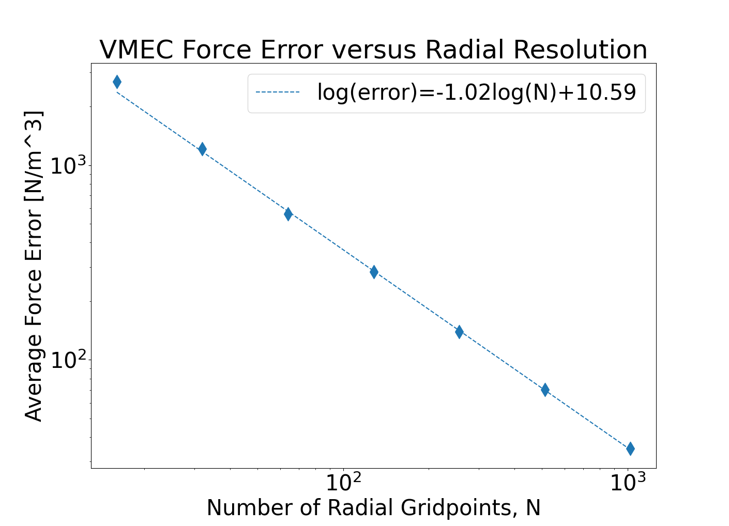
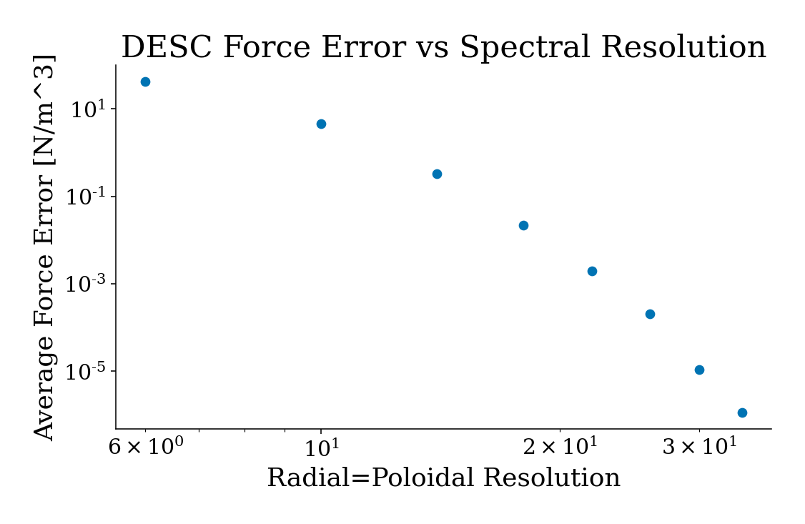
DESC compares well to VMEC – Convergence on log-log scale
 | Angular Convergence | Radial Convergence
DESC | Exponential | Exponential (coupled to Poloidal)
VMEC | Exponential
Notes:
DESC also compares well to VMEC in terms of the convergence rate
While both codes control their angular resolution with a spectral basis, allowing for exponential convergence, Increasing VMEC’s radial resolution will only result in algebraic convergence
limited by the first-order finite differences it employs in the radial direction
To achieve higher radial resolution in DESC, both the poloidal and radial resolution must be increased. While coupled, this still is an improvement over algebraic convergence with only increasing radial resolution in DESC
VMEC has algebraic rate of convergence (-log on a log linear graph implies error ~ O(N^-k) for some k (k=1 here)
DESC has geometric (linear decrease on a log linear graph implies error ~ O(exp(-r*N))
VMEC spectral in angular, findif in radial
Jacobi poly convergence order -> exponential if f(x) analytic in disk (paper by Bain and Delves, 1976)
Log log backup

Slide 49
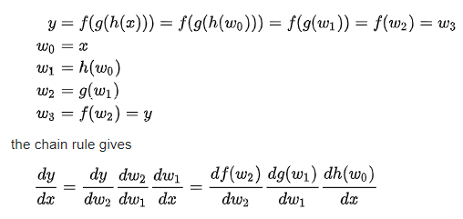
Automatic Differentiation
Essentially, is the chain rule
https://en.wikipedia.org/wiki/Automatic_differentiation

Slide 50
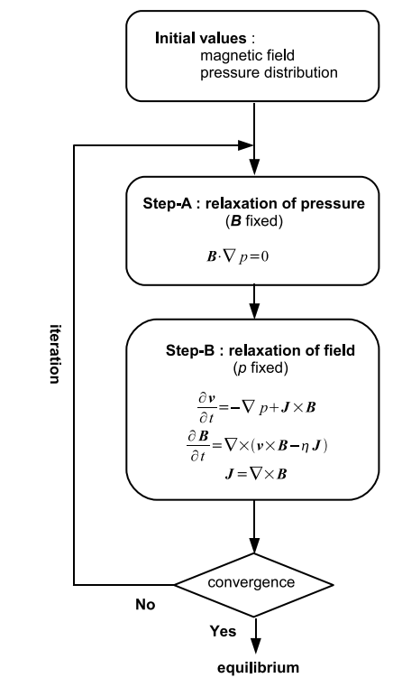
HINT2 Code
(Suzuki et al. 2006)
Relax pressure parallel to B
Fix p and let fields evolve until stationary state reached

Slide 51
PIES Code
Reiman et al. J. Comp. Phys. (1986)

Slide 52
SPEC Code
(Hudson et al. 2012)

Slide 53
DESC vs STELLOPT QS Optimization
STELLOPT
Finite-difference derivatives
Parallelized across CPUs
Speed depends strongly on resolution
DESC
First iteration takes longest (JIT compilation), then additional iterations are very fast
Resolution limited by GPU memory
Speed is independent of number of optimization variables
MPOL = NTOR = 8, NS = 65
FTOL = 1E-12
48 optimization variables
Optimize QS on all surfaces
Courtesy of Daniel Dudt

Slide 54
Rotational Transform
B
1
2
4
𝛁B
3
Notes:
Definition as like a pitch angle, or angle the B field makes with the toroidal direction (I think is the def)
Torsion of magnetic axis (caused by coils I think? Or figure 8 stell like concept)
Helical ripple of B field introduced by coils
Have a current running through the plasma (tokamak)
Donut
Include better pics (planes, etc)

