Slide 1
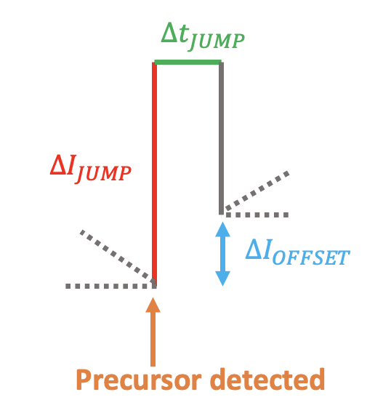
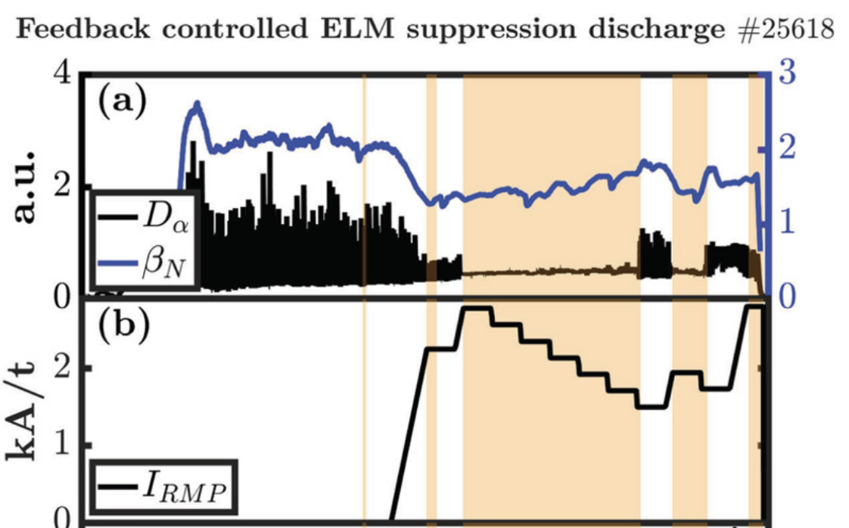
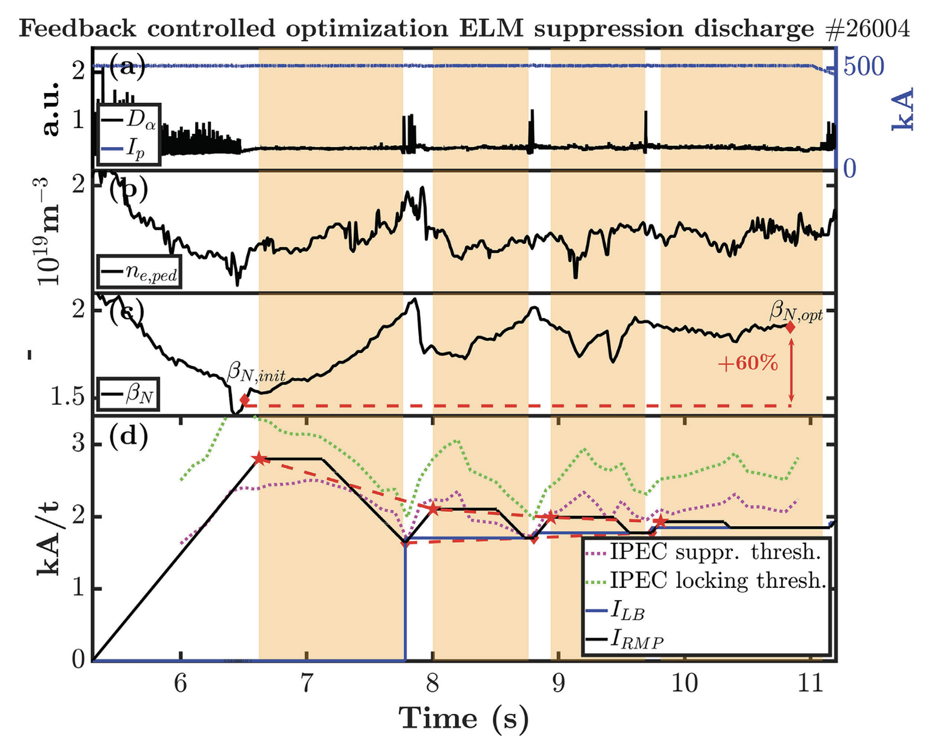
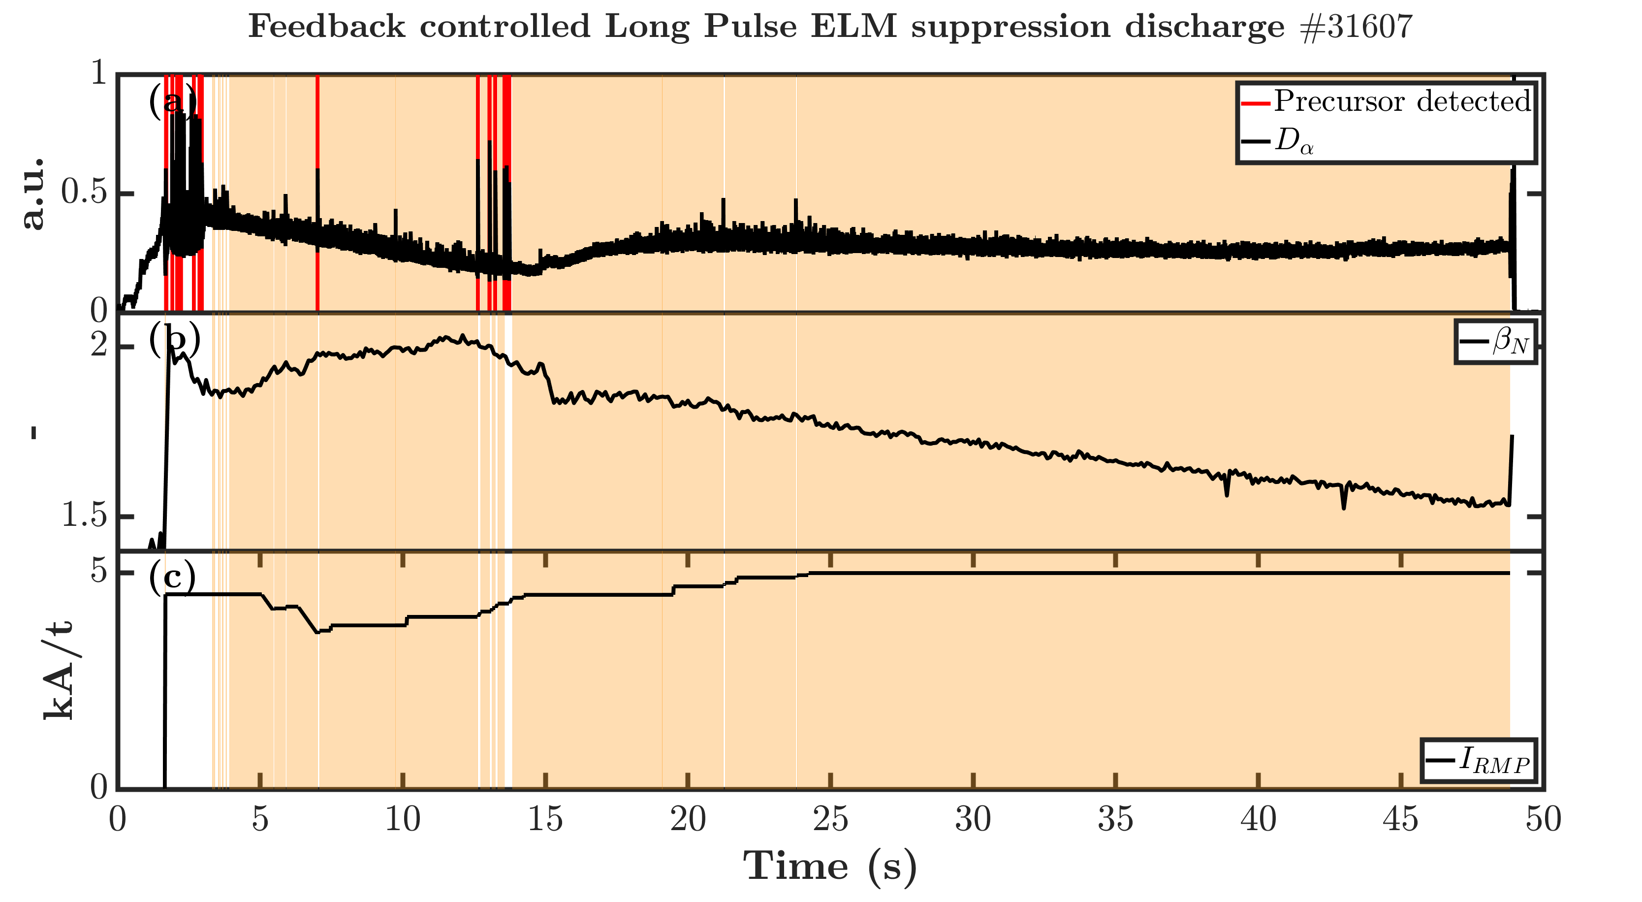
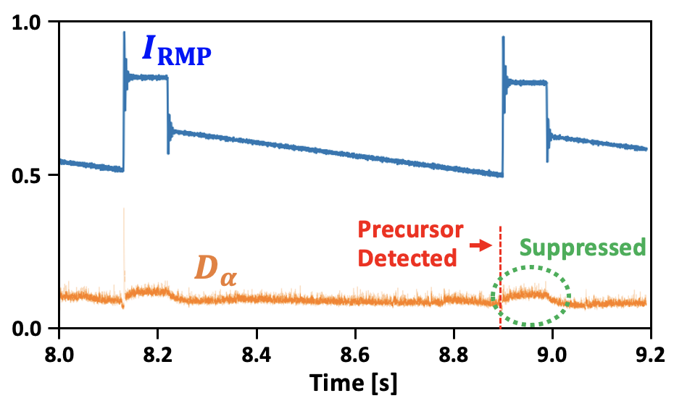
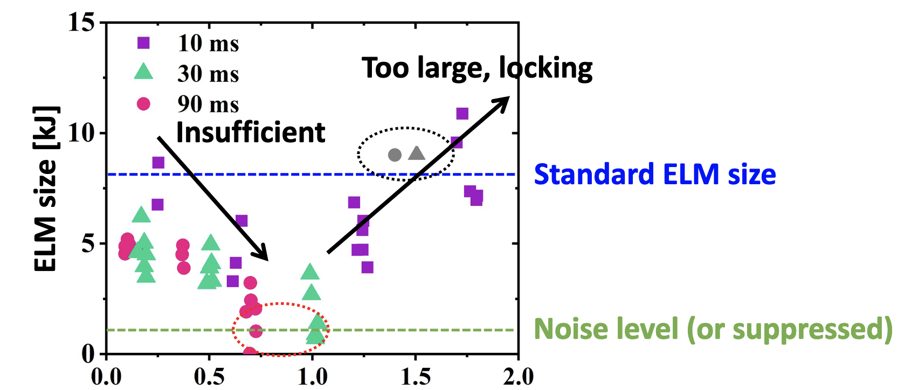
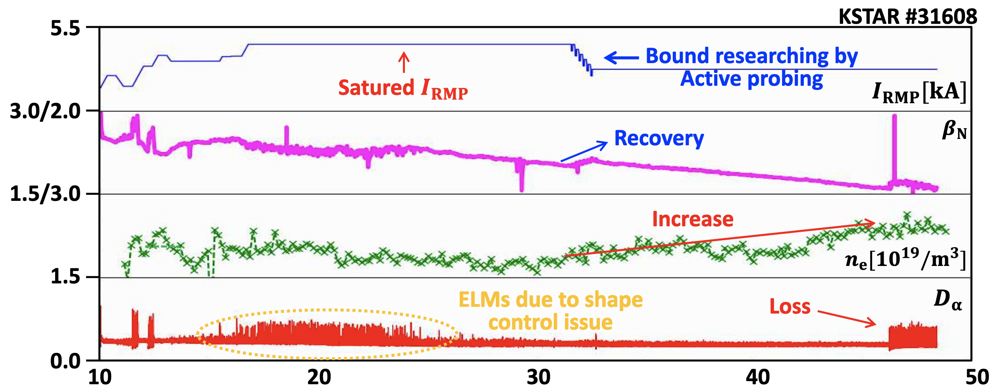
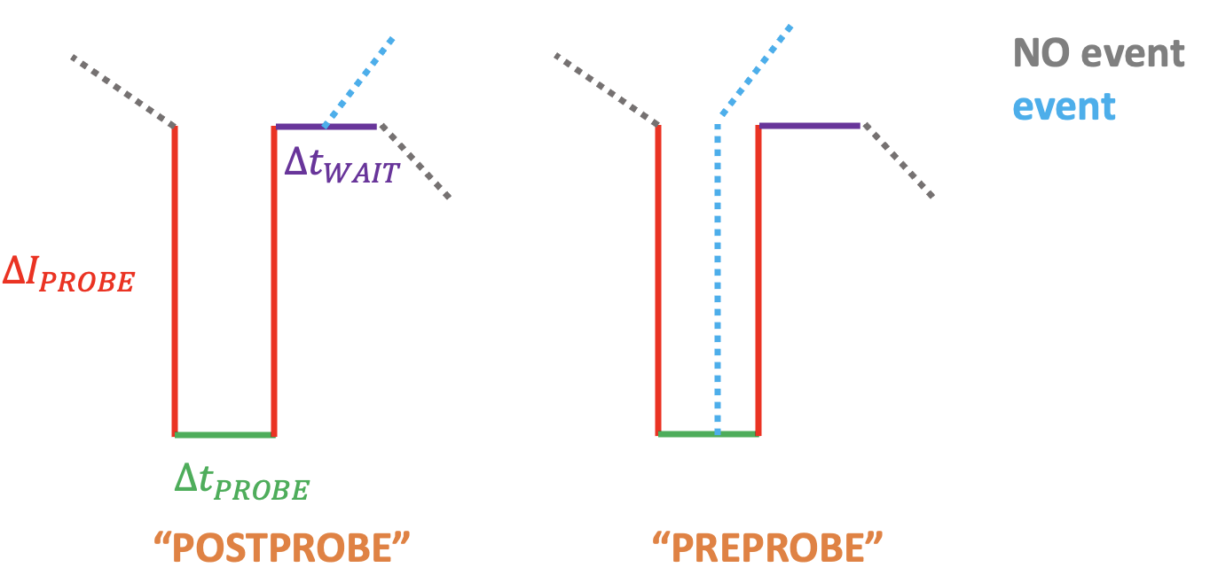
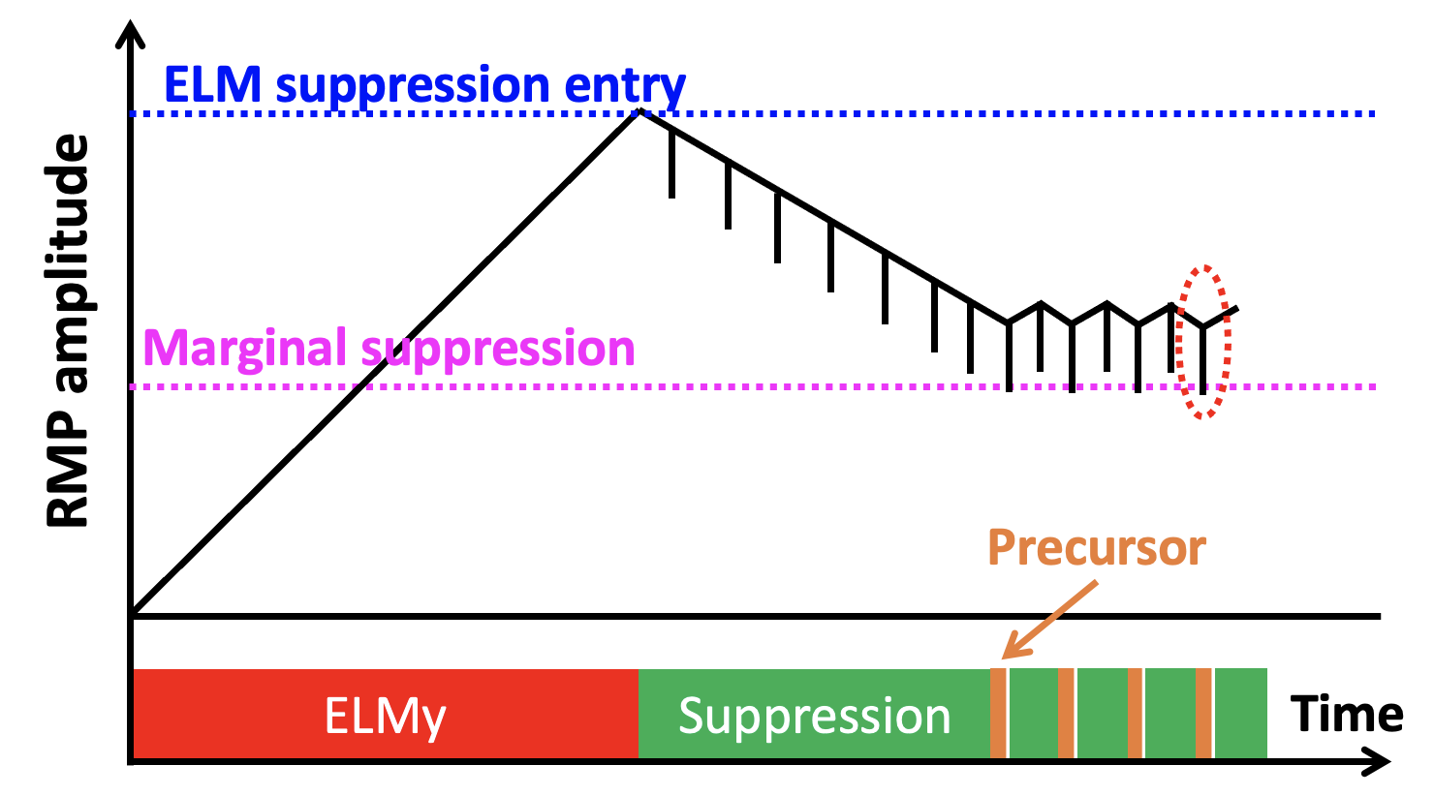
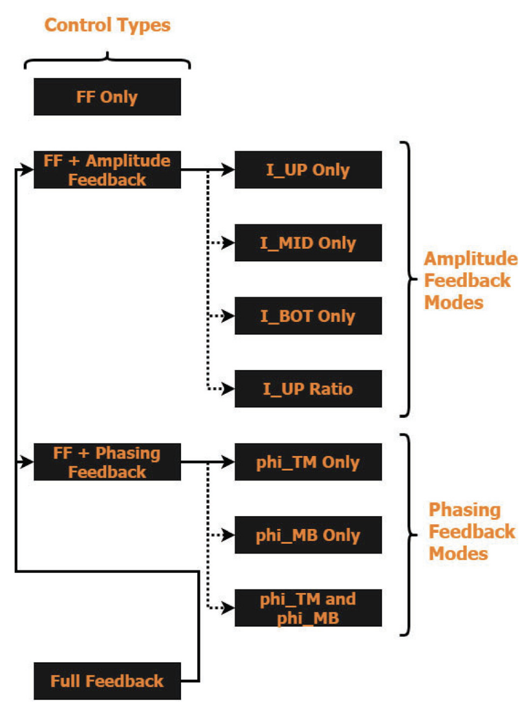
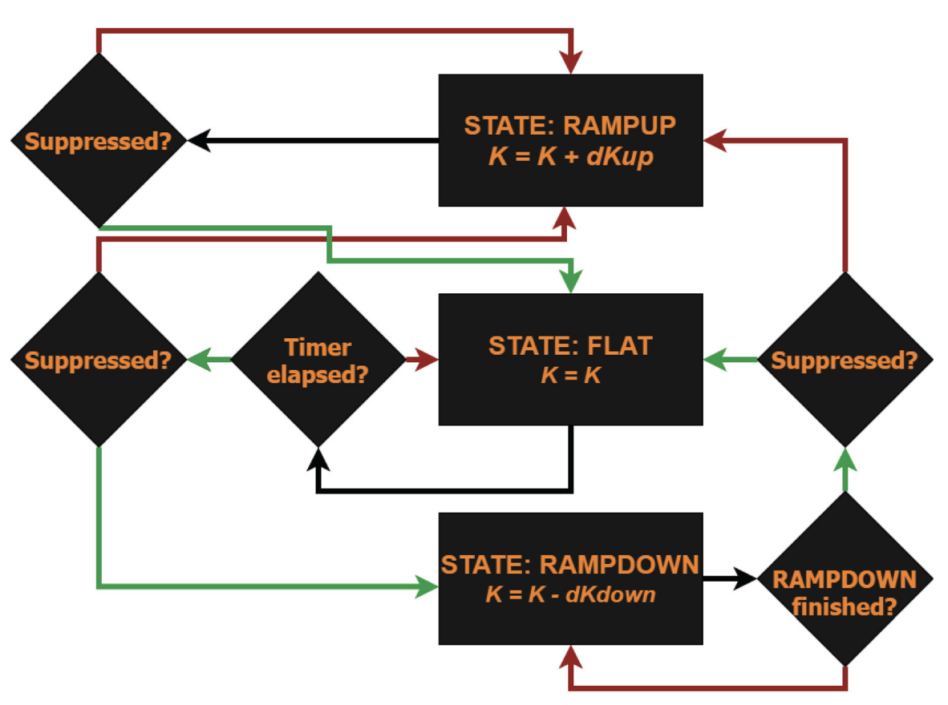
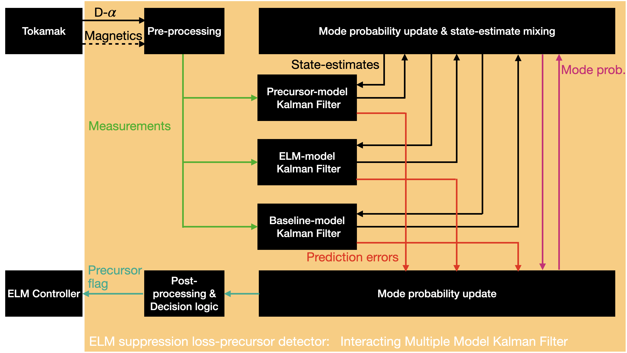
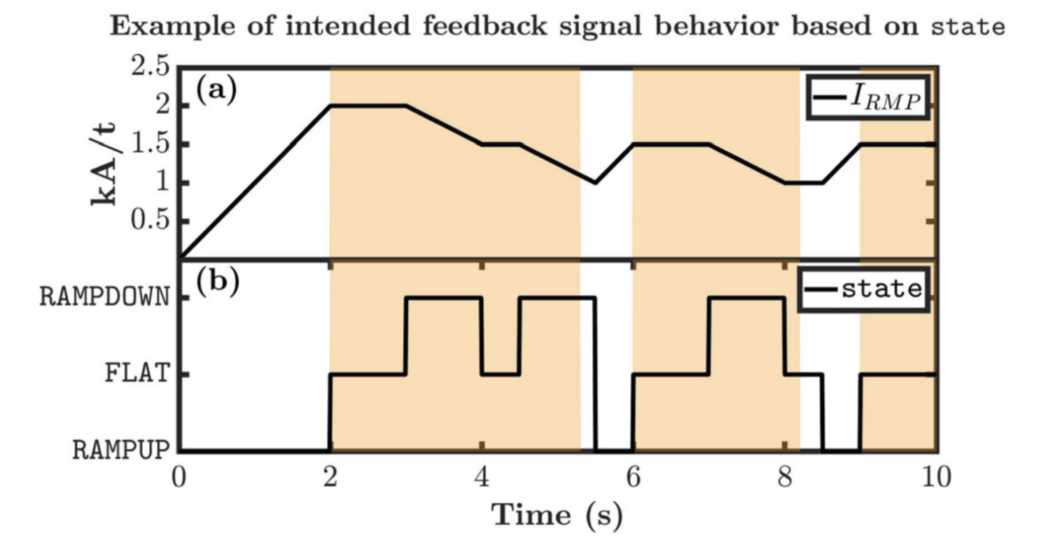
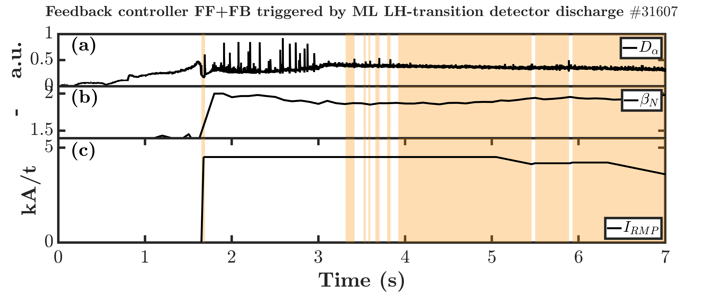
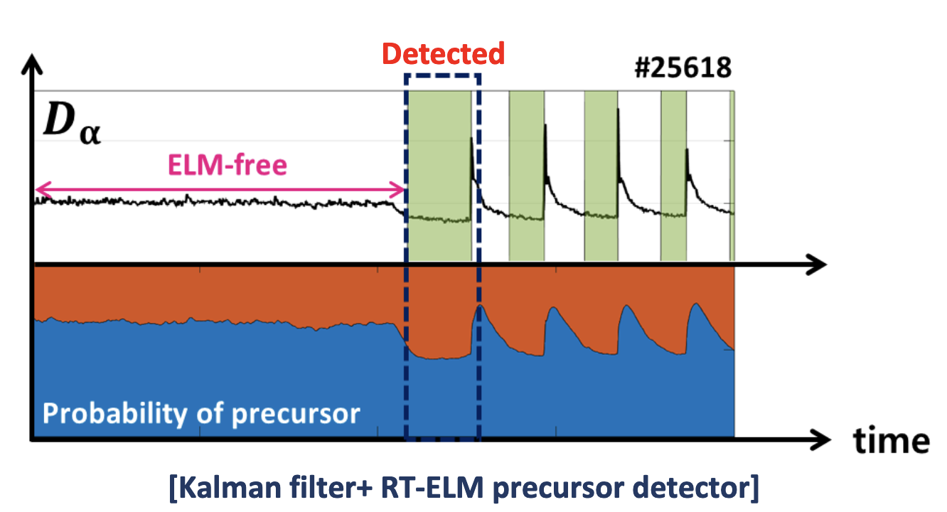
Mechanical &
Aerospace
Engineering
ELM suppressed high performance fusion scenarios achieved with Feedback Adaptive RMP ELM Control
R. Shousha, S.K. Kim, K.G. Erickson, J.-K. Park, S.M. Yang, M.W. Kim, G. Shin, S.-H. Hahn, G.Y. Park, Y.M. Jeon, N.C. Logan and E. Kolemen (rshousha@Princeton.edu)
Department of Mechanical & Aerospace Engineering, Princeton University
Background and motivation
Adaptive Lowerbound
Avoiding imminent ELMs: Jump scheme
Long pulse feedback ELM suppression
Why a feedback controller for ELM suppression?
Need high performance plasma for fusion (ITER relies on H-mode)
H-mode associated with quasi-periodic bursts of particles and energy (ELMs)
ELMs cause unacceptable damage to devices on ITER scale and need to be controlled
Models are not good enough yet to describe optimized Feedforward controlled ELM suppression (ELM onset time in some sense unpredictable)
How do we give the controller capability to reduce number of losses of ELM suppression?
Idea:
ELM controller incrementally ramps down to regain confinement until loss of suppression detected
ELM controller stores the RMP amplitude at which ELM suppression is lost as Adaptive Lowerbound: $I_{LB}$
ELM controller ramps up and regains suppression
ELM controller incrementally ramps down to regain confinement, but not below Adaptive Lowerbound*
*$I_{LB}=I_{LOSS}+ΔI_{LB,PCS}$
Where $ΔI_{LB,PCS}$ can be chosen in PCS
Can a jump scheme be effective in preventing imminent ELMs?
Idea:
Precursor detector detects precursor to loss of ELM suppression
If Jump-scheme active, controller jumps up by amount $ΔI_{JUMP}$ (PCS configurable target)
Controller holds RMP at elevated level for $Δt_{JUMP}$ (PCS configurable target)
After $Δt_{JUMP}$ has elapsed, controller goes back to previous level, changed by offset $ΔI_{OFFSET}$ (PCS configurable target)
→Result: sometimes. Need scans for optimization.
So how could the Feedback Adaptive ELM controller be leveraged in a joint attempt to achieve feedback optimized record long pulse ELM suppression?
Idea:
Use Feedback Adaptive RMP ELM Controller in I_UP RATIO amplitude feedback
Use ERMP optimal amplitude ratios computed by Dr. S.M. Yang
Use ML trigger developed by Dr. M.W. Kim
Use scenario development by LPT team under leadership J.-K. Park
How can we suppress ELMs?
Resonant Magnetic 3D-field Perturbations:
Can achieve ELM suppression
Unfortunately, confinement degrades with increasing RMP amplitude
However, due to hysteresis-effect, less amplitude required to sustain suppression than to initialize it
This can be exploited
Results KSTAR campaign:
Good:
Achieved converged optimized RMP
Regained more than 60% of lost confinement
Stay close to marginal boundary
Stay far from locking threshold
Bad:
Still need to LOSE elm suppression at least once for optimization, not acceptable
→ Need to detect before happens
2022 (1):
Record length Feedback ELM suppressed discharge
However:
Sporadic ELMs in early phase made controller set LB high
Probing not turned on so no LB reduction possible
Confinement could not be optimized due to absence probing
2022 (2):
Active probing successfully used to reduce LB
However:
Due to some shape control issues causing ELMs in early phase, not perfect trophy shot yet
Optimize RMP with Adaptive Control
Minimize applied RMP
Maximize confinement
[1]
[1,2]
$ΔI_{JUMP}$
How is the controller designed?
ELM suppression-loss precursor detection
Reducing Lowerbound safe: Probe scheme
How can we monitor ELM activity?
$D_{α}$ signal from any RT PCS available photo-diode at sufficient cycle rate
How can we change ELM activity?
By applying specific RMP spectra (KSTAR: 3 rows with each 4 coils)
3 amplitudes (TOP,MID,BOT)
2 phasings (TM,MB)
(1 phase (MID))
This results in the following simplified control loop:
Controller feedback mode options:
Need all coils for optimal ELM suppression
Need flexibility for physics studies
Allow amplitude feedback with FF phasings
Allow phasing feedback with FF amplitudes
Allow full feedback
NEW: Allow ML assisted feedback (ampl+phs)
Is it possible to detect imminent ELMs before they happen, and early enough to do something?
Can an active probing scheme be effective in reducing lowerbound without causing ELMs?
Idea:
Lowerbound is activated and preventing RMP from decreasing
Once probing activated, controller applies downward pulse (customizable)
If PREPROBE mode, controller starts checking for precursors DURING downward pulse and exit immediately at time of event
If POSTPROBE mode, controller starts checking for precursors AFTER downward pulse (to study transients)
→Result: Effective at reducing lowerbound, but not able to prevent all ELMs that follow precursor
Diagnostics that show precursors to loss of ELM suppression:
The $D_{α}$ signal characteristics:
Constant Baseline in H-mode
Rapid sustained dip before ELM
Rapid spike with slow tail during ELM
The Mirnov probe signal characteristics:
Constant broadband in H-mode
Rapid sustained reduction in standard deviation before ELM
Rapid spike in broadband during ELM
Time scales that need to be considered (and can be device specific, here just rough est.):
Pedestal evolves on pedestal confinement time (τ_{ELM} ∼10-50ms)
PCS commands (∼50-250 μs)
Power supply control / ramp rate (ex. Coils can jump 1kA in 5ms)
Recovery of suppression: A resistive penetration time to recover island (∼3ms)
So we can recover an island in ∼5-10ms < 10-50ms evolution from suppressed to ELMing state
The instability itself is very fast (γ∼ω_{*eff} ∼1ms) so we can’t rely on detecting the early phase of the ELM itself
Precursor needs to be detected at least ∼10ms before the ELM on KSTAR
Conclusions and outlook
Where are we at and how do we move forward?
Controller demonstrated feedback ELM suppression capability using:
N=1 non-rotating amplitude feedback I_UP Ratio
N=1 phasing feedback (TM+MB)
N=1 rotating amplitude feedback I_UP Ratio
N=2 amplitude feedback
N=1 ML feedback mode (I_UP Ratio with ratios and phasings generated by ML IPEC acceleration model, not shown on this poster)
N=3 amplitude feedback ELM suppression on DIII-D (portability!)
Strengths and weaknesses of current design:
General Finite state machine design capable of :
Reliably achieving and sustaining ELM suppression
Able to reliably regain confinement before losing ELM suppression
ELM detector needs to be improved:
Should not be calibration specific
Should ideally get as direct as possible measurements of heat load to wall, and distinguish ELMs among deceptive signal features
ELM suppression loss precursor detector based on IMMKF D-a:
Works reliably on KSTAR PCS (not yet on DIII-D) using only D-a
But need to include more signals for robustness (magnetics)
Advanced control schemes such as Jump and Active Probing:
Jumps shown to be able to eliminate imminent ELMs sometimes
Need to scan shape and optimize precursor lead time to determine final effectiveness
Active probing shown effective in reducing lowerbound in long pulses where plasma evolves
However, when probing at stability boundary, not always able to avoid ELM
Need shape scan and optimize precursor lead time to determine final effectiveness
ML generated ratios and phasings give more “brains” to the controller
Neural net needs to be trained on wide variety of discharges
Portability unclear
Next steps: We want complete ELM suppression and as much optimization as possible:
Improve weaknesses listed above
Better ELM detector with more direct measurements of what we care about (IRTV?), and otherwise be able to distinguish ELMs from other signatures with less FP
Trying ML based precursor detection
Gain control over crucial parameters, to sustain suppression window (q95 ctrl, density/radiation ctrl), so that we can optimize suppression in less naturally evolving plasma, until predictive capability strong enough to let go of additional actuators
[1]
Feedback Mechanism Design:
Need control over shape of current requests (plasma response, hardware limitations)
Need to balance optimized control and controlled physics studies
Finite State Machine design
States:
RAMPUP (linear ramp)
FLAT (hold steady)
RAMPDOWN (linear ramp)
Re-use same mechanism in any feedback mode
Method:
Design simple ODE descriptions of expected signal patterns in H-mode, during precursor and during ELM. Let each KF predict signal changes using their internal mode. Most probable model wins.
Feedback Initialization and ML integration
How can we avoid the first ELM and accommodate smooth transition from FF to FB?
Idea:
ML based LH-transition detector by Dr. M.W. Kim exists in PCS
When LH transition detected in RT, PCS activates Feedback Adaptive RMP ELM Control sequence
Controller can:
Smoothly take over FB after initial FF
Start without FF but initial condition on RMP
[1]
Result:
Detector can detect this dip with sufficiently early if precursor starts early (only small detection delay)
Subsequent precursor detection in inter ELM period get ignored (controller knows difference between precursor during ELM suppression and during ELMy phase)
Adaptive CTRL APPLIES FF
[1]
Adaptive CTRL APPLIES FB
[1]
ML triggers Adaptive CTRL
[1] R. Shousha, S.K.Kim et al, POP 22. [2] S.K.Kim, R. Shousha et al, NF 22.

