Slide 1
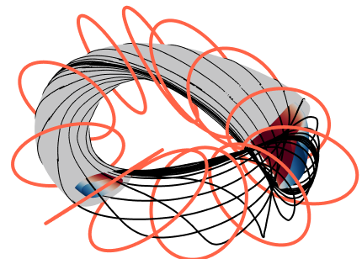
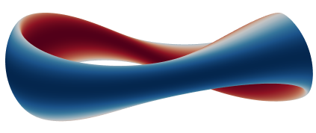
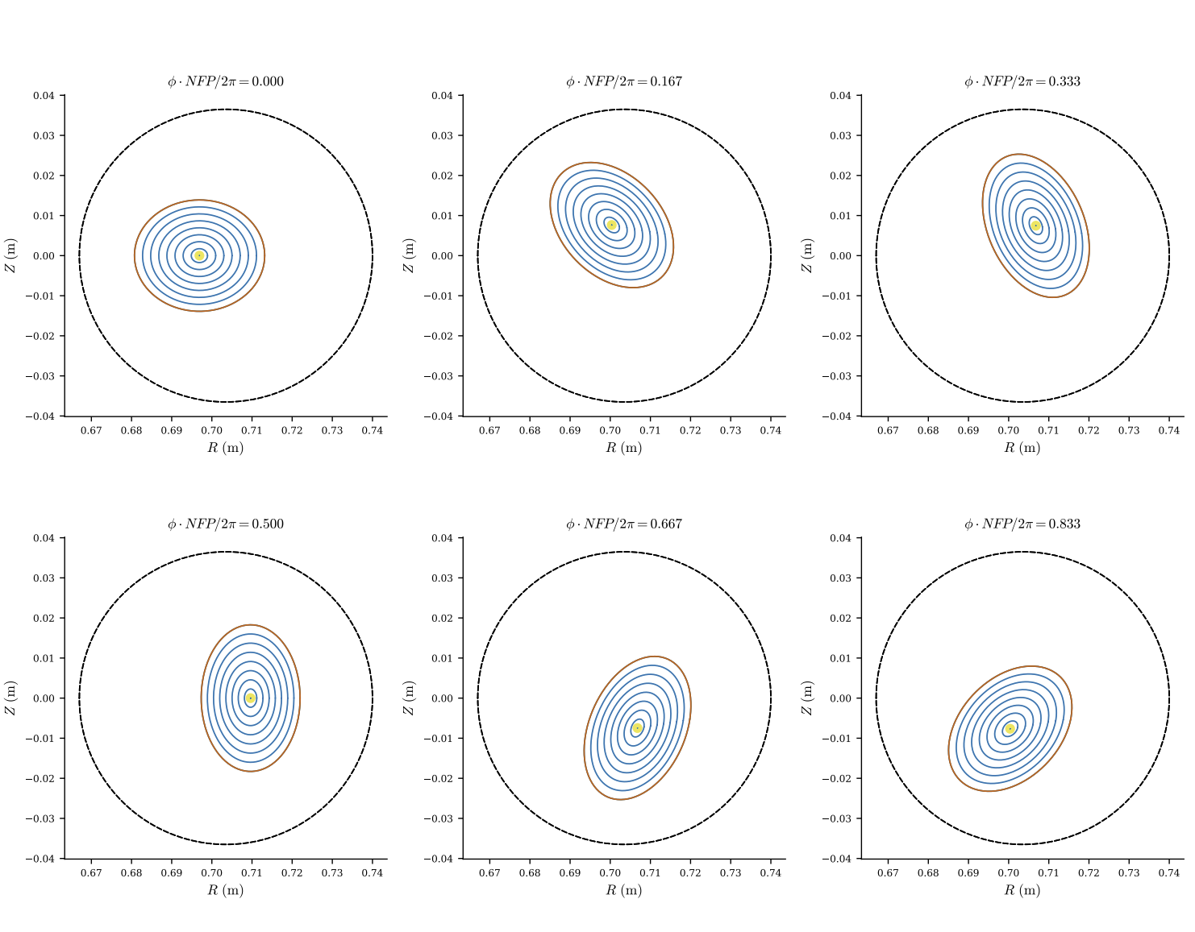
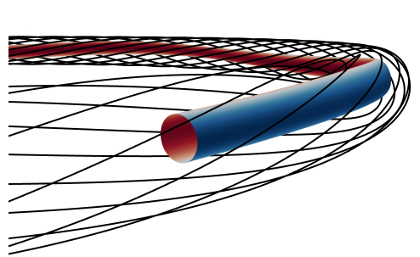
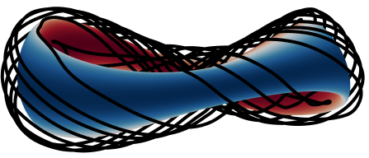
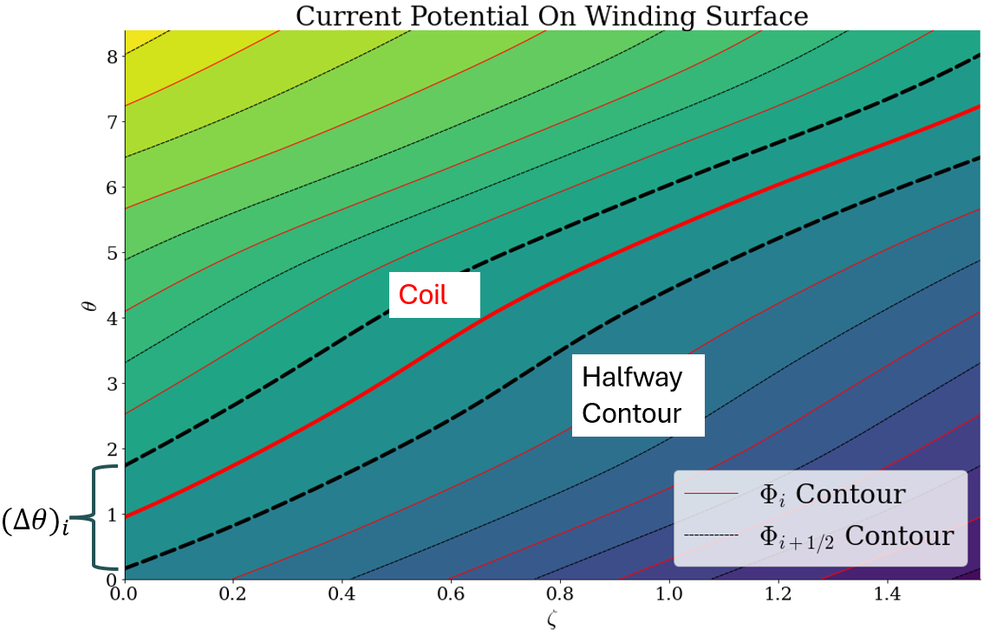
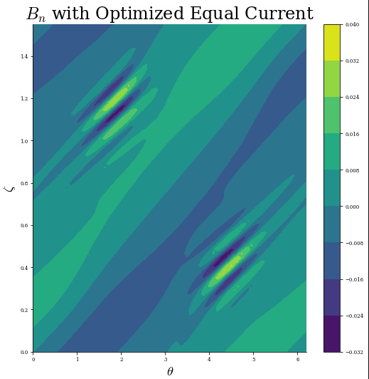
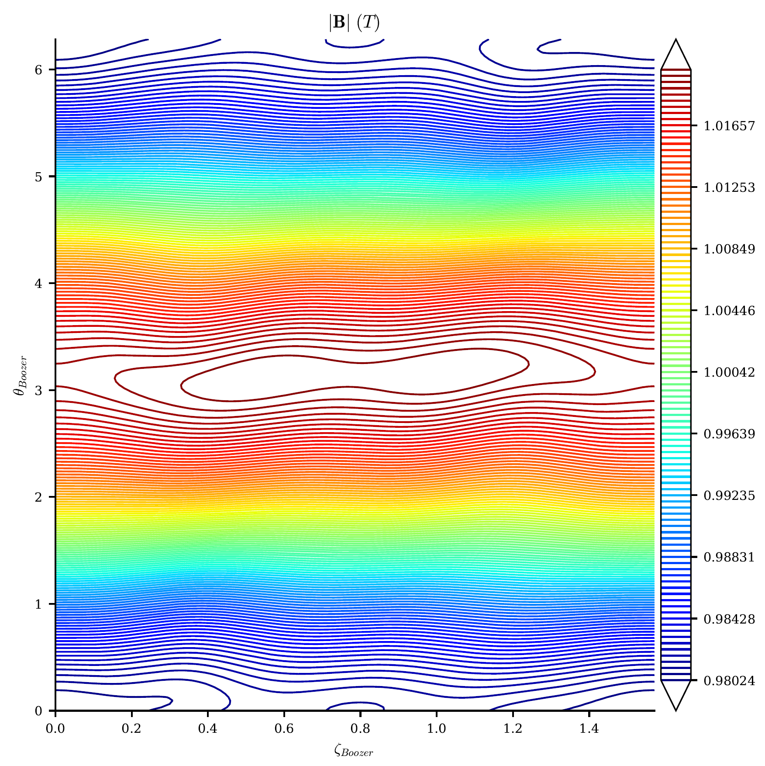
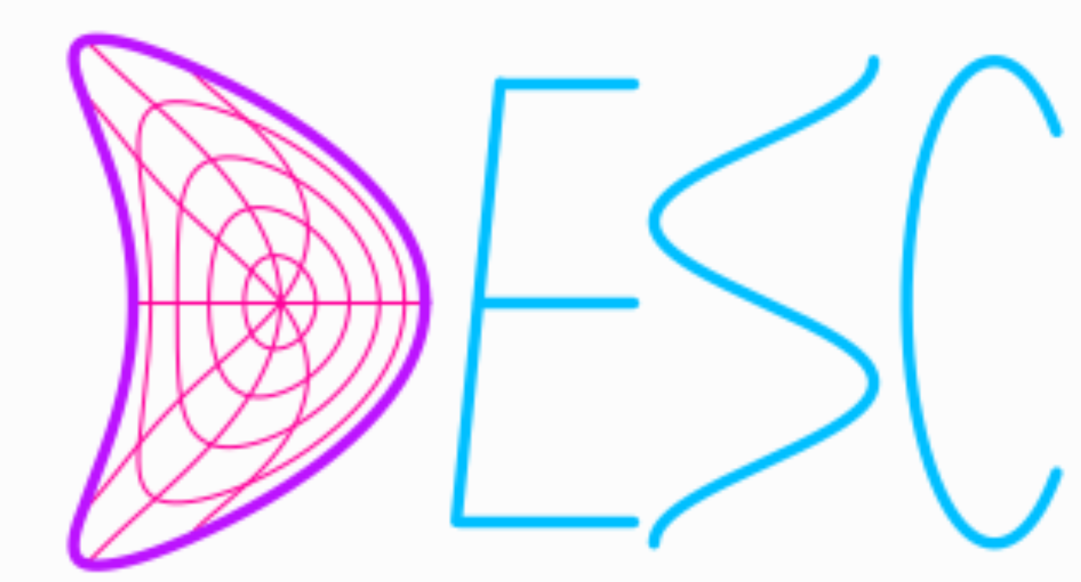
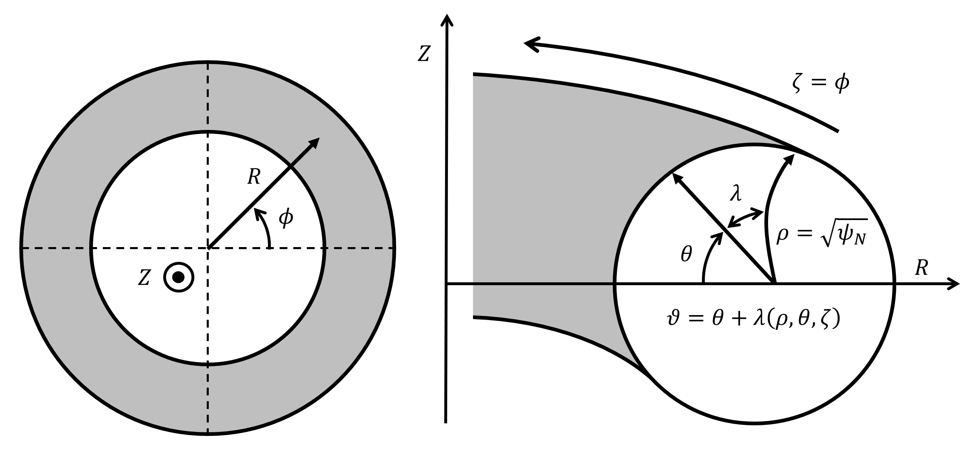
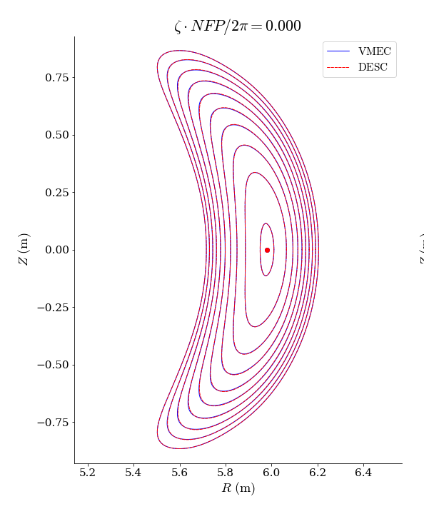
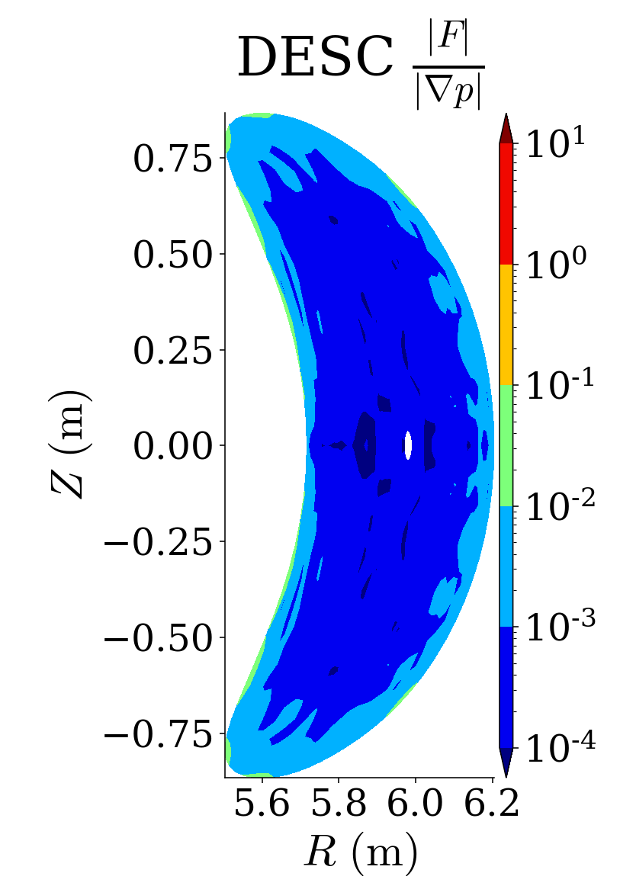
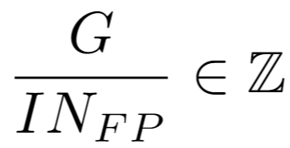
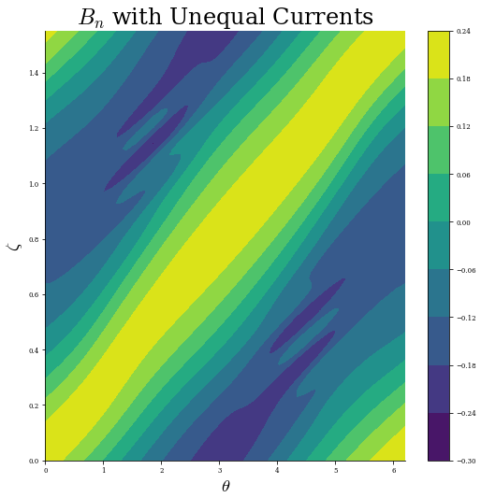
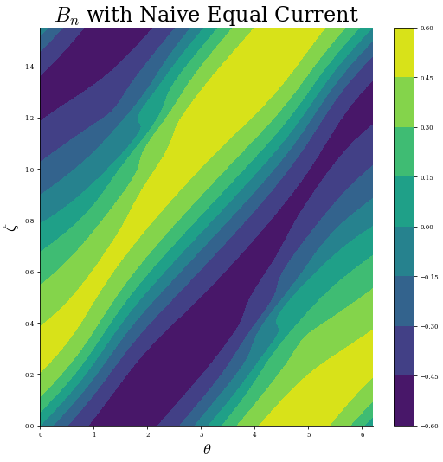
Helical Coil Design in DESC
Dario Panici¹, Rory Conlin¹, Todd Elder³, Rahul Gaur¹, Daniel Dudt¹, Tal Shpigel¹,
Itay Gissis⁴, Nadav Snir⁴, Yasha Nikulshin⁴, Egemen Kolemen^{1,2}
1 Princeton University, 2 Princeton Plasma Physics Laboratory , 3 Columbia University, 4 nT-Tao
Motivation
Accounting For External Fields
Results
Stellarator optimization typically takes a two-stage approach:
Stage 1: Optimize Physics Objectives To Obtain Boundary
Stage 2: Minimize $B_{n}$ on Boundary to obtain Coils
Implementing coil optimization capabilities in DESC:
Combine equilibrium + coil optimization code [cite Rogerio 1stage]
Utilize DESC’s automatic differentiation
Helical Coil Optimization: Limited options with current coil codes
Total net poloidal current outside plasma determined by equilibrium field
External coils (TF, PF, Planar, etc) may be present outside of winding surface - must account for this!
Example helical coilset for QA Equilibrium on a circular toroidal winding surface
Demonstrates low normal field on surface
Can be extended to include external solenoid
Quasisymmetry
Optimization Code (DESC)
Stability
Fig: Equilibrium (red-blue) with representative winding surface (grey) with helical coils (black) inside an external planar coil set (orange)
Optimized Equilibrium
Coil Optimization Code (DESC, REGCOIL, FOCUS)
Coil Cutting Procedure
Minimize $B_{n}$
Each constant $Φ$ contour is a possible coil – can choose coils by picking contours starting from evenly spaced values in $θ$at $ζ=0$
Assigning Coil Currents
To assign currents to the helical coils (in the absence of saddle coils), we can think of each coil has being responsible for the current up to halfway between its neighboring coils
To find the current this represents, we only need to consider the current entering the region from one side (due to K being divergence-free):
Current entering left region = current exiting right region
Only need to evaluate
Equal Current Algorithm
Equal current in all coils advantageous from engineering perspective
However, cannot naively pick equally spaced contours and set currents equal
Instead, minimize current difference $≔f(θ_{i})$ w.r.t. $θ_{i}$
Note: Sum of currents in coils must be equal to net toroidal current $I$
DESC Stellarator Optimization Code
$$Right$$
DESC¹ is a 3D ideal MHD Stellarator Equilibrium and Optimization code²
Written in Python+JAX² enables GPU + Automatic Differentiation capability
Extension underway to handle optimization of coils + surfaces + equilibria
REGCOIL³ algorithm being implemented as part of the coil capabilities
$$n_{2d}$$
Top
$$K$$
$$Left$$
Bot
Current per Coil | 73.35 KA
Number of Coils | 12
Max B_{normal} on Plasma Surface | 1.1e-3 T
REGCOIL Algorithm
Conclusions and Future Work
Using surface current distributions on a specified winding is an efficient approach to the coil-finding problem^{4,5}
Then minimization of quadratic flux becomes a linear (in $Φ_{sv}$) least-squares problem, after expanding in Fourier Series (I,G, and other terms are known)
However, can lead to poor solutions without regularization -> REGCOIL adds regularization to the problem based on the surface current
Helical coils found by specifying net toroidal current $I$ such that
Can calculate net toroidal or net poloidal current through a section of the surface as:
REGCOIL algorithm implemented in Python+JAX inside of the DESC code suite
Helical coil cutting algorithms implemented, with capability to optimize chosen coil contours so that resulting coils have equal currents
Future work:
Adding filamentary coil optimization capability to DESC
Implement ability to handle saddle coils
Using REGCOIL + AD to provide coil objectives for use in stellarator optimization
0
Surface Current Density
Unit Normal to Winding Surface
Current Potential
$G$: Surface Net Poloidal Current
$I$: Surface Net Toroidal Current
b/c
References
[1] D. Panici, R. Conlin, D.W. Dudt, K. Unalmis, and E. Kolemen. The DESC stellarator code suite. Part 1. Quick and accurate equilibria computations. JPP, 89(3):955890303, Jun. 2023.
[2] J. Bradbury et al, JAX: composable transformations of Python+NumPy programs. 2018.
[3] M. Landreman. An improved current potential method for fast computation of stellarator coil shapes. Nuclear Fusion, 57(4):046003, April 2017.
[4] P. Merkel. Solution of stellarator boundary value problems with external currents. Nuclear Fusion, 27(5):867–871, May 1987.
0.24
0.60
0.040
0.18
0.45
0.032
Current Potential On Winding Surface
0.12
0.30
0.024
Acknowledgements
$$2π$$
0.06
0.15
0.016
0.00
0.00
0.008
The authors are grateful to Matt Landreman for help with understanding the REGCOIL algorithm
This work is supported by US DoE DE-AC02-09CH11466, DESC0022005, and Field Work Proposal No. 1019
Visit
Our Website!
$$θ$$
$$I$$
-0.06
-0.15
0.000
$$θ_{i}$$
-0.12
-0.30
-0.008
$$I_{i}$$
-0.18
-0.016
$$G_{i}$$
$$2π/N_{FP}$$
-0.24
-0.45
-0.024
$$ζ$$
-0.30
-0.60
-0.032

