Slide 1
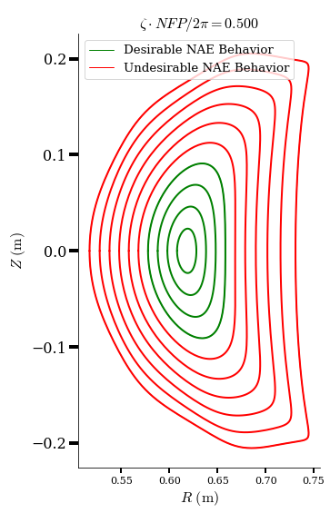
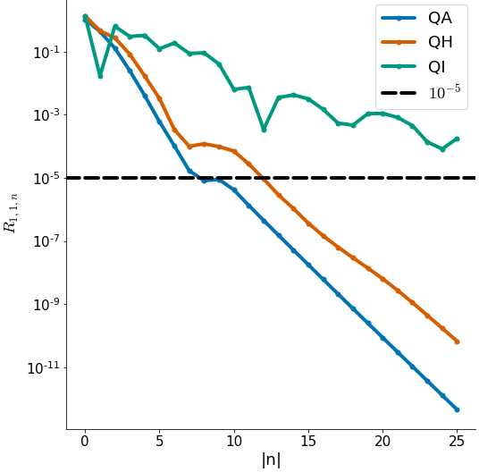
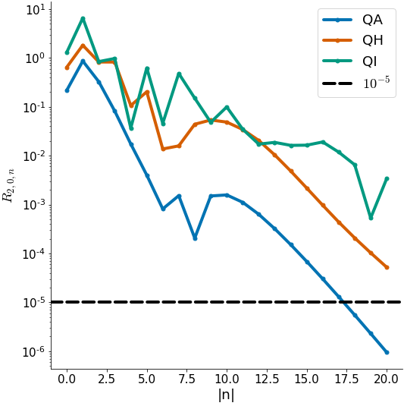
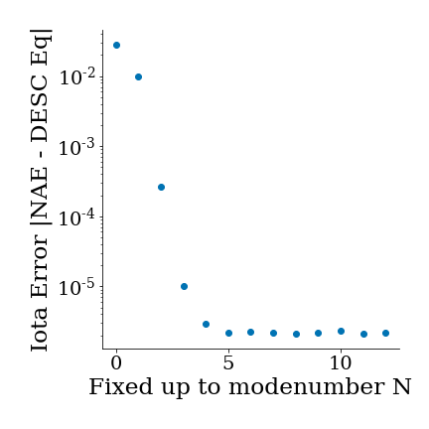
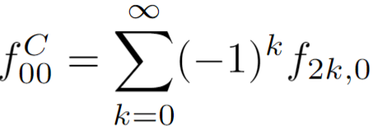
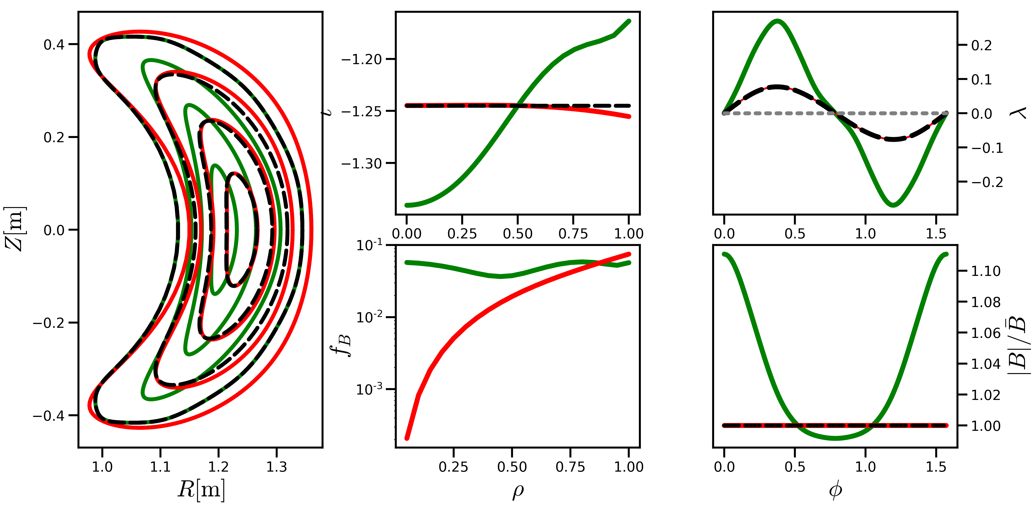
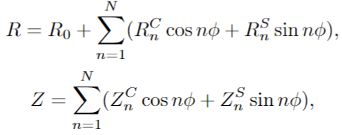
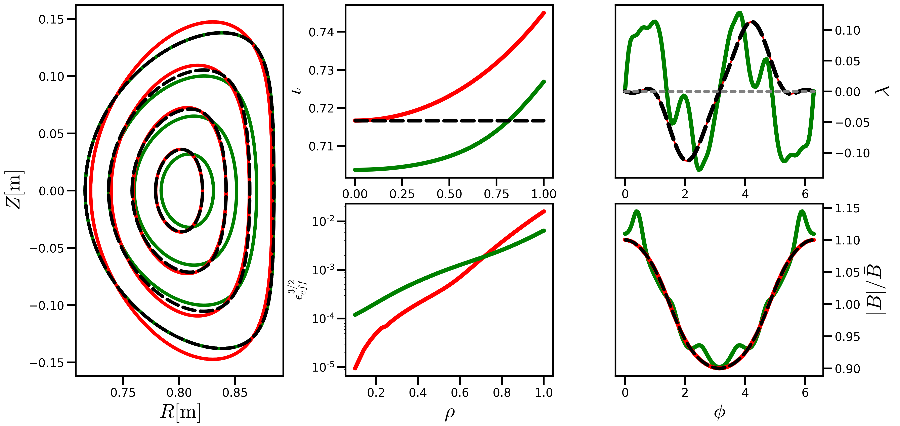
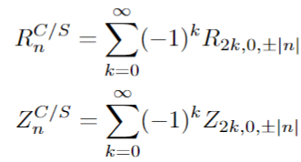
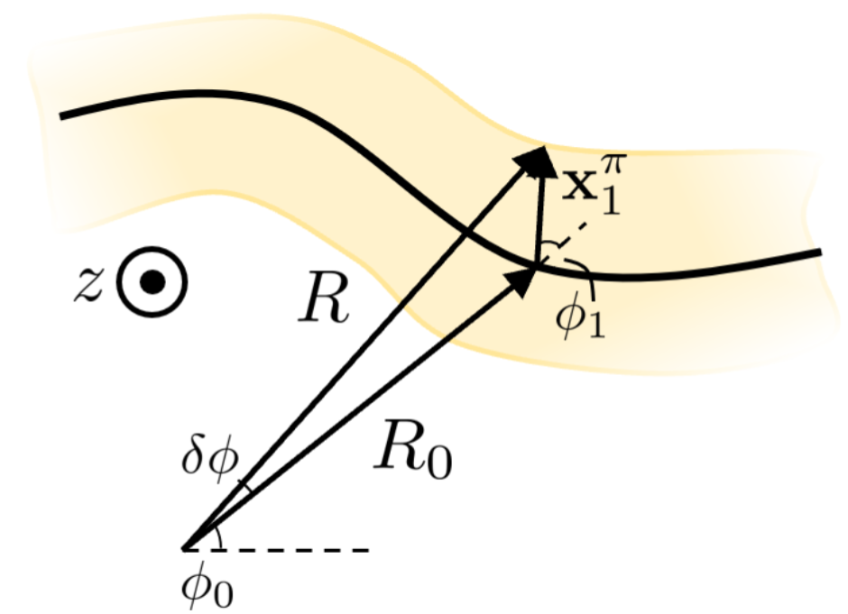
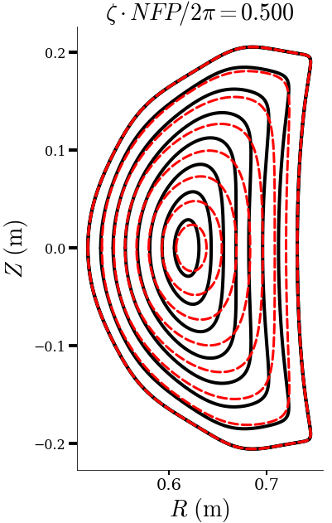
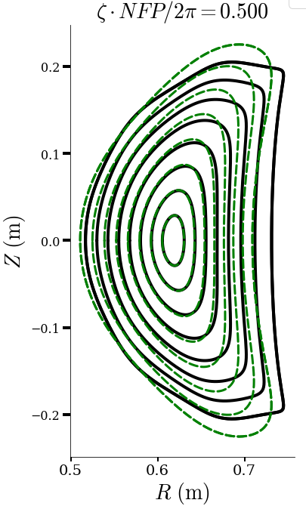
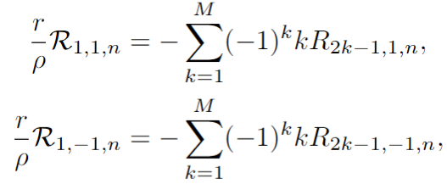
DESC Near-Axis-Constrained Equilibria
Dario Panici¹, Eduardo Rodriguez ³, Rory Conlin¹, Daniel Dudt¹, Egemen Kolemen^{1,2}
1 Princeton University, 2 Princeton Plasma Physics Laboratory , 3 IPP-Greifswald
Motivation
NAE Behavior Verification Quantities
Discussion
Near-axis expansion (NAE) theory lends analytic insight into 3D ideal MHD equilibria¹
However, global 3D ideal MHD solutions still necessary
Current method of using NAE in global solutions fixes outermost boundary – where NAE is least reliable!
Reliable NAE information is near-axis: let’s constrain global solution here!
Following quantities are shown below to verify the DESC equilibrium matches the NAE
Results confirm that the DESC NAE-constrained equilibria agree with NAE near-axis, as expected
To constrain the NAE behavior, the NAE coefficients are fit with a cylindrical toroidal Fourier series
Rate of convergence of Fourier fit indicative of how well that NAE behavior is described with cylindrical $φ$
Poor convergence motivates use of a generalized toroidal angle
Magnetic Axis and Near-Axis Flux Surfaces
On-axis Rotational Transform
On-axis Poloidal Angle ($θ=θ_{B}$)
Near-Axis Confinement
(f_{B} for QS, $ε_{eff}^{3/2}$for QI)
On-axis Magnetic Field Magnitude $|B|$
O(ρ) NAE-constrained DESC Equilibria
O($ρ$) Coefficient $R_{1,1,n}$
O($ρ^{2}$) Coefficient $R_{2,0,n}$
QA NAE behavior simplest to describe
QI NAE behavior very difficult to describe with cylindrical angle!
O($ρ$) NAE behavior much easier to describe with cylindrical angle than O($ρ^{2}$)
O($ρ^{2}$) – constrained equilibria may require very high N_{tor} to capture behavior accurately
Generalized toroidal angle may help condense spectrum
Precise QA³
Fig. 1: NAE flux surfaces from pyQSC
Connecting NAE Expansion and Zernike Basis
NAE Basis
Zernike Basis
Given this, how do quantities of interest converge with the resolution with which we constrain the NAE behavior?
Shown is error in on-axis $ι$ for precise QA case between the DESC NAE-constrained solution and NAE
Each point is an equilibrium constrained with the NAE behavior fit only up to the given toroidal resolution N
Equilibrium on-axis iota converges to NAE iota quicker than the NAE coefficients decay -> possibly need less toroidal resolution to constrain the solution to target NAE behavior than above plots otherwise indicate
We can choose $θ=θ_{B}$
We then proceed by setting these two expressions equal and collecting terms on both sides, to find the relation between coefficients in each basis
Ignore toroidal dependence for now
Relation for arbitrary order:
Zeroth Order, evaluate at $f(ρ=0,θ)$
In NAE basis, corresponds to only $f_{00}^{C}$
In Zernike, corresponds to linear combination of even (radial) modes $f_{n,m=0}$:
Jacobi polynomial in $ρ$ of degree n
First Order, compare $sinθ$ and $cosθ$ terms
In NAE basis, corresponds to only $f_{11}^{C}$ and $f_{11}^{S}$
In Zernike, corresponds to linear combination of odd (radial) modes $f_{n,m=±1}$:
Precise QH³
Connecting NAE and DESC Geometry
Conclusions and Future Work
DESC² uses cylindrical coordinates ($R,φ,Z$)
NAE describes flux surfaces in Frenet-Serret frame, using as coordinates ($r,θ_{B},ζ_{B}$)
Must connect these two geometric representations to constrain DESC with NAE
We do so order by order in $ρ$
DESC Geometry Described with Fourier-Zernike Basis
Demonstrated connection between global 3D MHD equilibria and NAE behavior – available to use in the DESC code!
Future work includes:
Performing global optimization with NAE-constrained core behavior
Implementation and verification of O($ρ^{2}$) NAE constraints (enforce stability)
Using a generalized toroidal angle in DESC to better represent NAE behavior
extension to anisotropic NAE⁵
Zeroth Order – Magnetic Axis
In NAE, axes described by R,Z as functions of $φ$ (which can be mapped to length and therefore equivalent to $ζ_{B}$)
In DESC, we simply evaluate the Fourier-Zernike basis at $ρ=0$, where all $m>0$ modes are zero, leaving with:
First Order – O($ρ$) Behavior (Elliptical)
We will express the position (to O($ρ$)) on a flux surface as
And our goal is to find expressions from the NAE of the form:
Which we can then match with the DESC representation.
After a geometric derivation, we find:
$x_{1}^{α}=x_{1}∙\hat{α}$ , $r_{0}\left(φ\right)=R_{0}\hat{R}+Z_{0}\hat{Z}$
And with the O($ρ$) position from NAE:
We can now translate the NAE information into the cylindrical form used in DESC, yielding (similar to before):
identical form for Z
QI⁴
References
[1] D A Garren and A H Boozer. Magnetic field strength of toroidal plasma equilibria. Phys. Fluids B, 3:2805, 1991
[2] D. Panici, R. Conlin, D.W. Dudt, K. Unalmis, and E. Kolemen. The DESC stellarator code suite. Part 1. Quick and accurate equilibria computations. JPP, 89(3):955890303, Jun. 2023.
[3] M. Landreman and E. Paul. Magnetic Fields with Precise Quasisymmetry for Plasma Confinement. Physical Review Letters, 128(3):035001, Jan. 2022
[4] G. G. Plunk, M. Landreman, and P. Helander. Direct construction of optimized stellarator shapes. Part 3. Omnigenity near the magnetic axis. JPP, 85(6), Dec. 2019.
[5] E. Rodriguez and A. Bhattacharjee. Connection between quasisymmetric magnetic fields and anisotropic pressure equilibria in fusion plasmas. Phys. Rev. E 104, 015213, Jul. 2021.
Acknowledgements
Visit
Our Website!
NAE-constrained solutions asymptotically match the NAE to the specified order as the axis is approached
NAE-DESC behavior connection derived up to 2nd order, in theory could proceed as high as desired (although 2nd order probably is highest needed)
The authors would like to thanks M. Landreman for helpful discussions on NAE theory.
This work was supported by US DoE DE-AC02-09CH11466, DESC0022005, and Field Work Proposal No. 1019
Fig. 2: NAE-Constrained DESC equilibrium versus fixed-boundary solve

