Slide 1
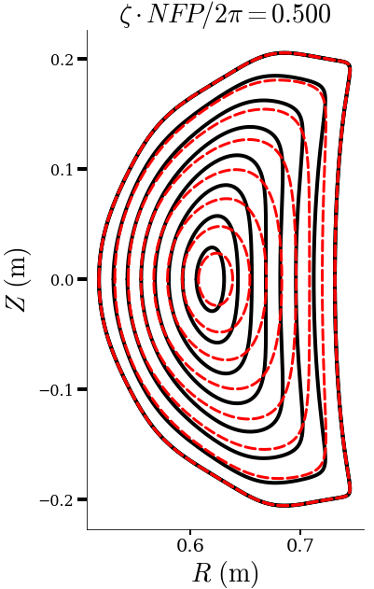
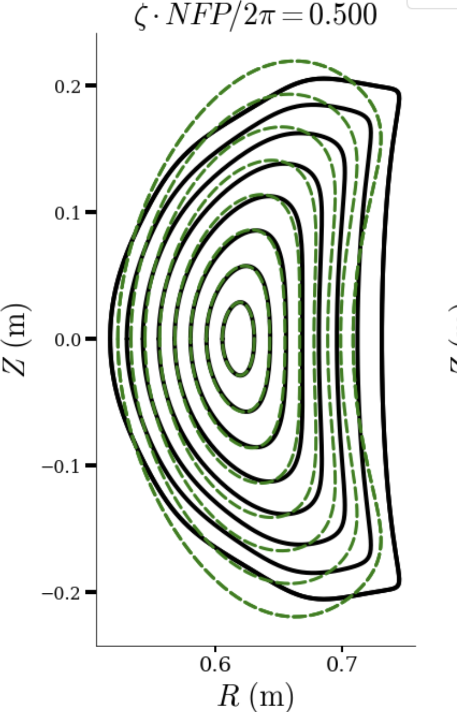
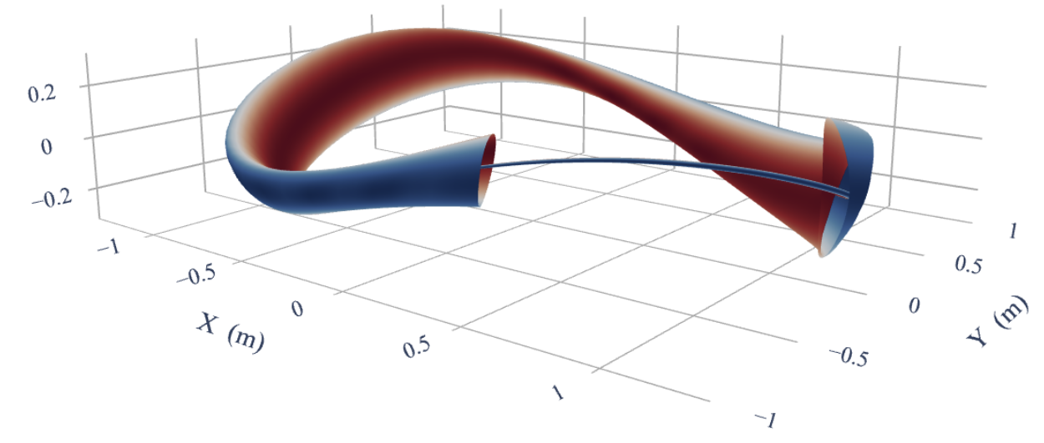
Near-Axis Constrained Equilibria with the DESC code
Dario Panici, Daniel Dudt, Rory Conlin, Eduardo Rodriguez, Egemen Kolemen

Slide 2
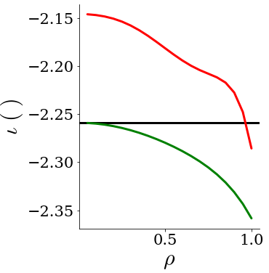
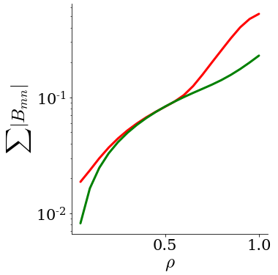
Near-Axis-Expansion Constrained Equilibria in DESC
NAE-constrained equilibrium iota matches NAE near axis
NAE-constrained equilibrium maintains better QS near axis
Global equilibria solutions with near-axis behavior constrained to match the NAE to O($ρ$)
Enables the connection between global MHD equilibria solutions and the existing insight on optimized stellarators
Notes:
QSC Equilibrium from Eduardo Rodriguez
NAE evaluated at r =0.1

Slide 3
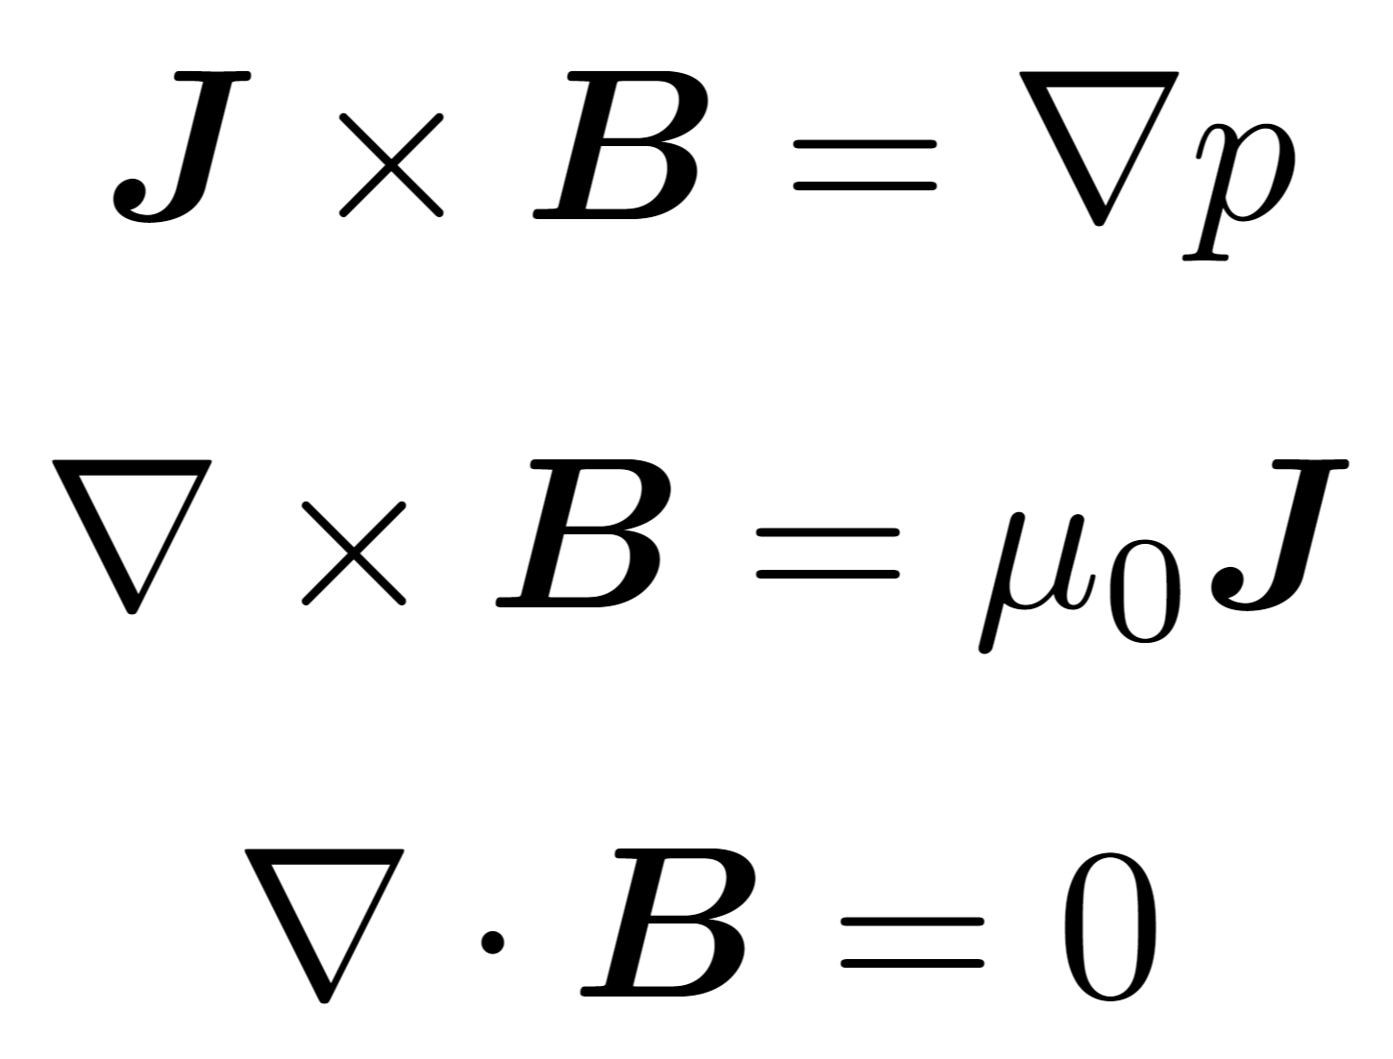
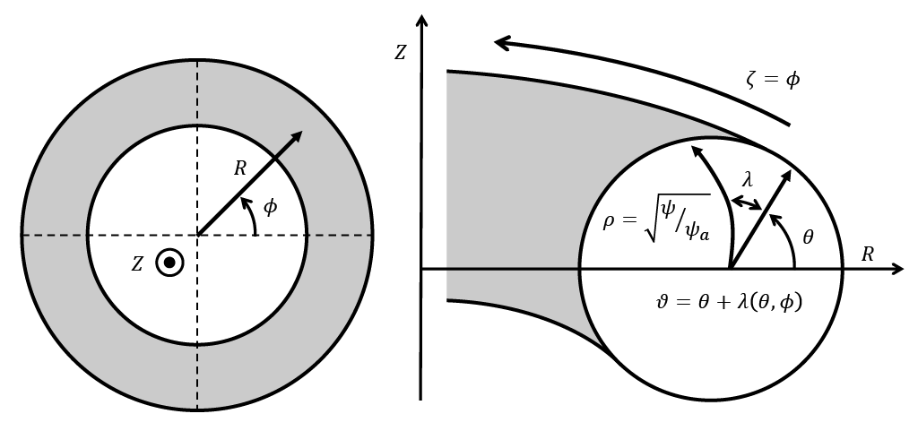
Ideal MHD Equilibrium
Inverse Equilibrium Problem
Cast problem as solving for the locations of the flux surfaces
Yields 2nd order PDE in (𝝆,𝜽,𝞯)
Notes:
Physically, the force balance tells us…
Simple 1D example is an infinitely long, rotationally symmetric cylindrical plasma with current running axially, called a Z-pinch
Additionally, we can see that by taking dot products with B and J, that both these fields lie on surfaces of constant pressure CLICK
these are called ‘flux surfaces’, and are surfaces upon which the B field is everywhere tangential. Shown here are the flux surfaces for this 1D example

Slide 4
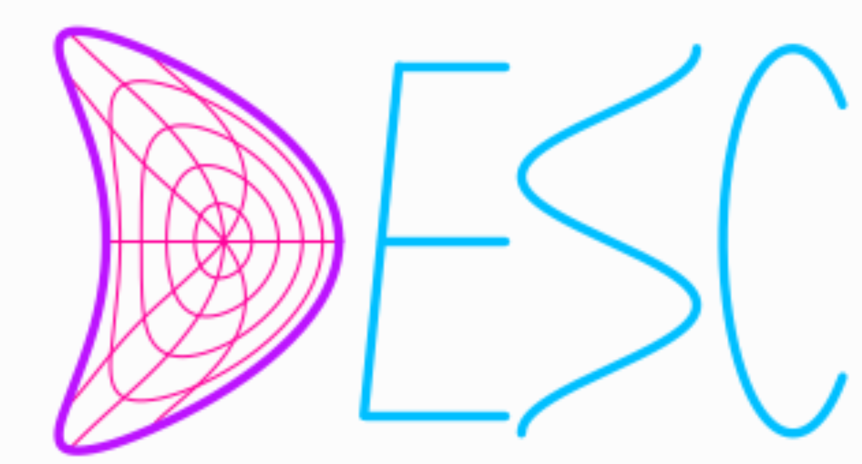
Stellarator Equilibrium - DESC
3D Ideal MHD Equilibrium Code
Assumes Nested Flux Surfaces
Inverse Equilibrium Problem
Minimizes Force Error Directly
Pseudospectral Code
(Dudt and Kolemen 2020)
Notes:
Now let me introduce the DESC code
DESC solves the same problem as VMEC does, but in a different way
While VMEC minimizes energy, DESC minimizes the force error directly
Further, DESC is a pseudospectral code with a spectral basis for both the angular dependence AND the radial dependence
this allows analytic radial derivatives, not finite differences like VMEC must use
Additionally, by casting our problem as finding the roots to the force error residual on the collocation grid, we can use Newton methods

Slide 5
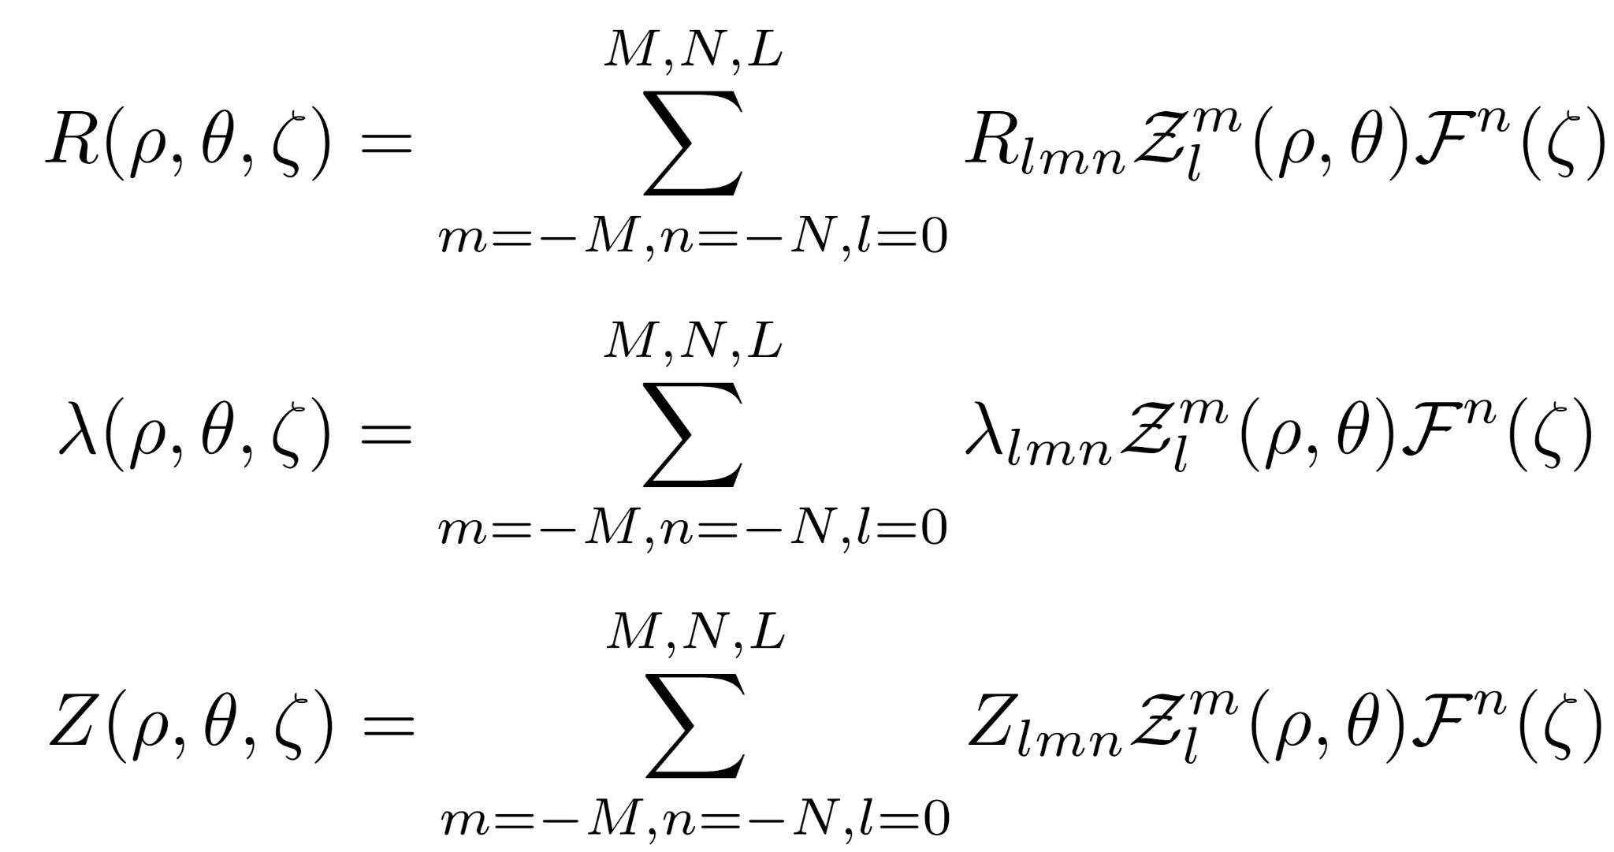
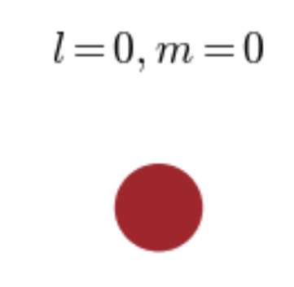
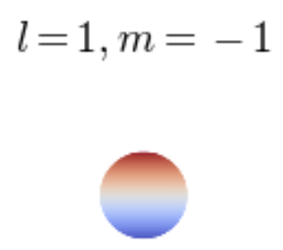
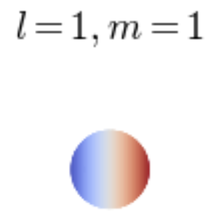
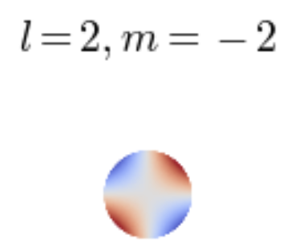
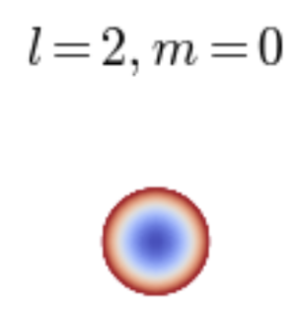
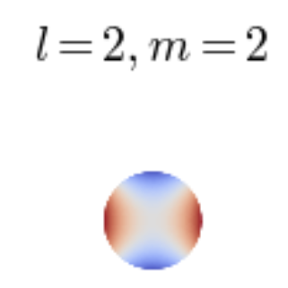
DESC - Fourier-Zernike Spectral Basis
Zernike Polynomials in $(ρ,θ)$ plane
Zernike Polynomials
Radial Polynomial is of degree l-2s, and l=m,m+2,…, L
Toroidal Fourier Series

Slide 6
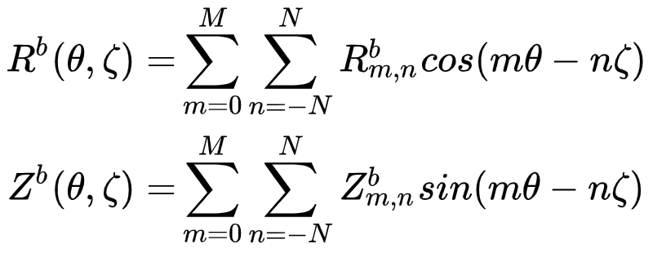
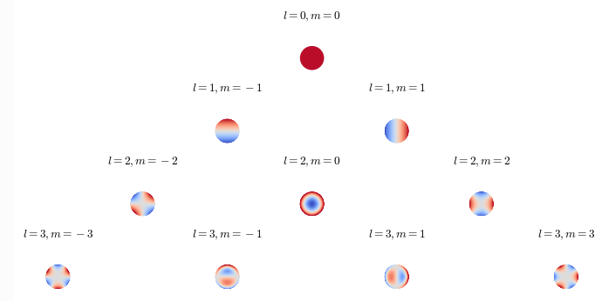
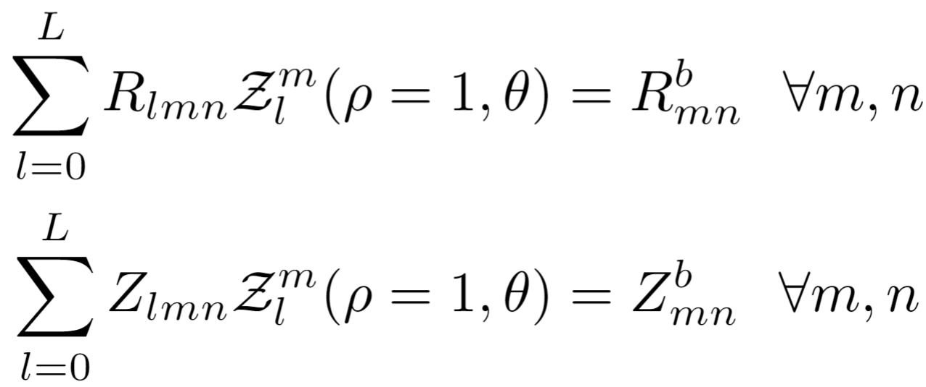
DESC Allows Flexible Constraints when Defining Equilibrium Problem - Fixed 𝝆=1 Boundary
Zernike Polynomials
Fixed-Boundary 𝝆=1 Constraint

Slide 7
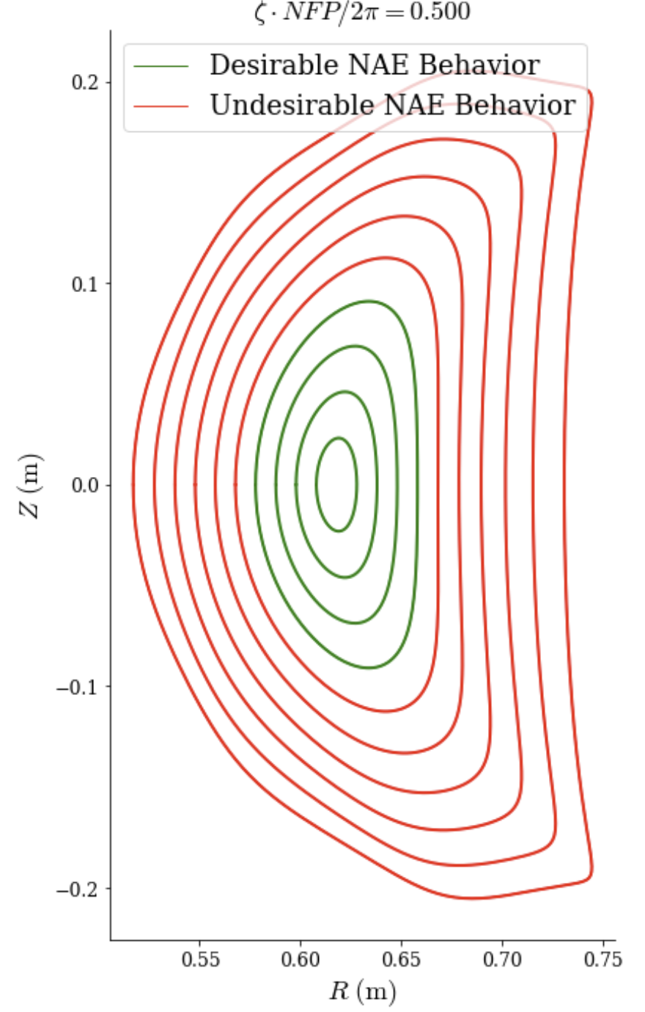
Near-Axis Expansion (NAE) Constraints in DESC
(with E. Rodriguez)
Idea is to constrain the global equilibrium to have NAE behavior as 𝝆→𝟢
only use information from NAE where it is most valid
Avoid singular behavior present when evaluating at large r
Map NAE coefficients to Fourier-Zernike modes of DESC to fix O(𝝆⁰) (axis), O(𝝆¹), O(𝝆²) behavior
pyQSC equilibrium evaluated at r =0.1

Slide 8
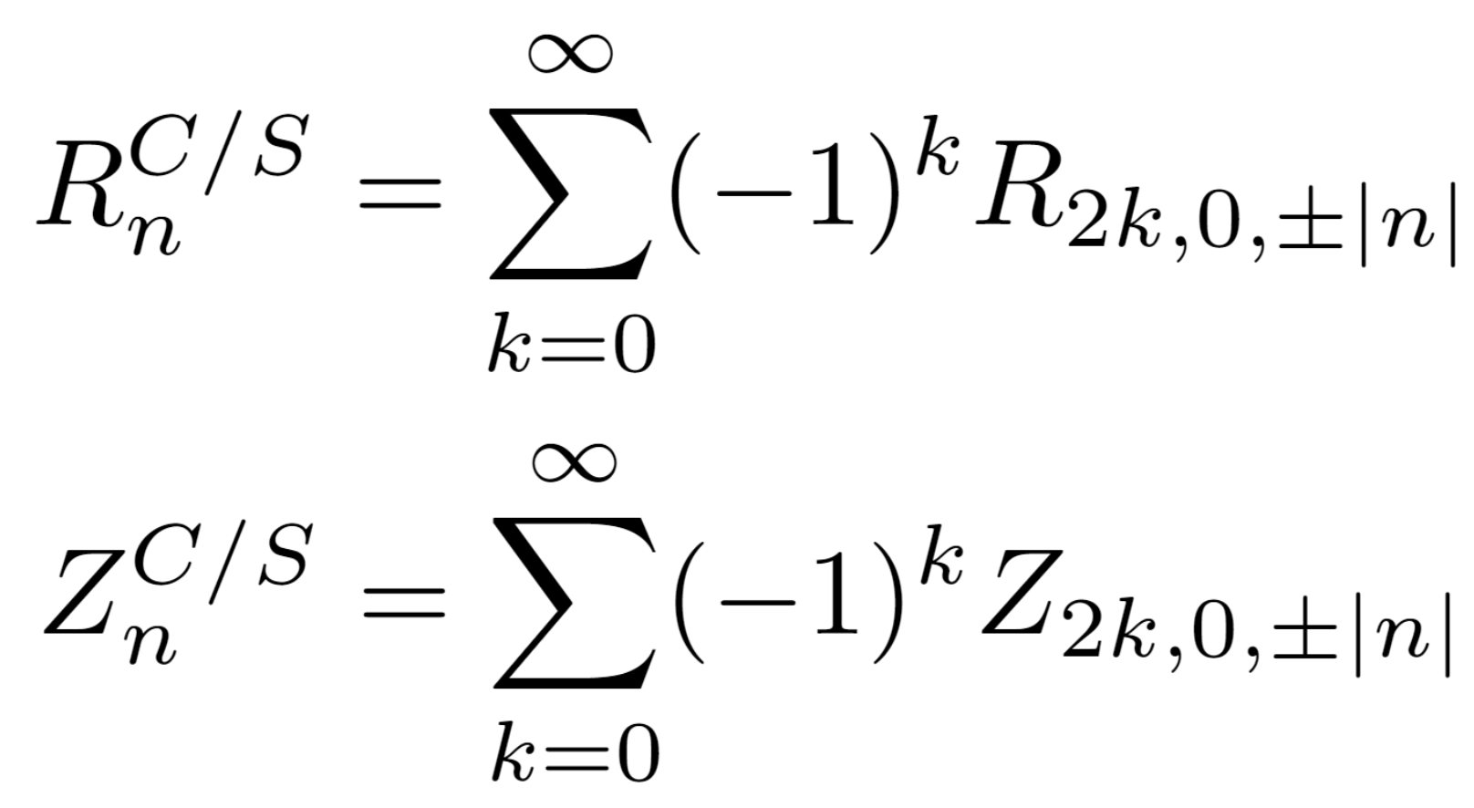
O(𝝆⁰) (axis) Constraint in DESC
NAE axis in pyQSC given as Fourier series in cylindrical toroidal angle 𝝓:
Constraint in DESC representation is simple: Evaluate DESC R(𝝆,𝜃,𝝓), Z(𝝆,𝜃,𝝓) at 𝝆=0 and match terms:
DESC Fourier-Zernike Coefficients
NAE Axis Coefficients
Notes:
obviously, is an underconstrained system, is initial guess dependent (show same axis and 2 different equilibria?)
But opens opportunity to keep the same axis optimized in pyQSC
Further, can constrain near-axis behavior to match the NAE as well

Slide 9
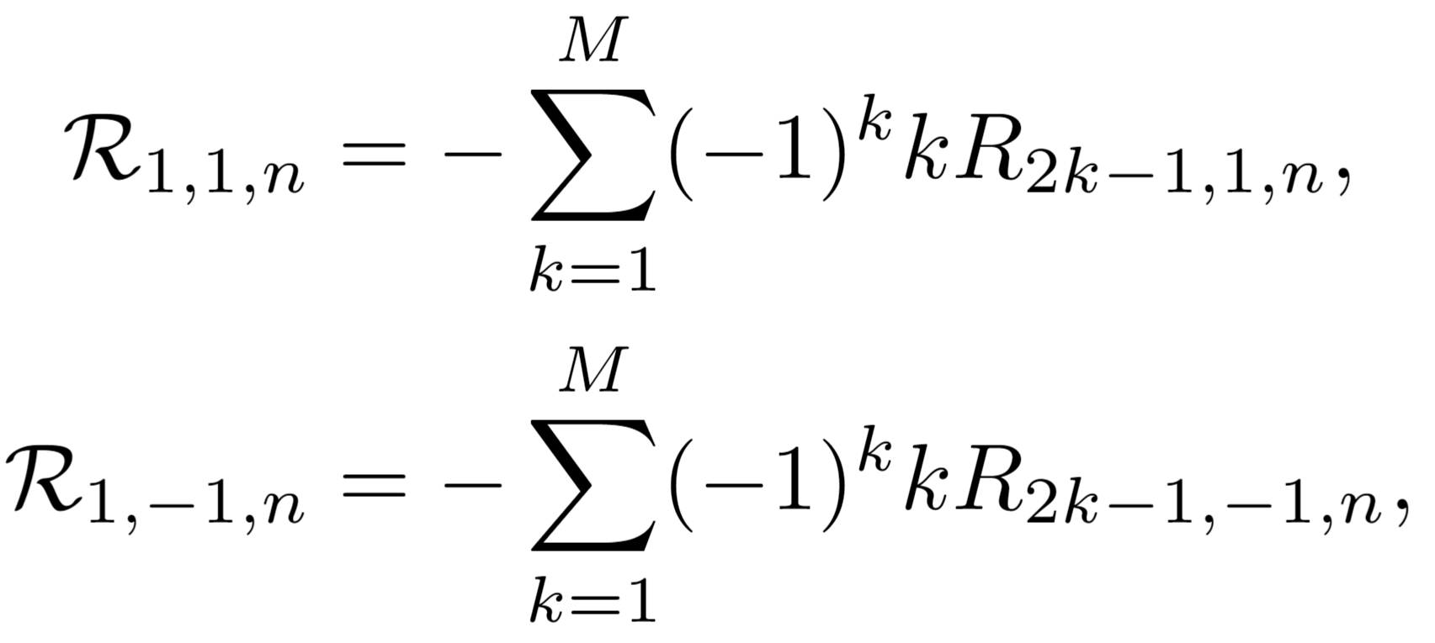
O(𝝆¹) NAE Constraint in DESC
- After a short geometric derivation, one can derive (up to O(𝝆)) the R,Z position of a point on a flux surface from the NAE in terms of the cylindrical angle
where
- And the coefficients are functions of the NAE X,Y coefficients and the Frenet-Serret basis vectors
- Then, equating the O(𝝆) coefficients in the DESC Fourier-Zernike basis with the above expressions yields:
(Identical expressions for Z as well)
DESC Fourier-Zernike Coefficients
NAE Coefficients
Notes:
boozer poloidal angle - mention

Slide 10
Verification of DESC Equilibrium Quantities Against the NAE
On-axis Rotational Transform
On-axis Poloidal Angle ($θ=θ_{B}$)
Magnetic Axis and Near-Axis Flux Surfaces
Near-Axis Confinement
(f_{B} for QS, $ε_{eff}^{3/2}$for QI)
On-axis Magnetic Field Magnitude $|B|$
Will show 3 examples: QA, QH, and a QI NAE-constrained equilibrium

Slide 11
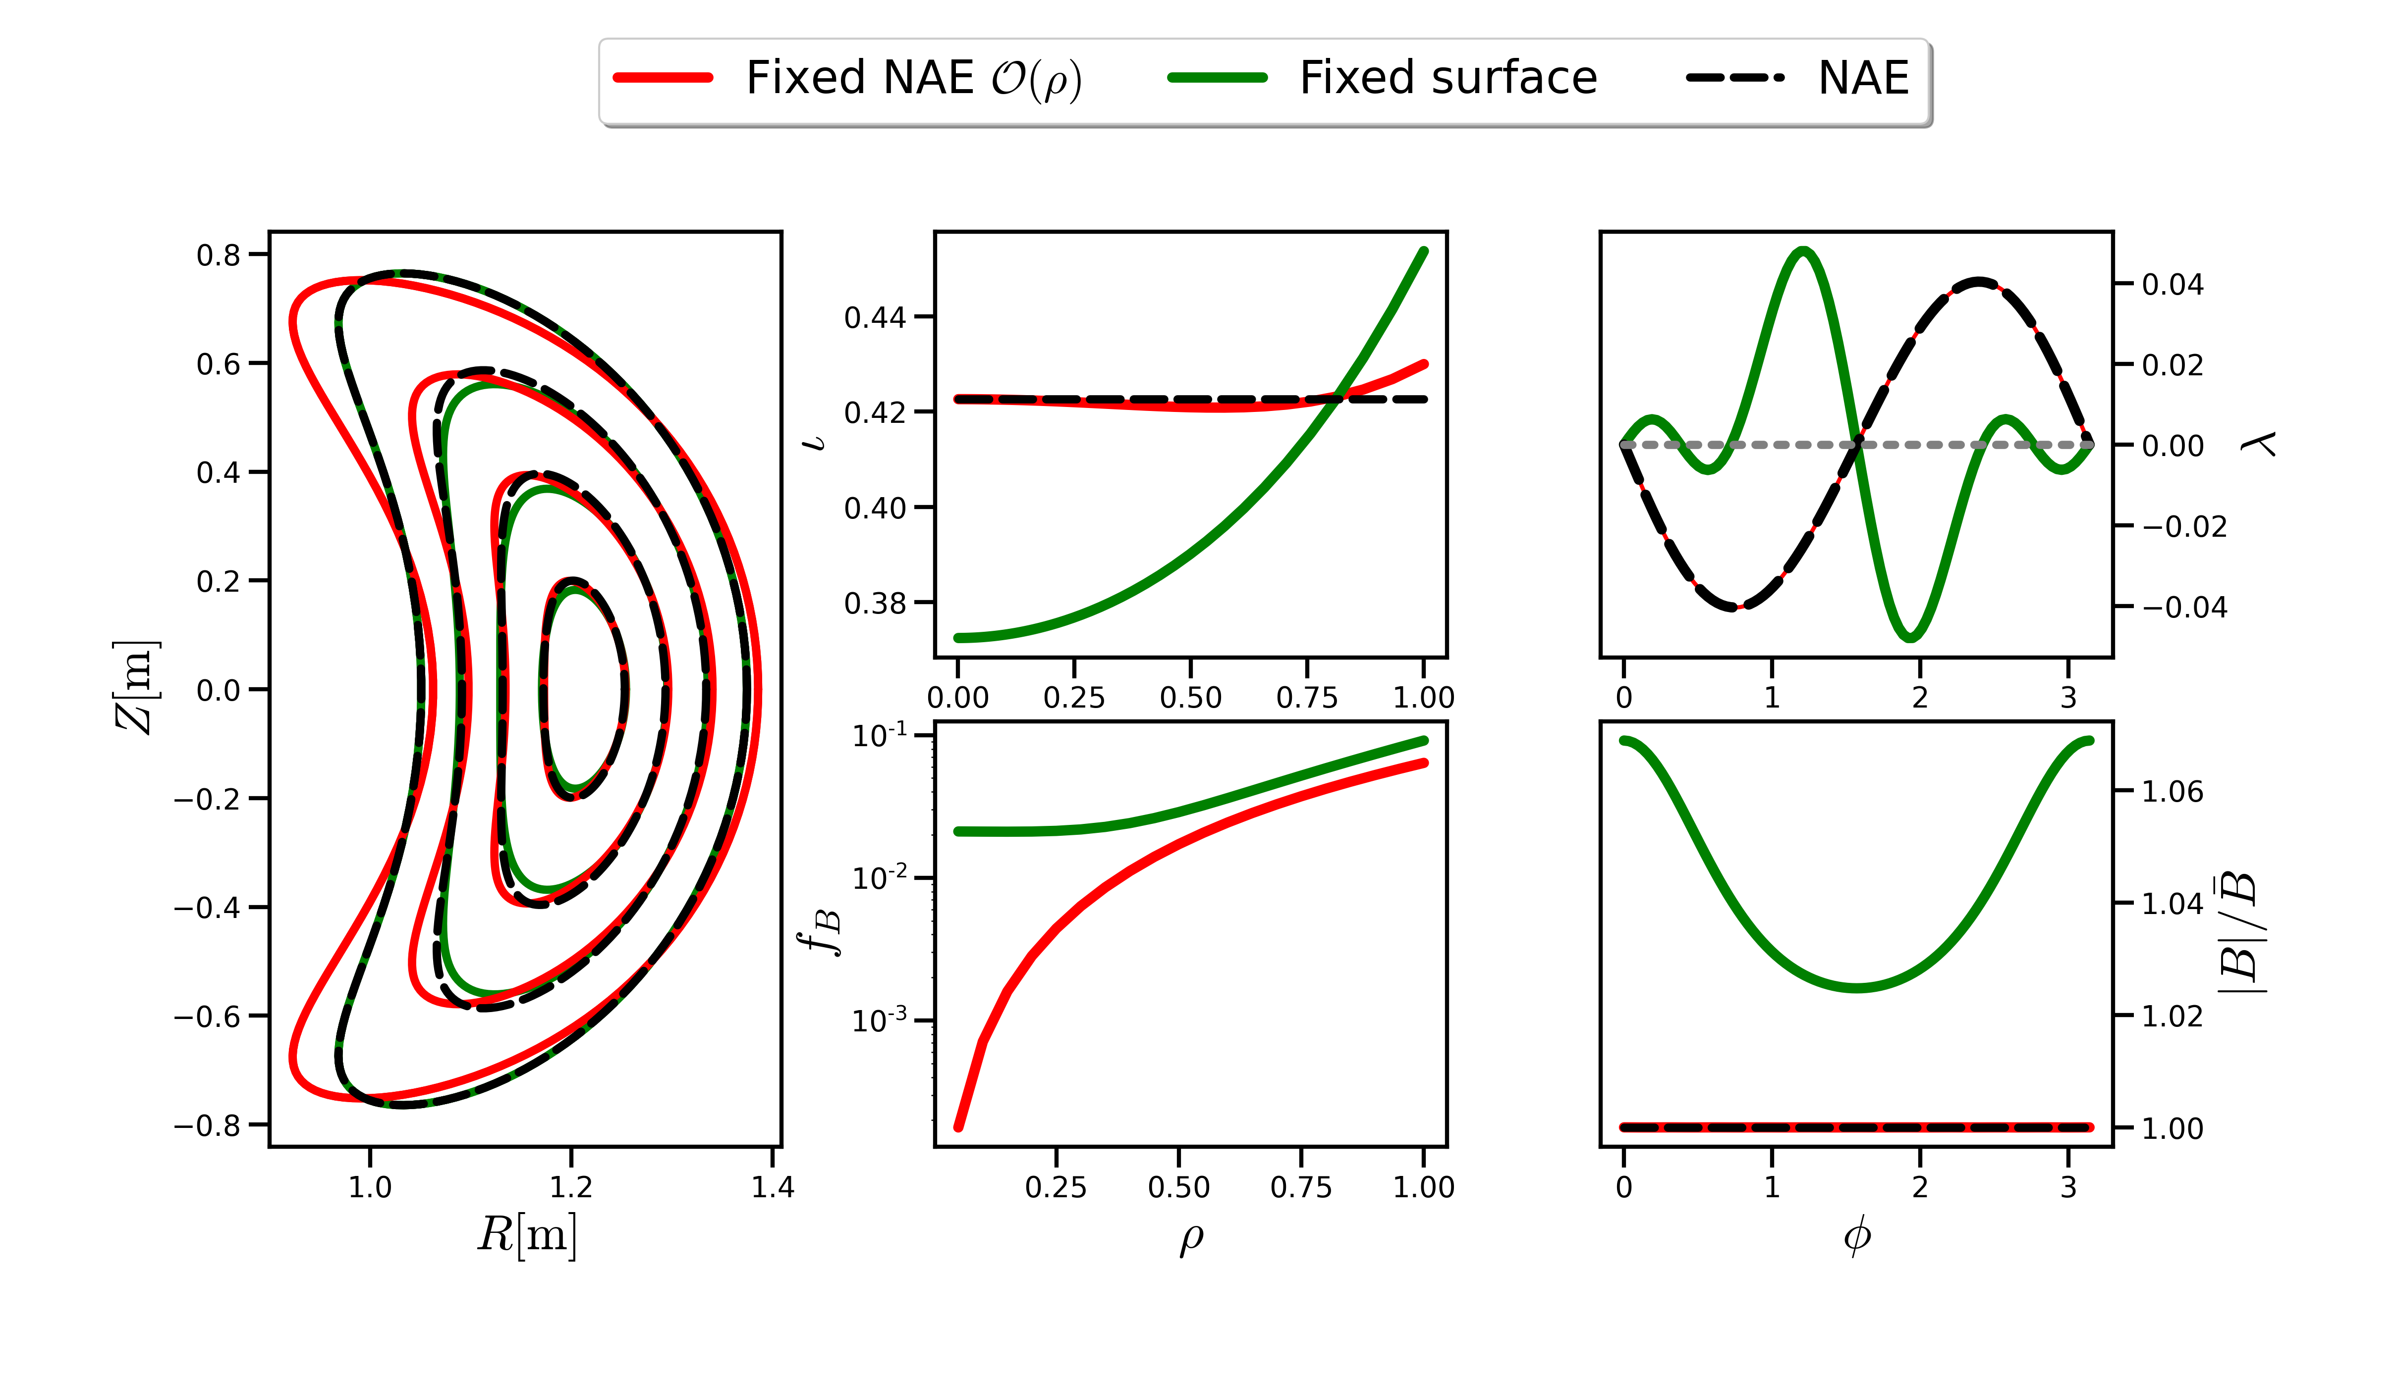
QA O(𝝆¹) NAE-constrained Equilibrium
pyQSC based on Precise QA from (Landreman and Paul 2022)

Slide 12
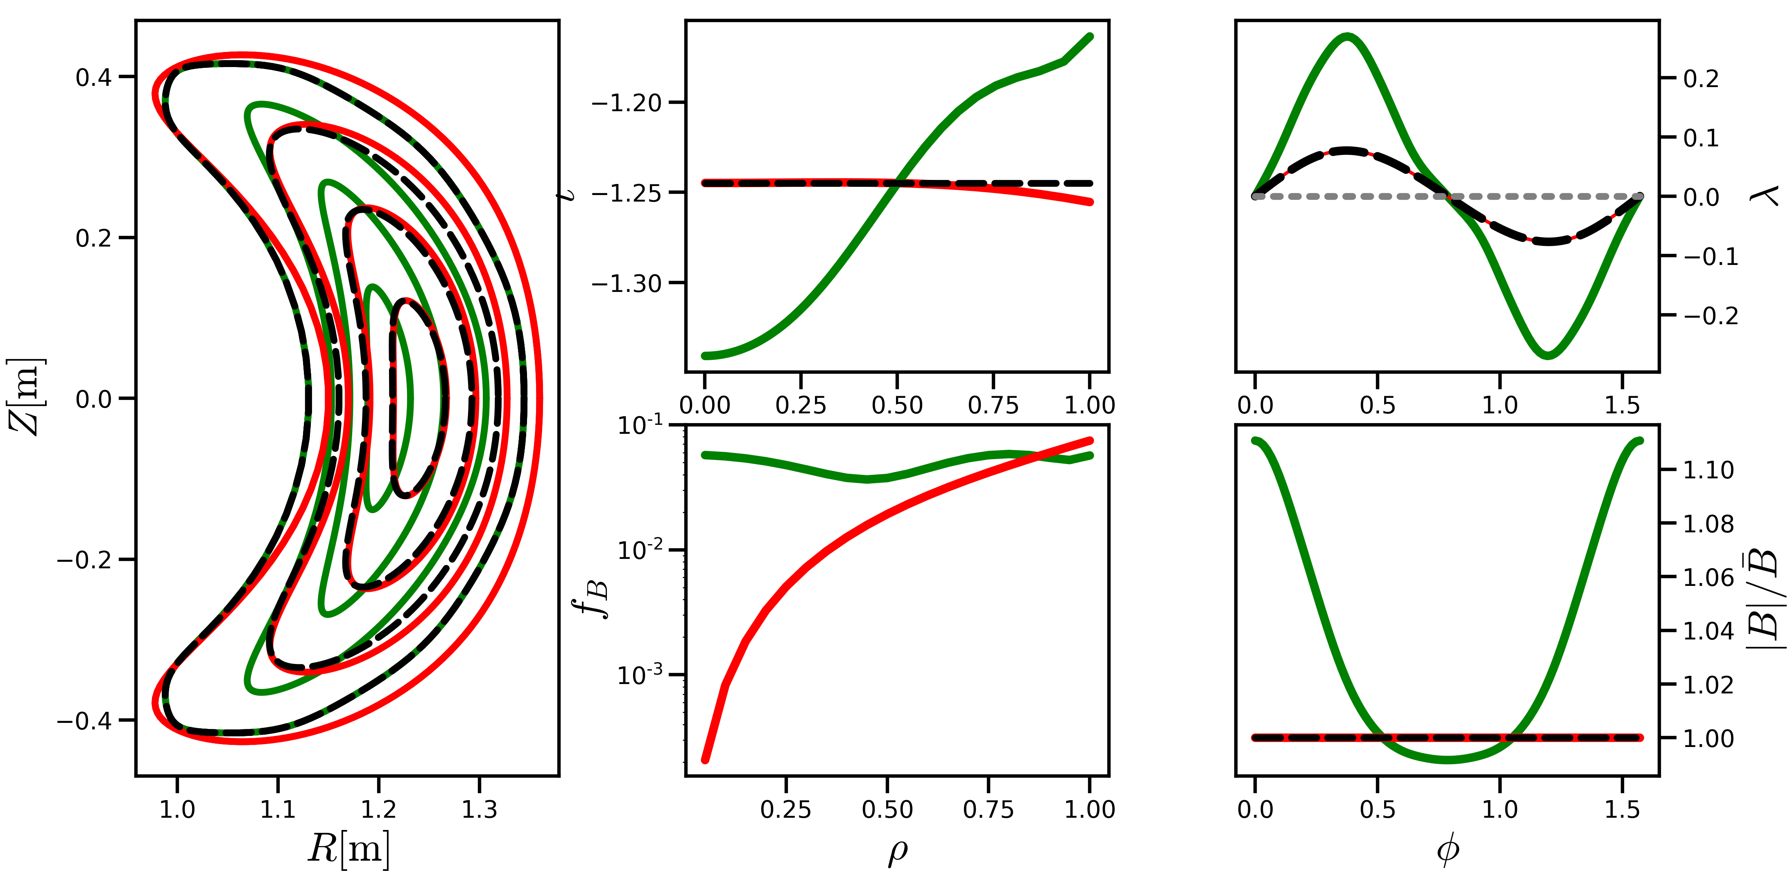
QH O(𝝆¹) NAE-constrained Equilibrium
pyQSC based on Precise QH from (Landreman and Paul 2022)

Slide 13
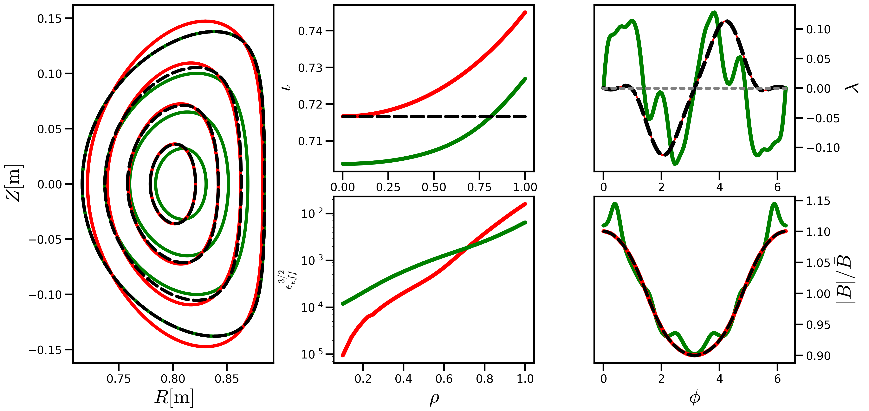
QI O(𝝆¹) NAE-constrained Equilibrium
pyQIC based on QI from section 8.2 of (Plunk, Landreman and Helander 2019)

Slide 14
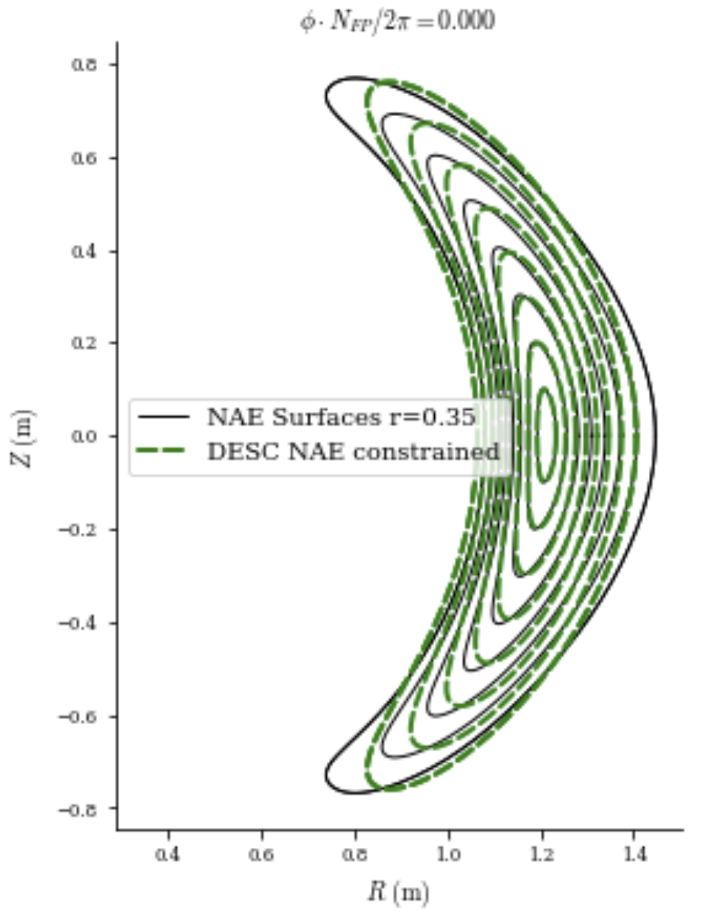
Example Python Code for NAE-Constrained Equilibria in DESC – Simple!
# imports
from qsc import Qsc
from desc.objectives import get_NAE_constraints
from desc.equilibrium import Equilibrium
# fit initial DESC equilibrium from desired qsc solution
qsc = Qsc.from_paper('precise QA',nphi=99)
desc_eq = Equilibrium.from_near_axis(qsc,r=0.35,L=9,M=9,N=10)
# get constraints on axis and O(r) coefficients
# to pass to eq.solve using utility function
cs = get_NAE_constraints(desc_eq, qsc, order=1)
# solve NAE-constrained equilibrium
desc_eq.solve(objective=”force”,constraints=cs);
Tutorial on DESC documentation website: desc-docs.readthedocs.io

Slide 15
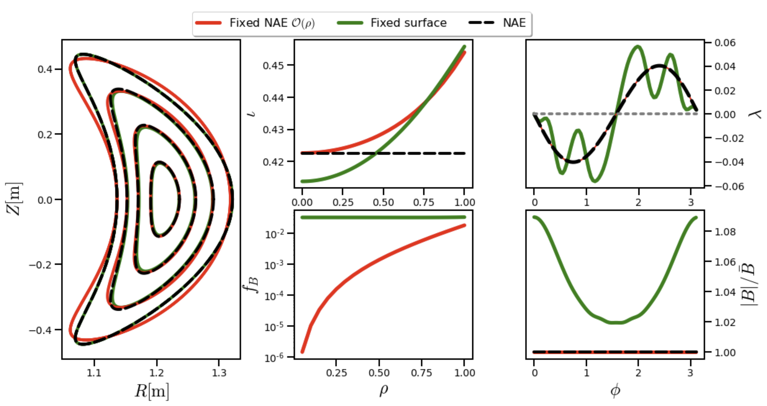
QA O(𝝆²) NAE-constrained Equilibrium

Slide 16
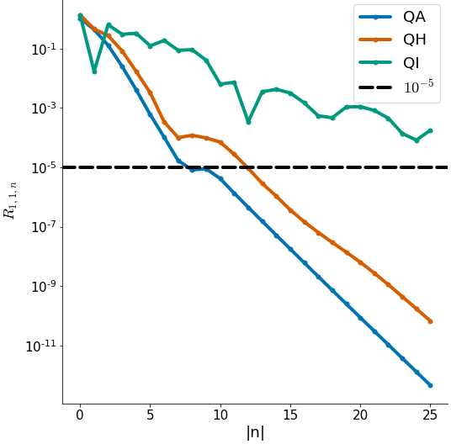
Fitting NAE Behavior with Toroidal Fourier Series – O($ρ^{1}$)
O($ρ$) Coefficient $R_{1,1,n}$
QA NAE behavior simplest to describe
QI NAE behavior very difficult to describe with cylindrical angle!

Slide 17
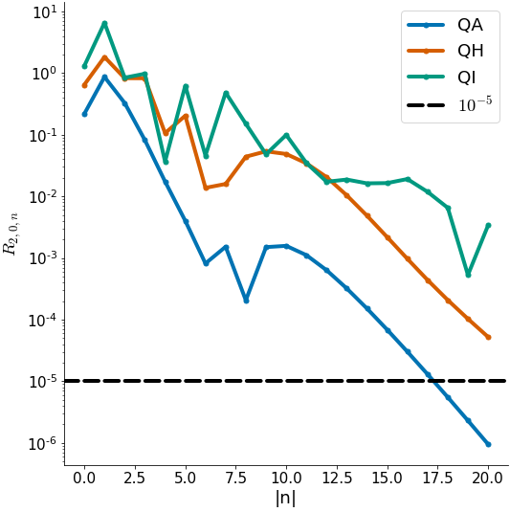
Fitting NAE Behavior with Toroidal Fourier Series – O($ρ^{2}$)
O($ρ$) Coefficient $R_{1,1,n}$
O($ρ^{2}$) Coefficient $R_{2,0,n}$
O($ρ$) NAE behavior much easier to describe with cylindrical angle than O($ρ^{2}$)
O($ρ^{2}$) – constrained equilibria may require very high N_{tor} to capture behavior accurately
Generalized toroidal angle may help condense spectrum

Slide 18
(REG)Coil Optimization In DESC

Slide 19
REGCOIL Algorithm
Using surface current distributions on a specified winding is an efficient approach to the coil-finding problem^{4,5}
Then minimization of quadratic flux becomes a linear (in $Φ_{sv}$) least-squares problem, after expanding in Fourier Series (I,G, and other terms are known)
However, can lead to poor solutions without regularization -> REGCOIL adds regularization to the problem
Surface Current Density
Unit Normal to Winding Surface
Current Potential
$G$: Surface Net Poloidal Current
$I$: Surface Net Toroidal Current

Slide 20
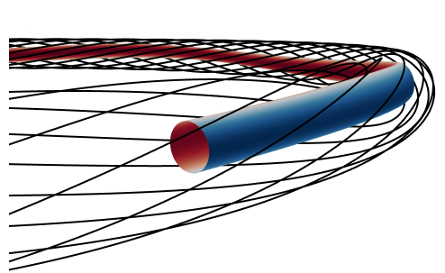
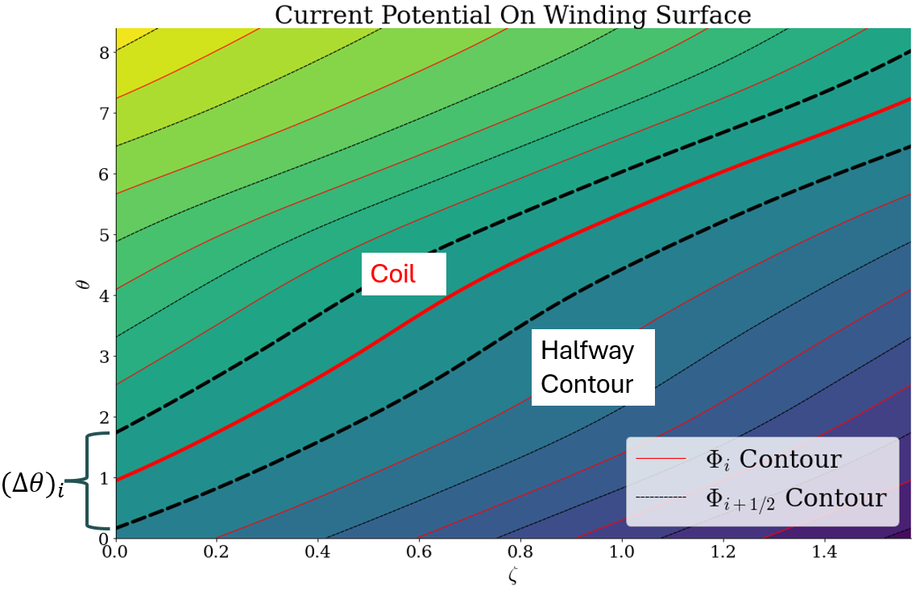
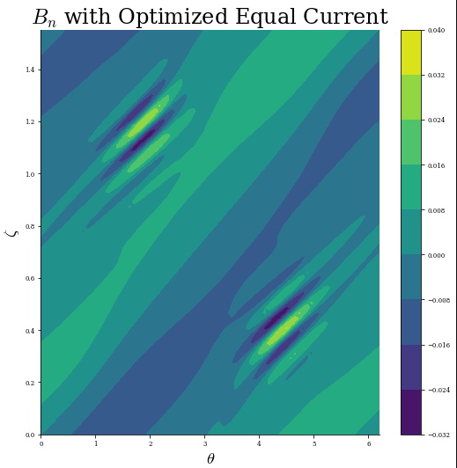
Helical Coilset in DESC
Helical Coilset
$$B_{n}$$
REGCOIL Algorithm implemented in DESC to find surface currents
Helical coil-cutting capabilities also implemented to discretize into helical coils

Slide 21
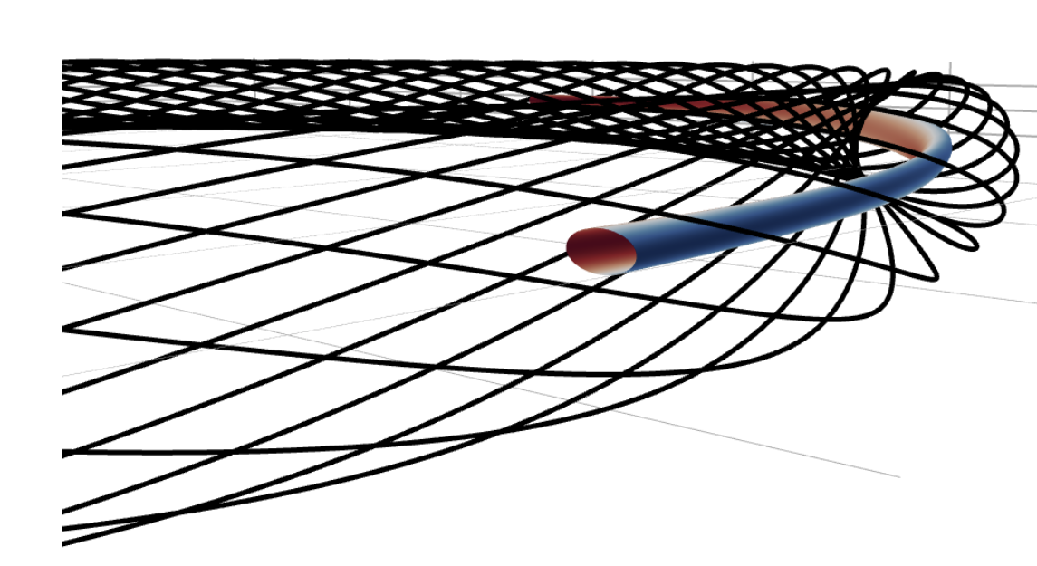
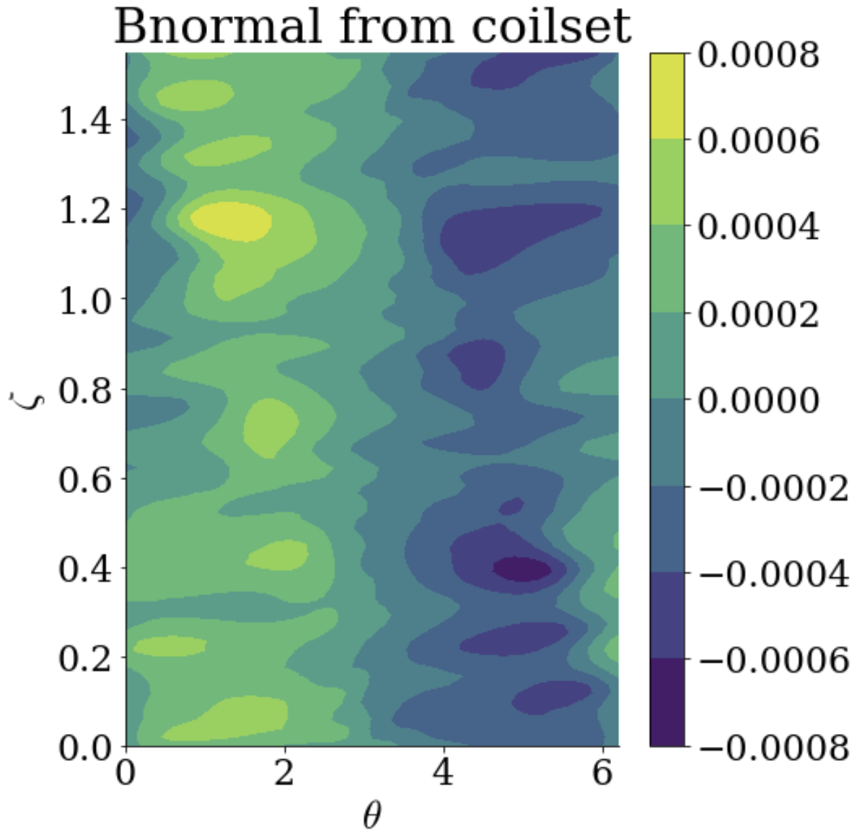
Example Python Code to create Helical Coilset
# load equilibrium, this case is a simple vacuum rotating ellipse
eqname = "./tests/inputs/ellNFP4_init_smallish.h5"
eq = load(eqname)
# get the surface current which minimizes Bn with REGCOIL algorithm
(surface_current_field, _, _, _, _,) = run_regcoil(
eqname=eq,
# resolutions of plasma surface grid upon which Bn is minimized
eval_grid_M=20,eval_grid_N=20,
# resolutions of source grid for calculating Bn
source_grid_M=40, source_grid_N=80,
alpha=1e-15, # regularization parameter
# ratio of I/G, 0 for modular, integer for helical coils
helicity_ratio=-1)
# discretize into helical coils using utility function
numCoils = 15 # we want 15 helical coils
coilset2 = find_helical_coils(surface_current_field, eqname, desirednumcoils=numCoils)
Notes:
Default winding surface is being used here which is an axisymmetric torus

Slide 22
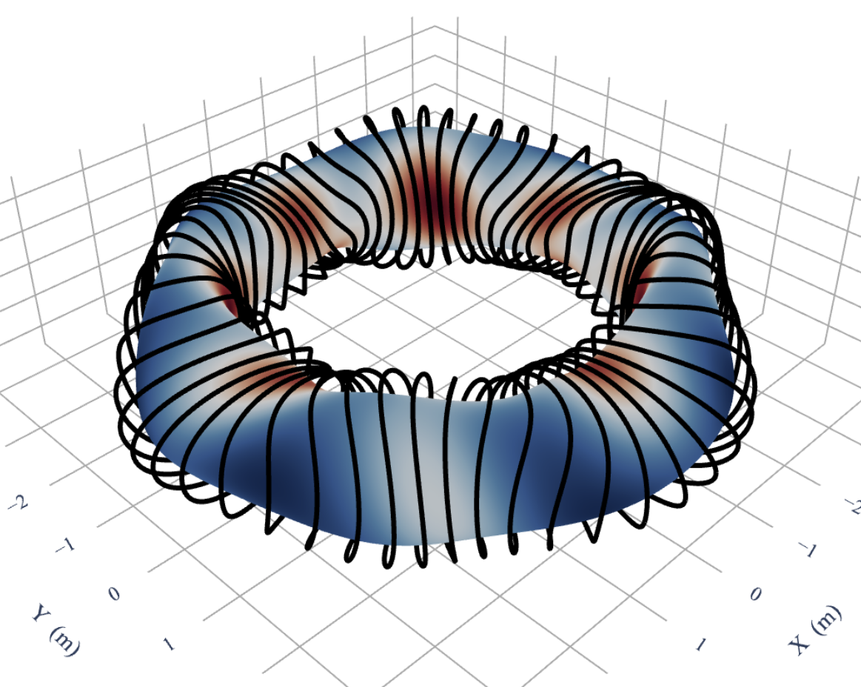
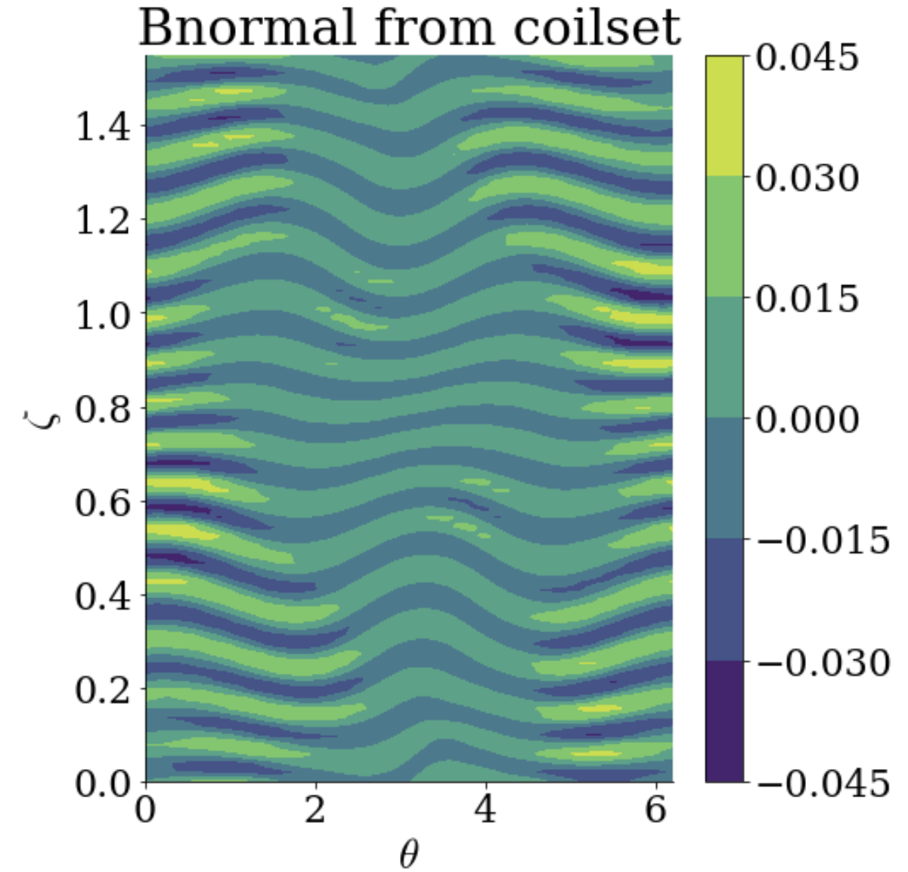
Example Python Code to create Modular Coilset
# load equilibrium, this case is a simple vacuum rotating ellipse
eqname = "rotating_ellipse_5_aspect_ratio.h5"
eq = load(eqname)
winding_surf= load(“rotating_ellipse_wind_surf.h5”)
# get the surface current which minimizes Bn with REGCOIL alg
(surface_current_field, _, _, _, _,) = run_regcoil(
eqname=eq, basis_M=16, basis_N=16,
# resolutions of plasma surface grid upon which Bn is minimized
eval_grid_M=60,eval_grid_N=60,
# resolutions of source grid for calculating Bn
source_grid_M=100, source_grid_N=100,
alpha=1e-16, # regularization parameter
# ratio of I/G, 0 for modular, integer for helical coils
helicity_ratio=0, winding_surf = winding_surf)
# discretize into modular coils using utility function
numCoils = 60 # we want 60 modular coils, (15 per field period)
coilset2 = find_modular_coils(surface_current_field,
eqname, desirednumcoils=numCoils)

Slide 23
DESC Offers Unique Flexibility in Constraints that Open New Possibilities
NAE Constrained Equilibrium Solve
Can offer connection between rich NAE+QS theory and global solutions
Allow global solutions to be found matching NAE axes that otherwise could not be found traditionally
Verified against pyQSC and pyQIC for O(rho) constraints
Ongoing verification of 2nd order constraints
Can allow geometrically constraining on-axis Mercier stability, for example
Can be used with DESC constrained optimization
Available to use now in main DESC code
DESC Coil Optimization
REGCOIL algorithm implemented in Python
Modular and Helical Coil-cutting algorithms implemented
Written in JAX, so can be used with optimization, combined with other objectives
Single-stage optimization?
Will be available soon in main DESC code

Slide 24
Backup

Slide 25
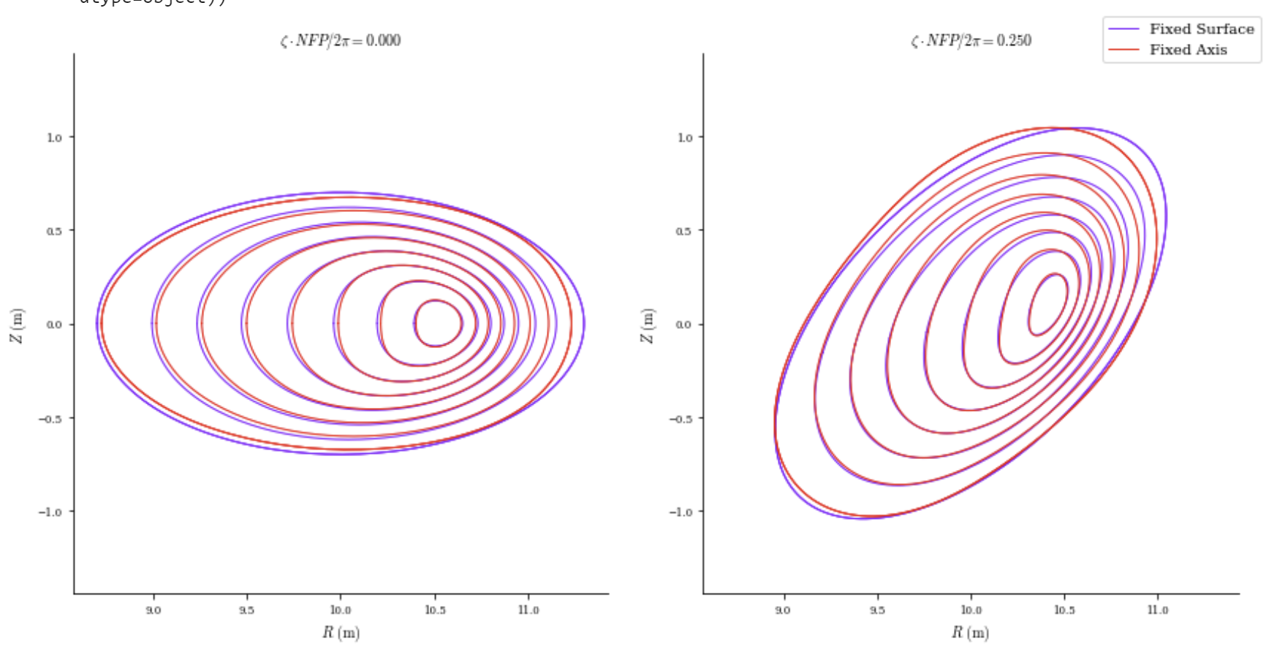
O(𝝆⁰) (axis) Constraint in DESC - Example Solve

Slide 26
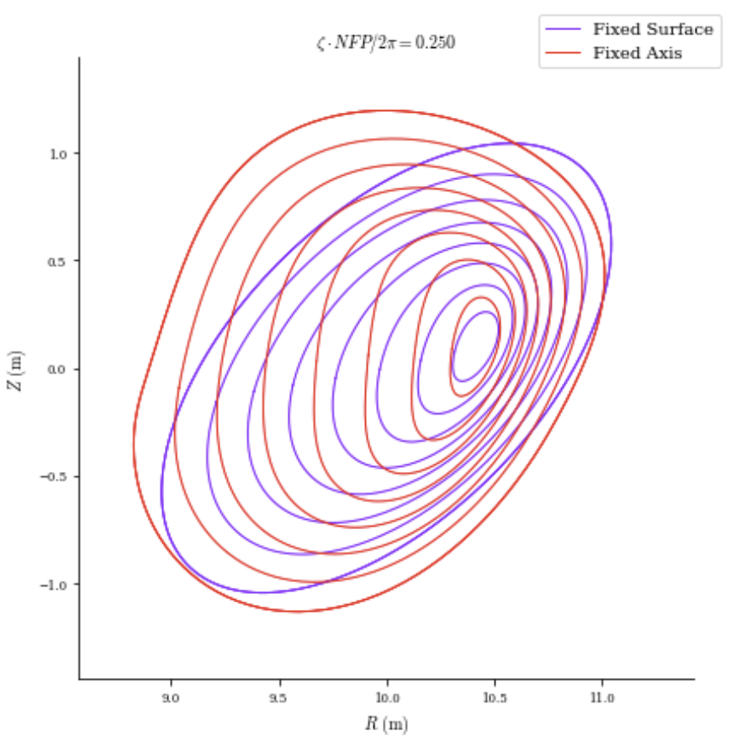
O(𝝆⁰) (axis) Constraint in DESC - Under-constrained Problem, Finds Closest Equilibrium
Different Initial Guess
Notes:
want to emphasize the non-uniqueness of the constraint here, this goes as well for the NAE constrain I will show next

Slide 27
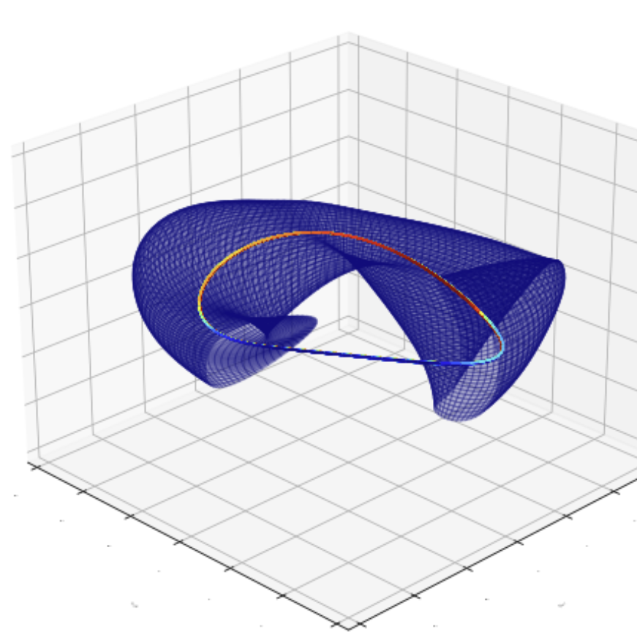
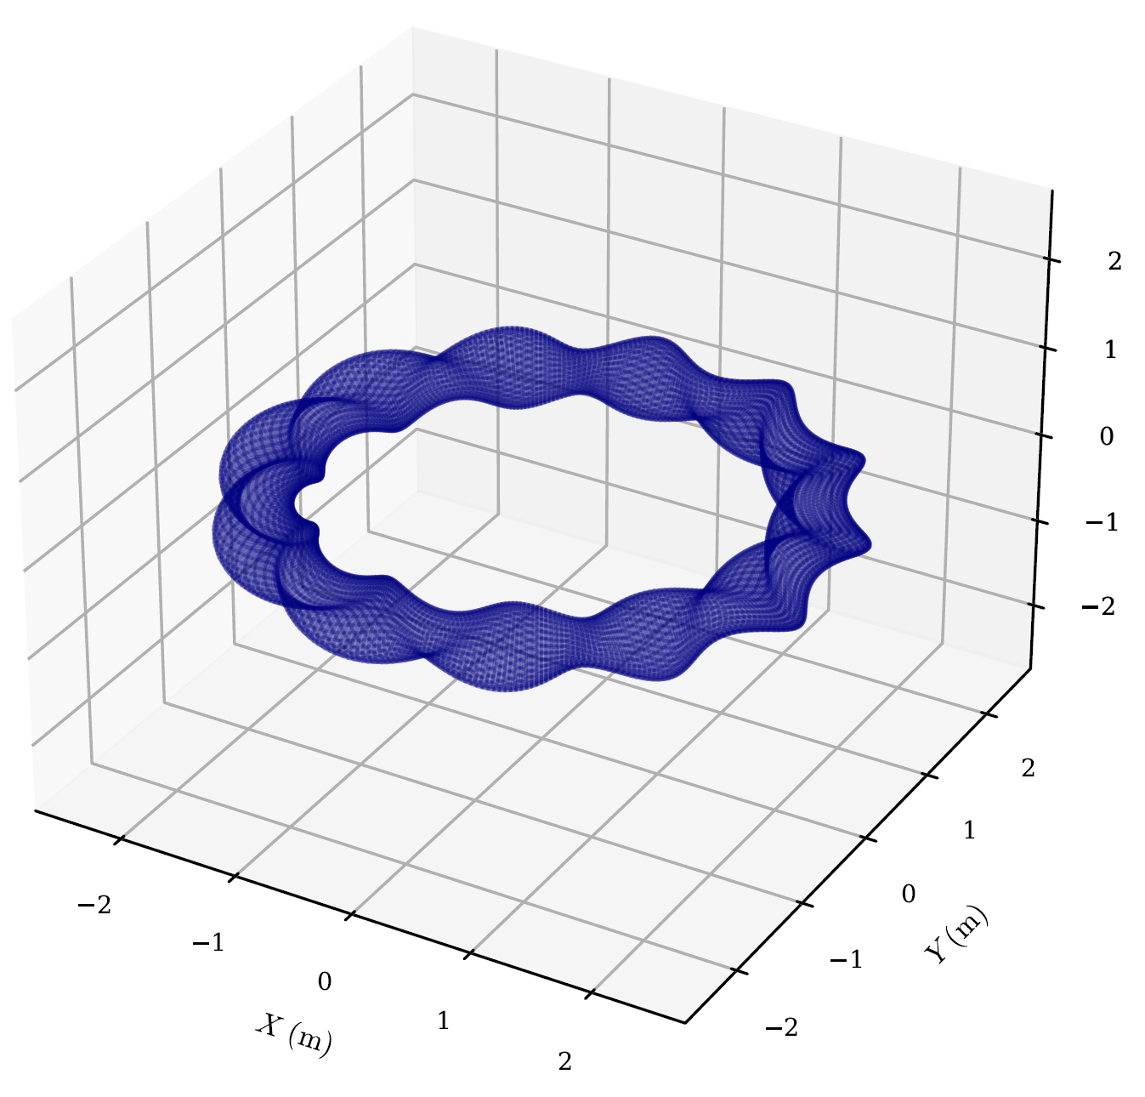
Physical Insights Yield Constraints on XS or near Axis
Axis + Near-Axis Behavior
Poincare Section
Near-Axis Expansion (NAE) yields what asymptotic behavior of equilibrium should be near the axis, and what the axis shape should be
Desire to avoid magnetic islands, and decoupling poloidal and toroidal resolution
Notes:
We ideally want to fix our desirable qualities stemming from other theory like NAE, which tells us information about an axis and the equilibrium shape asymptotically near the axis, which we know to be in equiibrium, or we can optimize for QS or QI.
Or we want our surfaces to be island-free,

Slide 28
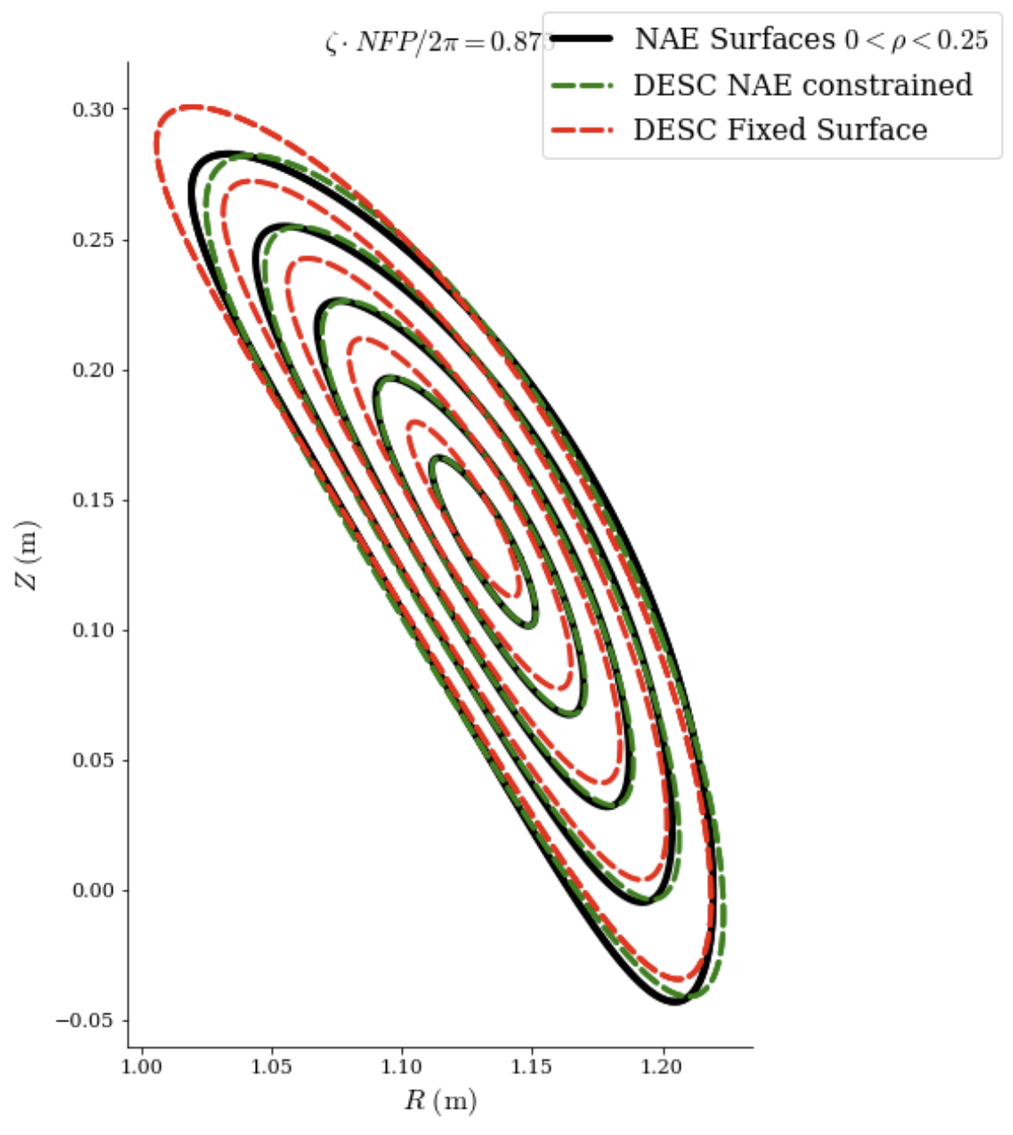
Closer look at flux surfaces near axis for Precise QA

Slide 29
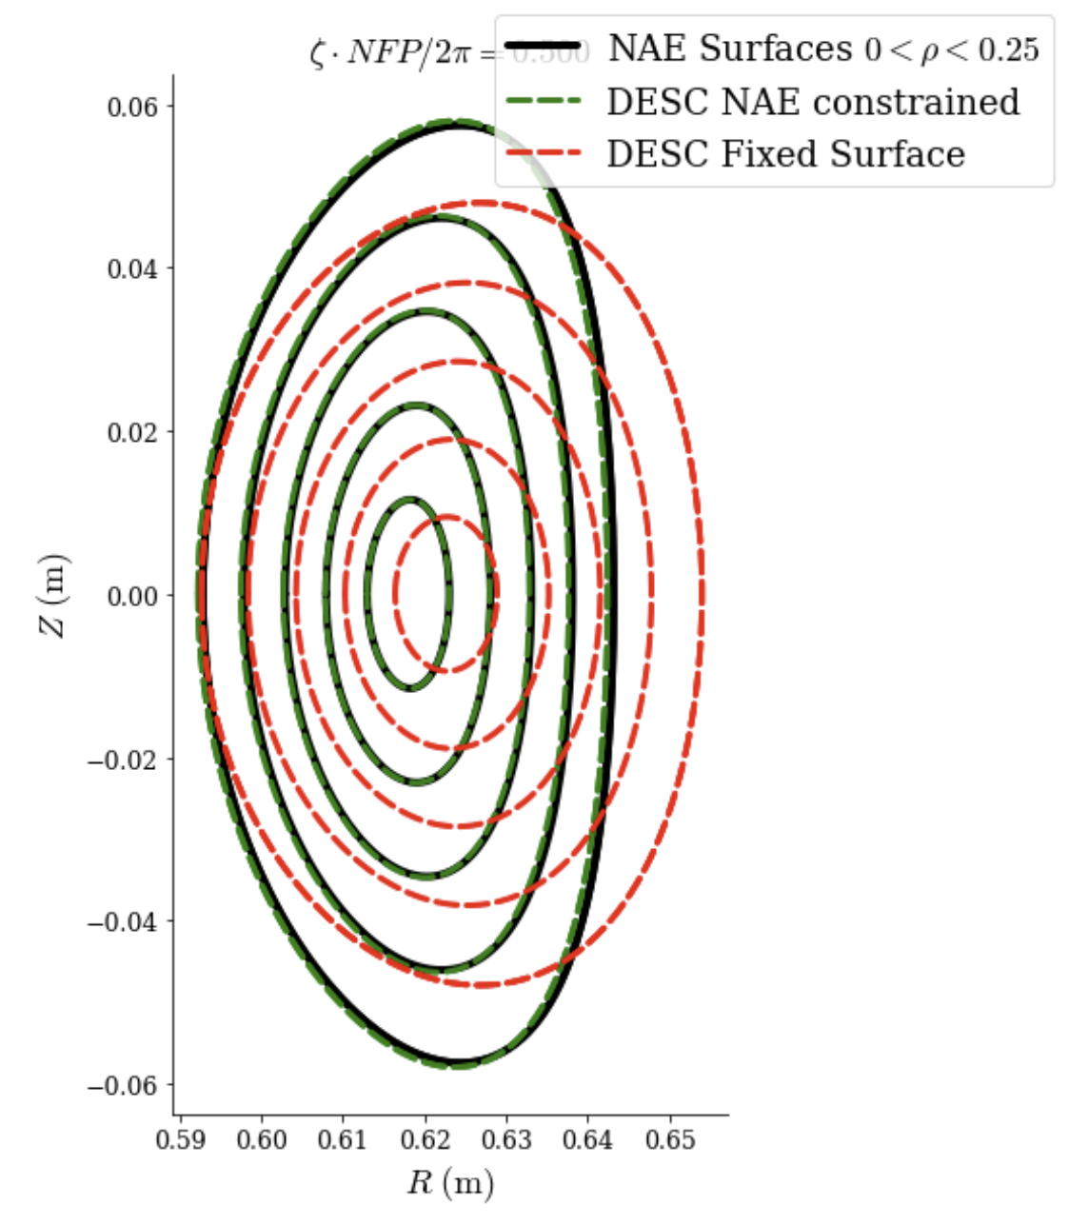
Closer look at flux surfaces near axis for difficult NAE
(from E. Rodriguez)
rc = [1, 0.426, 0.044, -6.3646383583351e-11, 2.851584586653665e-05, 3.892992983405039e-08]
zs = [0.0, 0.4110168175146285, 0.04335427796015756, 6.530936323433338e-05, 1.3623898672936873e-05, 1.1620514629503932e-05]
etabar=1.64209358
B2c = 0.11293987662545873
B0=1
nfp = 4
qsc = Qsc(rc=rc, zs=zs, B0=B0, nfp=nfp, I2=0, B2c = B2c, etabar=etabar, order = "r1", nphi = 201)
desc_eq= Equilibrium.from_near_axis(qsc,r= r,L=9,M=9,N=N,ntheta=ntheta)

Slide 30
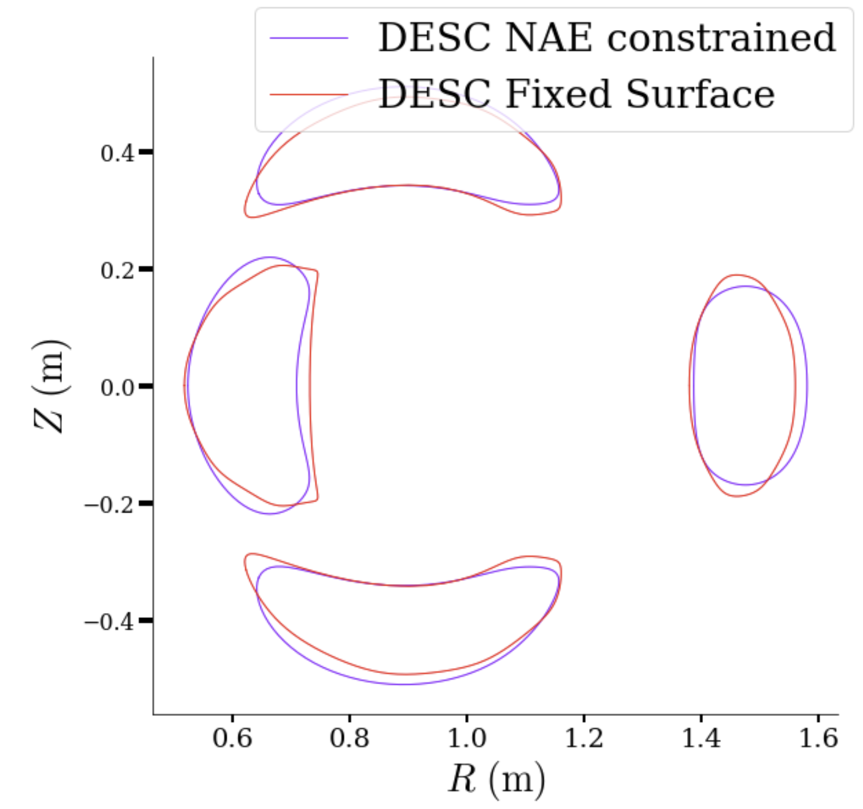
Closer look at LCFS for difficult NAE
(from E. Rodriguez)
rc = [1, 0.426, 0.044, -6.3646383583351e-11, 2.851584586653665e-05, 3.892992983405039e-08]
zs = [0.0, 0.4110168175146285, 0.04335427796015756, 6.530936323433338e-05, 1.3623898672936873e-05, 1.1620514629503932e-05]
etabar=1.64209358
B2c = 0.11293987662545873
B0=1
nfp = 4
qsc = Qsc(rc=rc, zs=zs, B0=B0, nfp=nfp, I2=0, B2c = B2c, etabar=etabar, order = "r1", nphi = 201)
desc_eq= Equilibrium.from_near_axis(qsc,r= r,L=9,M=9,N=N,ntheta=ntheta)

Slide 31
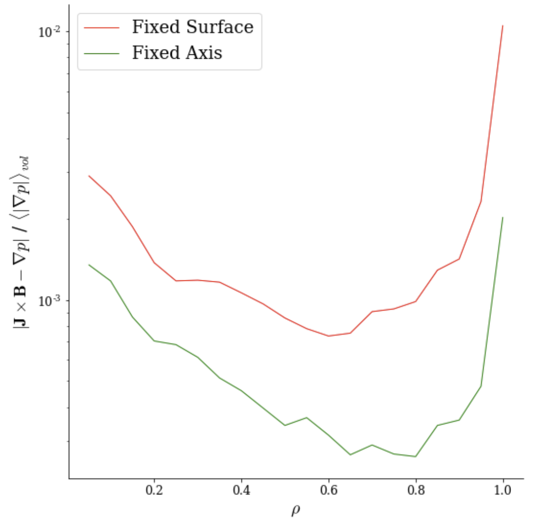
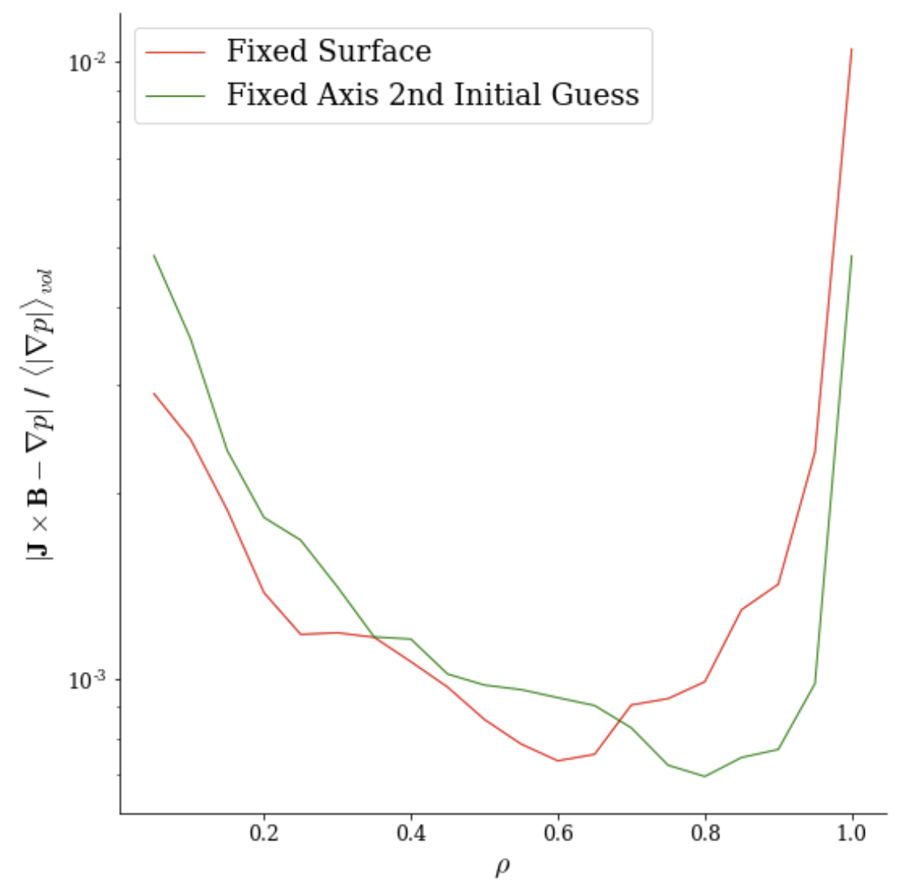
O(𝝆⁰) (axis) Constraint in DESC - Under-constrained Problem
Different Initial Guess

Slide 32
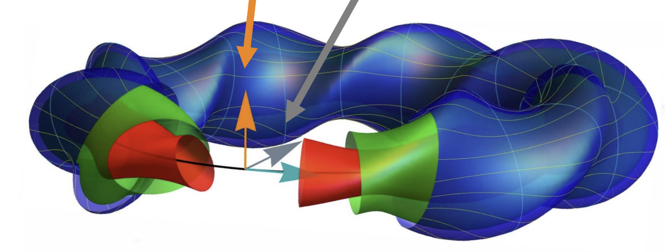
Near-Axis Expansion
Quantities are expanded in form
Inputs for $O(r^{2})$ solutions
Axis Shape (R(phi), Z(phi))
$\overline{η }=\frac{B_{1c}}{B_{0}}$ Measure of magnetic field variation
$σ_{0}$Deviation from stellarator symmetry at $φ=0$
Taken as 0 for most cases
$I_{2}$Current Density on axis
$p_{2}$ Pressure near axis
$B_{2c}$ magnetic field $O(r^{2})$ poloidal variation
Outputs:
Flux surface shapes in neighborhood of axis
$ι_{0}$ rotational transform on-axis
$B_{20}$ magnetic field variation on-axis
(Landreman 2022)
(Jorge 2022)
Notes:
Note that the QS is not guaranteed thru O(rho^2) (Garren-boozer), instead it is guaranted thru O(rho) away from axis
To get QS solutions, how the qsc code does it is that it optimizes the inputs B_2c etc to find the minimal B_20, since B_20 should be 0 in a perfectly QS device

Slide 33
DESC Allows Flexible Constraints when Defining Equilibrium Problem - Fixed 𝝆=1 Boundary
Zernike Polynomials
Fixed-Boundary 𝝆=1 Constraint
Notes:
(M+1)(2M+1)*2 ~ 4M^2

Slide 34
DESC Algorithm
Initialization
Main Algorithm
Repeat until Desired Resolution
Inputs
$R_{b}\left(ρ=1,θ,ζ\right),$
$$Z_{b}\left(ρ=1,θ,ζ\right),$$
$$p\left(ρ\right), ι\left(ρ\right), ψ_{a}$$
Fourier Series
$$R_{b,mn},Z_{b,mn}$$
Compute B and J from $R\left(ρ,θ,ζ\right),Z\left(ρ,θ,ζ\right), λ(ρ,θ,ζ)$
Scale Boundary as Initial Guess for Surface Geometry
$$R_{mn}\left(ρ\right)\sim ρR_{b,mn}$$
$$Z_{mn}\left(ρ\right)\sim ρZ_{b,mn}$$
Increase Collocation Grid and/or Spectral Resolution
Compute $F_{ρ},F_{β}$ on collocation grid
$f\left(x\right)=0$, use Newton Method to find $Δx$
Repeat until converged
$$x=[R_{lmn},Z_{lmn},λ_{lmn}]$$
Notes:
Show a pic for the Initial guess and boundary
like a simple circle, then you can show the fourier coeffs of the boundary
And profiles for iota and pressure
how does one choose these?
based off of desired boundary shape (this is fixed boundary), and desired iota, and the pressure can be chosen to match experimental-like profiles, and psi_a only scales the strength of the B field, not the geometry (I think)
And the timestepping is really a second order Richardson scheme
should change that
Point out differences btwn VMEC and DESC

